Slide 1
How To Walk
So I say, walk by the Spirit and you will not gratify the desires of the sinful nature…
Galatians 5:16

Slide 2
Walk
‘Walk’, or ‘Live’
The Christian life a walk and a race

Slide 3
Walking in Truth
“…you who pass judgment do the
same things…you who preach against stealing, do you steal? You who say that people should not commit adultery, do you commit adultery? You who abhor idols, do you rob temples, You who brag about the law, do you dishonor
God by breaking the law?
Romans 2:1, 21-24

Slide 4
Walking in Truth
It has given me great joy to find some of your children walking in the truth…It gave me great joy to have some brothers come and tell about …how you continue to walk in the truth. I have no greater joy than to hear that my children are
walking in the truth.
2 John 1:4; 3 John 1:3,4

Slide 5
Walking in
Truth
John 14:6
Jesus the truth;
John 1:14
Full of grace and truth

Slide 6
Walking in Love
God-love is action not feelings.
This is how we know what love is: Jesus Christ laid down his life for us. And we ought to lay down our lives for our brothers. If anyone has material possessions and sees his brother in need but
has no pity on him, how can the love of God be in him. Dear children, let us not love with words or tongue but with actions and in truth.
1 John 3:16-18

Slide 7
Walking in Love
If you really keep the royal law found in Scripture, “Love your neighbor as yourself.,” you are doing right. But if you show favoritism, you sin and are convicted by the law as lawbreakers.
James 2:8.9
I am not writing a new command but one we
have had from the beginning. I ask that we
love one another…As you have heard from the beginning, his command is that you walk in love.
2 John 1:5, 6b 2:8.9

Slide 8
Walking in Love
Be imitators of God, therefore, as dearly loved children and live a life of love,
just as Christ loved us and gave himself up for us as a fragrant offering and sacrifice to God.
Ephesians 5:1,2

Slide 9
Walking in Obedience
And this is love: that we walk in
obedience to his commands
2 John 6
This is how we know that we love the children of God: by loving God and carrying out his commands. This is love for God: to obey his commands. And his commands
are not burdensome.
1 John 5:2,3

Slide 10
Walking in Obedience
…for he who loves…has fulfilled the law…and whatever other commandment there may be, are summed up is this one rule: “Love your neighbor as yourself.
Rom. 13:8-11

Slide 11
Walking in Faith
Faith:
“God you know what is best, not me.”
This is the victory that has overcome the world, even our faith. Who is it that overcomes the world? Only he who believes that Jesus is the Son of God.
1 John 5:4-5

Slide 12
Be self controlled and alert.
Your enemy the devil prowls
around like a
roaring lion
looking for someone
to devour.
1 Peter 5:8

Slide 13
Command
Love
Truth
I am not writing a new command but an old one, which you have had since the beginning. This old command is the message you have heard. Yet I am writing you a new command; its truth is seen in him and you….
1 John 2:7-8

Slide 14
…. We have heard of your faith in Christ Jesus and of the love you have for all God’s people …about which you have already heard in the true message of the gospel… We continually ask God to fill you with the knowledge
of his will through all the wisdom and understanding that the Spirit gives so that
you may live a life worthy of the Lord and please him in every way: ….
Col 1:3-12

Slide 15
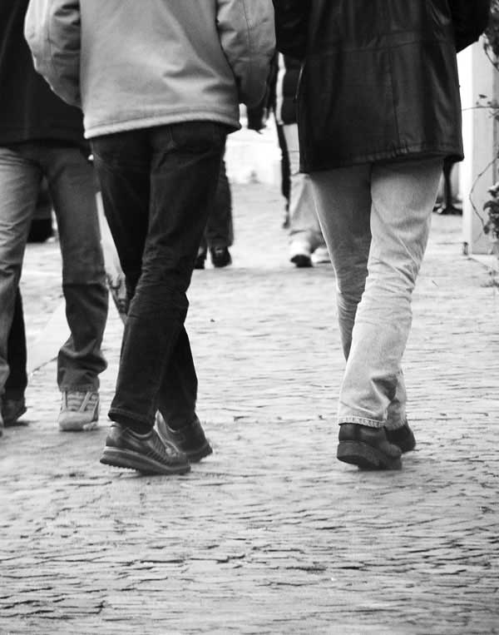
Walking in truth,
love and obedience
is a LIFESTYLE
of faith

