Slide 1
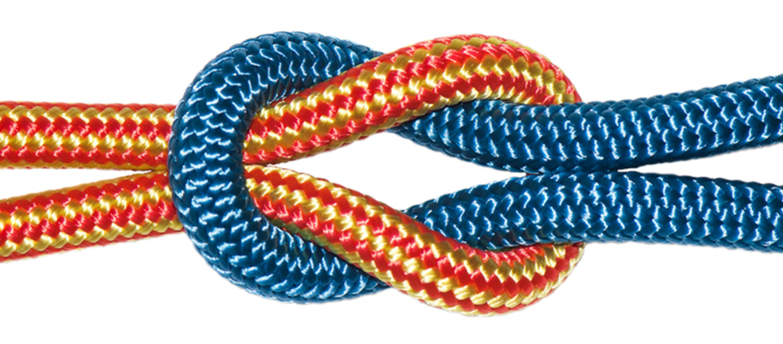
The Bond between
LOVE & TRUTH
Love rejoices with the truth
1 Corinthians 13:6

Slide 2
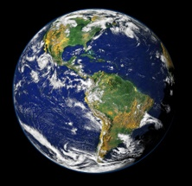
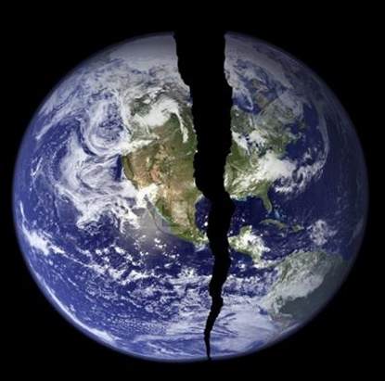
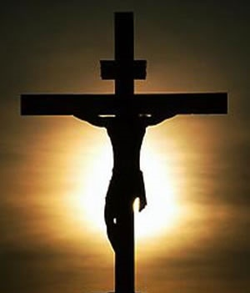
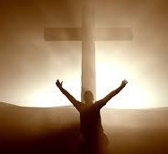
God created a perfect world that mankind promptly broke and
could not fix.
God prepared the world so that he could fix it which he did when he became a man, lived as we were meant to live and then took our punishment so that we live. Those who received this gift, by faith, are now
in the process of
becoming like him.
Creation
Sin Predestination
Incarnation
Propitiation
Grace
Faith
Sanctification

Slide 3
The world of “unthought”
Keep religious views private
truth is relative;
You have no right to judge me;
you deserve
you can’t know anything for certain
follow your heart

Slide 4
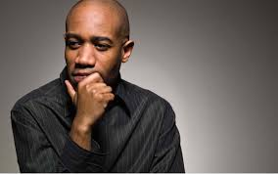
Thought battles “unthought”
…be made new in the attitudes of your minds
Eph.4:23
…be transformed by the
renewing of you minds
then you will be able to …think
Romans 12:2

Slide 5
TRUTH&LOVE
The goal of truth is love
The goal of this command is love…
1 Tim. 1:5
…whom I love in the truth
2 John 1

Slide 6
TRUTH&LOVE
The goal of love is truth
Love rejoices with the truth - 1 Cor. 13:6
For I wrote you out of great distress and anguish of heart and with many tears, not to grieve you but to let you know the depth of my love for you.
2 Corinthians 2:4

Slide 7
TRUTH&LOVE
Love directs the way I speak truth
Speaking the truth in love- Eph. 4:15
The Lord’s servant must not quarrel…Those who oppose him he must gently instruct…leading them to a knowledge of the truth…
2 Tim. 2:24-26

Slide 8
TRUTH&LOVE
Truth teaches me how to love
God is love- 1 John 4:16
This is how God showed his love among us: He sent his one and only Son
1 John 4:9
…his command (truth) is that
you walk in love
2 John 6

Slide 9
The indissoluble bond between
love and truth
Truth’s goal is love
Love’s goal is truth.
Love teaches me how to speak truth
Truth teaches me how to love.

Slide 10
The true light that gives light to every man was coming into the world…the Word became flesh and made his dwelling among us. We have seen his glory, the glory of the One and Only, who came from the Father, full of grace and truth.
John 1:9, 14
“Not hidden”

Slide 11
From the fullness of his grace we have all received one blessing after another. For the law was given through Moses; grace and truth came through Jesus Christ.
John 1:16, 17

Slide 12
Know Jesus is knowing the Truth
Putting his life into practice in my life
The man who says, “I know him,” but does not do what he commands is a liar, and the truth is not in him. But if anyone obeys his word, God’s love is truly made complete in him. This is how we know we are in him:
Whoever claims to live in him
must walk a Jesus did
1 John 2:4-6

Slide 13
Know Jesus is knowing the Truth
Putting his life into practice in my life
…your children walking in the truth…and this is love that we walk in obedience to his commands…his command is that you
walk in love
2 John 4-6

Slide 14
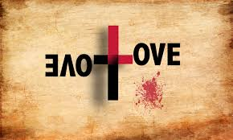
WHAT IS
?
It’s a way of life bound to God
His command is that you walk in love
2 John 6b
Whoever lives in love lives in God, and God in him.
1 John 4:16c

Slide 15
WHAT IS
?
Love was shown
to us and is shown by us
This is how we know what love is:
Jesus Christ laid down his life for us.
And we ought to lay down our lives
for our brothers
1 John 3:16, 17

Slide 16
WHAT IS
?
Doing
what is
right
Doing:– an action seen all through
the scriptures. Helping, serving, being kind & patient, protecting, encouraging.
Right: – has to do with the truth. Learning and acting like Jesus.

Slide 17
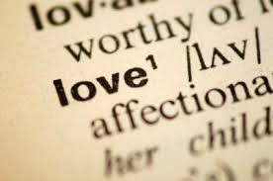
You can’t help but love.
I hear the voice of the one I love, as he comes leaping over mountains
and hills
Song of S 2:8
Love the wrong thing or in the wrong way and disaster follows.
Truth is seen in the life and teachings of Jesus.
Love is living out the life of Jesus in our lives.

