Slide 1
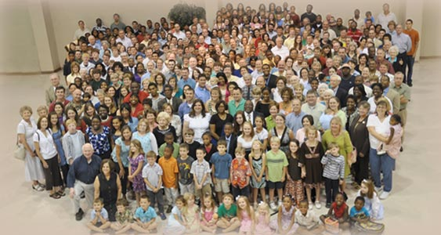

Slide 2
church
From
1 Thessalonians
Centered in God 2: 13-14a
Begins with how I am living my life
2:10-12; 4:1-12
Continues in how we help one another 5:12-21
Expands in being an example
1:2-10

Slide 3
Be perfect, therefore, as your
heavenly Father is perfect.
Matthew 5:48
…by one sacrifice he has made perfect those who are being made holy
Hebrews 10:14.
Not that I have obtain all this, or have already been made perfect, but I press on… Philippians 3:12

Slide 4
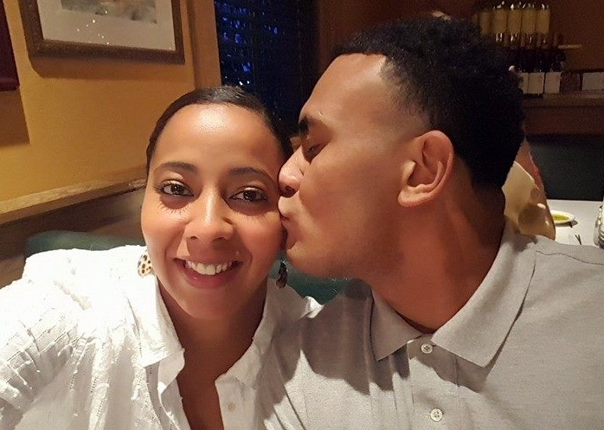
Perfecting our Marriages.
Marriage should be honored by all
Hebrews 13:4

Slide 5
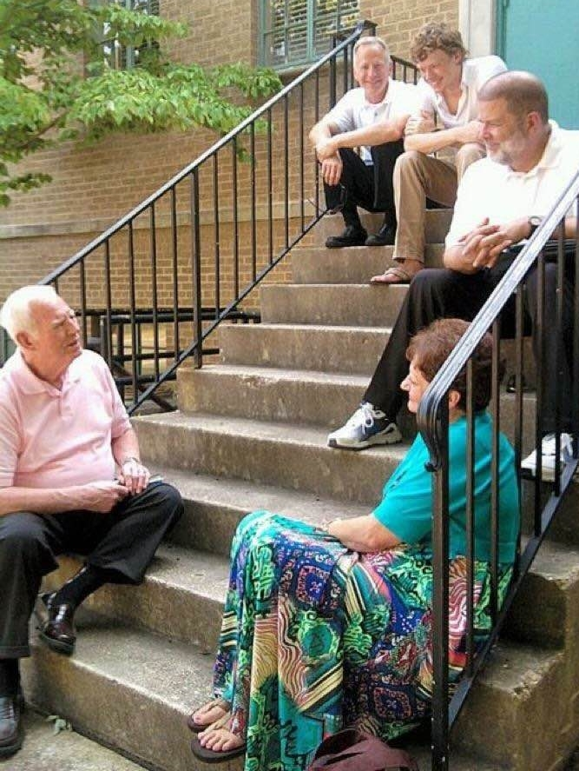
Perfecting Hospitality
Love must be sincere. Hate what is evil, cling to
what is good…
Practice hospitality.
Romans 12:9-13
Do not forget to entertain strangers, for by so doing some people have entertained angels without knowing it
Hebrews 13:2

Slide 6
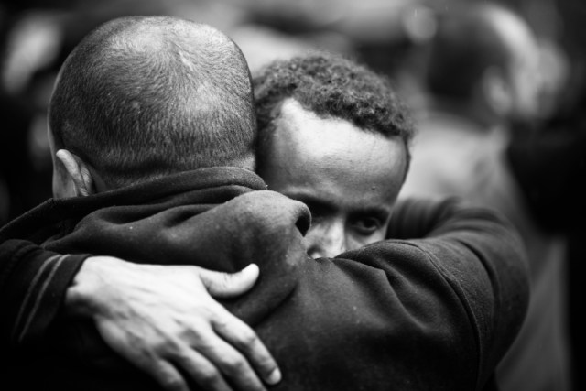
Perfecting Forgiveness
Bear with one another and forgive whatever grievances you may have
against one another.
Forgive as the Lord forgave you.
Colossians 3:13

Slide 7
Perfecting how we share with others
I pray that you will be active in sharing your faith, so that you will have a
full understanding of every good
thing we have in Christ.
Philemon 1:6

Slide 8
YOU do it!
What area do you think
we need perfecting?

