Slide 1
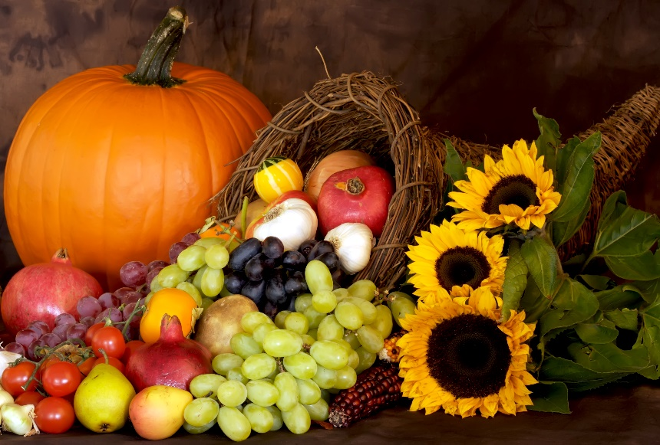
Everything you need
2 Peter 1:5-7

Slide 2
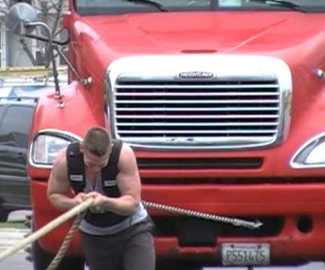
Apart from me you can do nothing
John 15:5
Power has to do with relation-ship
…having a form of godliness but denying its power
2 Tim. 3:5

Slide 3
His divine power has given us everything we need for life and godliness through our knowledge of him who called us by his own glory and goodness. Through these he has given us his very great and precious promises, so that through them you may participate in the divine nature and escape the corruption in the world caused by evil desire
2 Peter 1:3-4

Slide 4
For this very reason (v.5)
Peter is saying there are some
things we must do.
“Make every effort” (v.5)
7
Qualities

Slide 5
Without faith it is impossible
to please God
always produces actions

Slide 6
Valor
Courage
Virtue
Excellence
Christ called us by his….goodness.

Slide 7
Learn how and what to think.
We begin our relationship with God in knowledge.

Slide 8
Get a grip on yourself!
The Great Pursuit
of Humanity:
To feel good.

Slide 9
To hang on through tough times

Slide 10
“good worship”

Slide 11
“generous
spirit”

Slide 12
Defines God himself

Slide 13
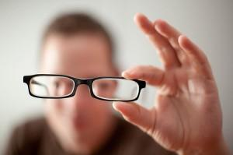
“Near sighted”
“Blind”
“Forgetful”

Slide 14
Confidence in Christ
“Therefore be eager”
As you pursue these 7 qualities a confidence rises in you
I have fought the good fight, I have finished the race… 2 Tim. 4:7-8

Slide 15
A RICH WELCOME!
You’re Home!

