Slide 1
Titus 3:9 But avoid foolish controversies and genealogies and arguments and quarrels about the law, because these are unprofitable and useless.

Slide 2
1 Timothy 1:3-4 …command certain people not to teach false doctrines any longer or to devote themselves to myths and endless genealogies. Such things promote controversial speculations rather than advancing God’s work—which is by faith.

Slide 3
1 Timothy 1:3-4 …command certain people not to teach false doctrines any longer or to devote themselves to myths and endless genealogies. Such things promote controversial speculations rather than advancing God’s work—which is by faith.

Slide 4
Acts 17:26-27 And He has made from one blood every nation of men to dwell on all the face of the earth, and has determined their preappointed times and the boundaries of their dwellings, so that they should seek the Lord, in the hope that they might grope for Him and find Him, though He is not far from each one of us.

Slide 5
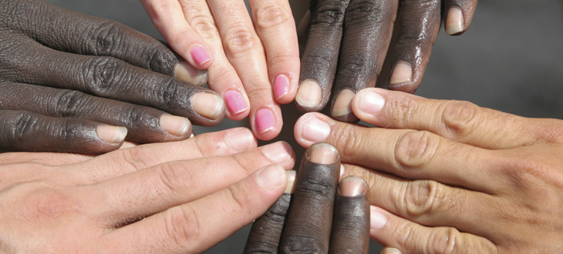
ONE RACE?

Slide 7
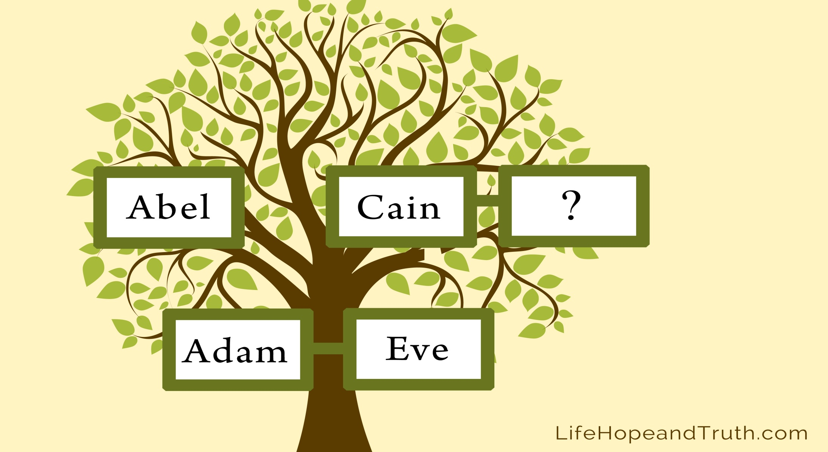
INCEST
The days of Adam after he fathered Seth were 800 years; and he had other sons and daughters. Thus all the days that Adam lived were 930 years, and he died. Gen 5:4-5

Slide 9
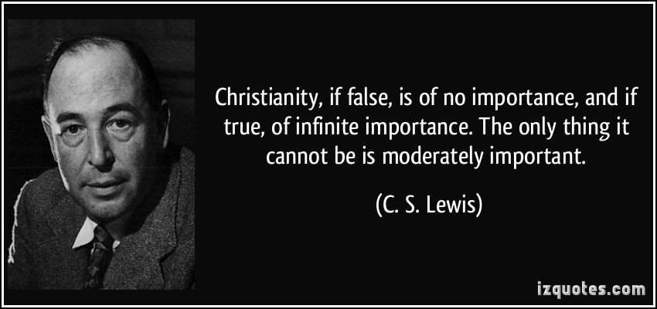

Slide 13
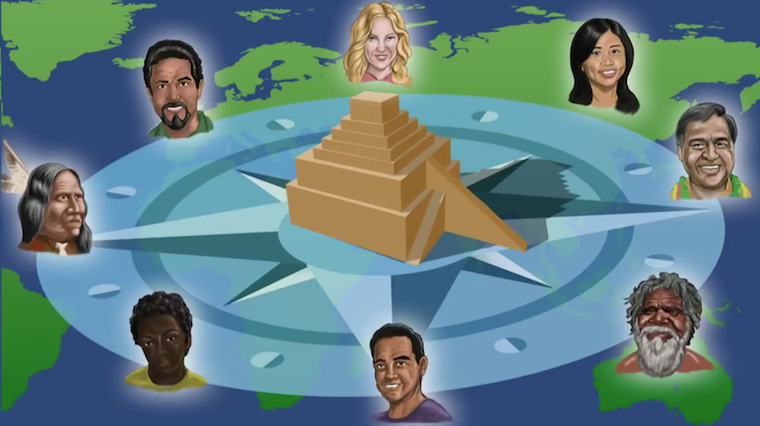

Slide 14
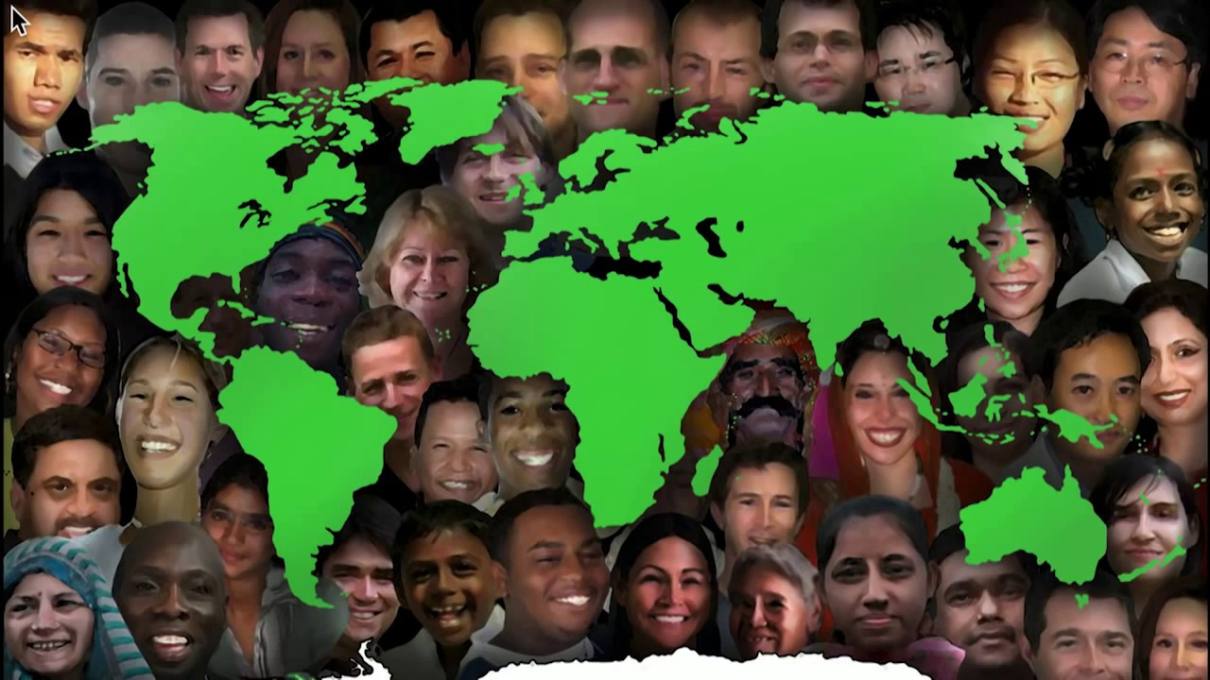

Slide 15
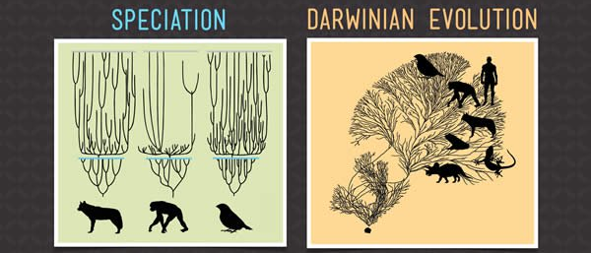
Creation Orchard
Evolution Tree
And God made the beasts of the earth according to their kinds and the livestock according to their kinds, and everything that creeps on the ground according to its kind. And God saw that it was good. Gen 1:25

Slide 16
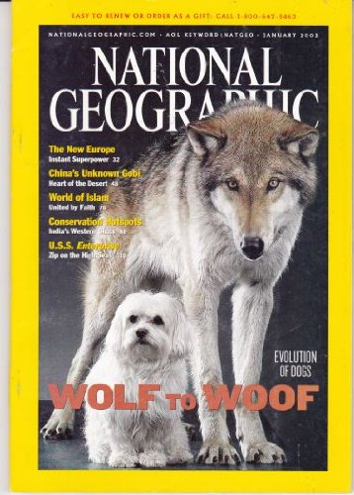

Slide 18
chihuahua
WOLF

Slide 19
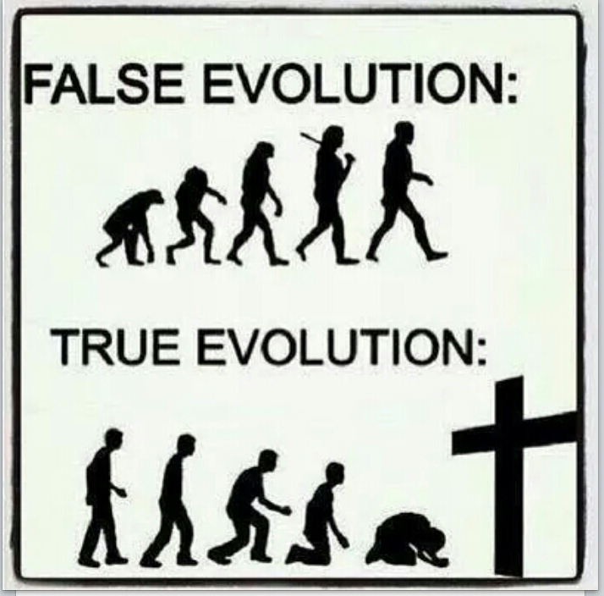
Then God said, “Let us make man in our image, after our likeness. Gen 1:26

Slide 21
Adam & Eve

Slide 23
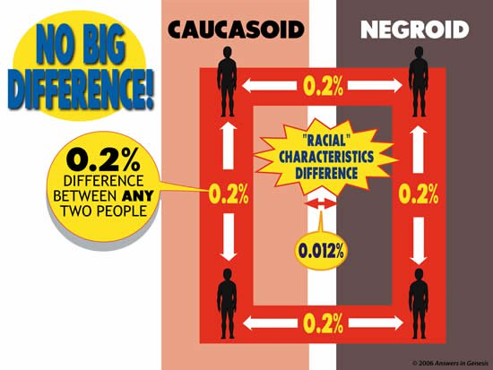

Slide 24
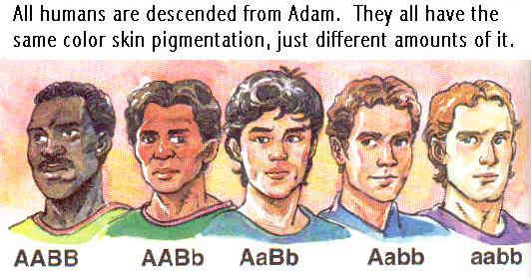
All humans are descendants of Adam. They all have the same color skin pigmentation (brown), just different amounts of it.

Slide 26
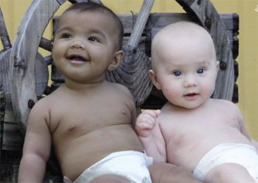

Slide 28
Better Alternative: People Groups or Ethnic Groups (Language & Culture)
Does Changing Our Language Erase Our Problem?

Slide 29
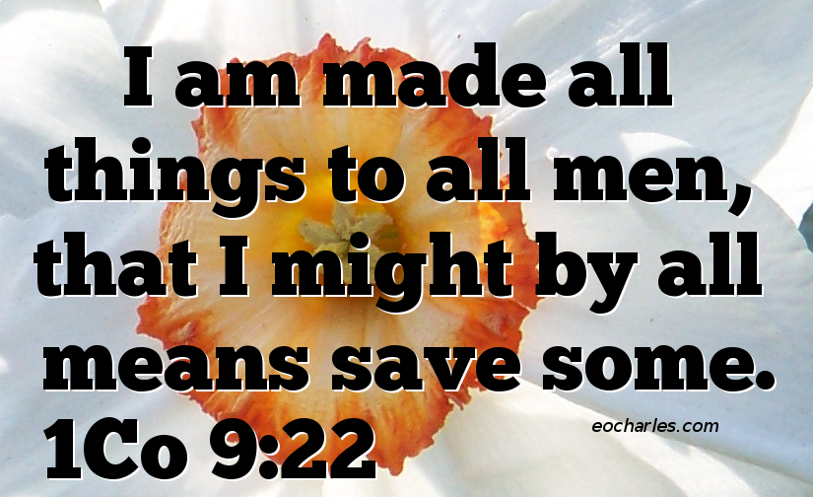

Slide 31
The Race Matters

Slide 32
2 Corinthians 6:14 Do not be yoked together with unbelievers. For what do righteousness and wickedness have in common? Or what fellowship can light have with darkness?

Slide 33
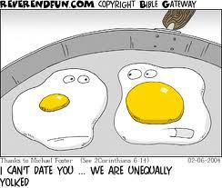

Slide 37
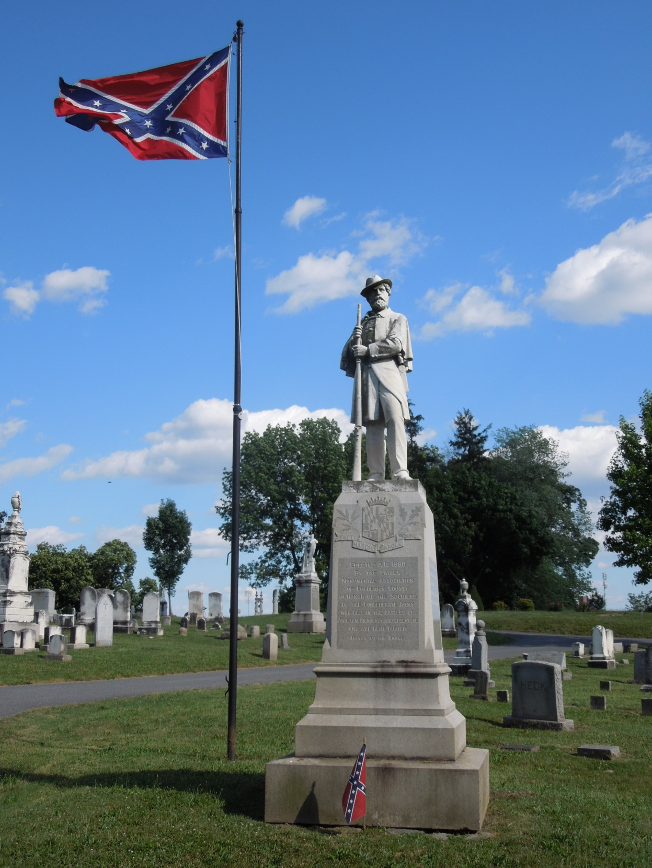

Slide 38
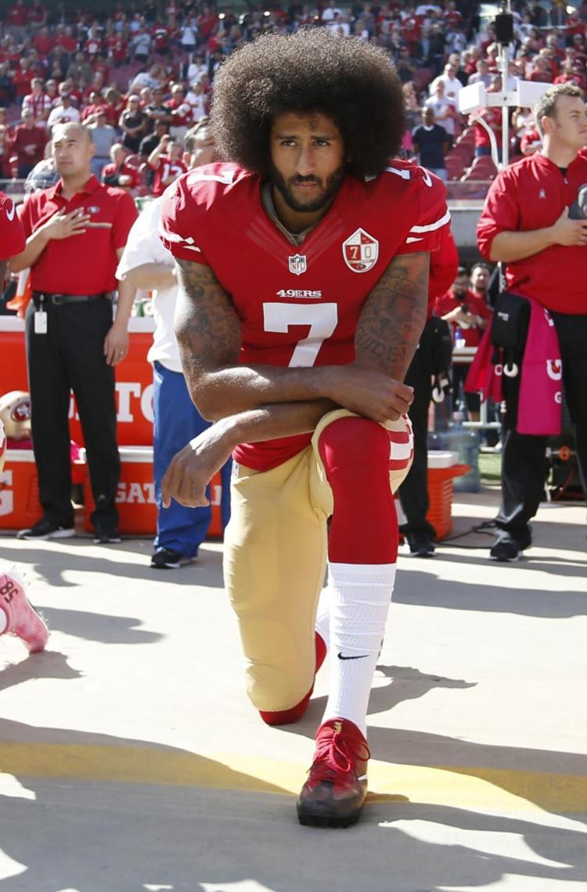

Slide 39
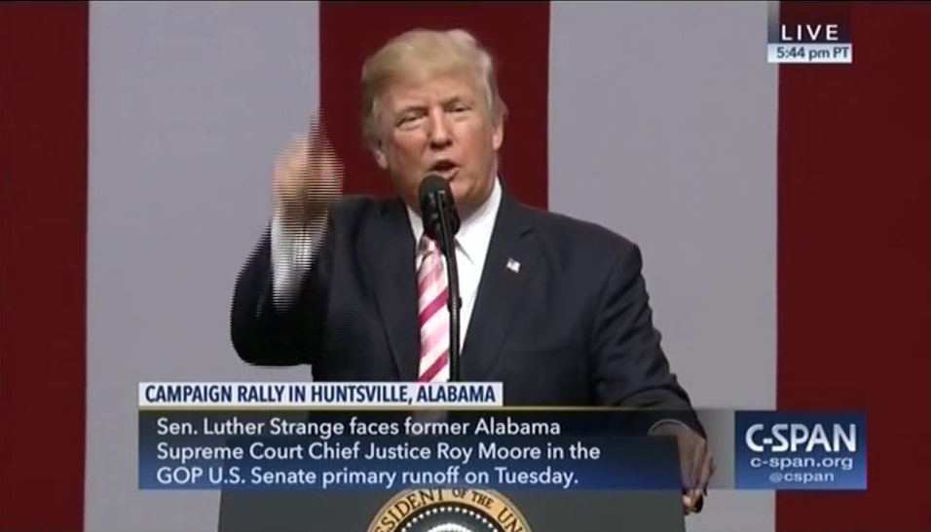

Slide 40
Galatians 5:6 For in Christ Jesus neither circumcision nor uncircumcision has any value. The only thing that counts is faith expressing itself through love.

Slide 41
Galatians 5:7-8 You were running a good race. Who cut in on you to keep you from obeying the truth? That kind of persuasion does not come from the one who calls you.

Slide 42
Galatians 5:9-10 “A little yeast works through the whole batch of dough.” I am confident in the Lord that you will take no other view. The one who is throwing you into confusion, whoever that may be, will have to pay the penalty.

Slide 43
I’m not racist. All lives matter. All cops aren’t bad. It’s better than it used to be. You’re not the only one... Get over it. Statistics prove…

Slide 44
Romans 12:9-21
Mourn with those who mourn…
Unless your statistics can prove them wrong
Live in harmony with one another...
If their the same skin shade
Live in peace with everyone…
Unless their a different political party

Slide 45
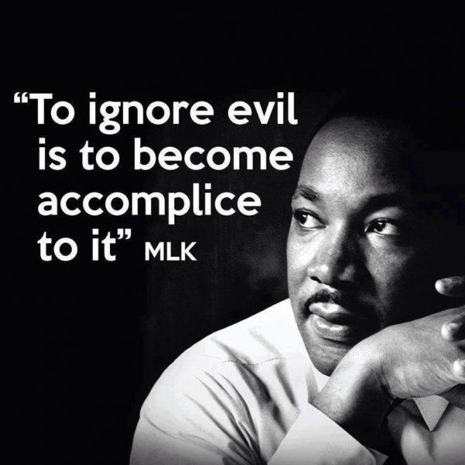

Slide 46
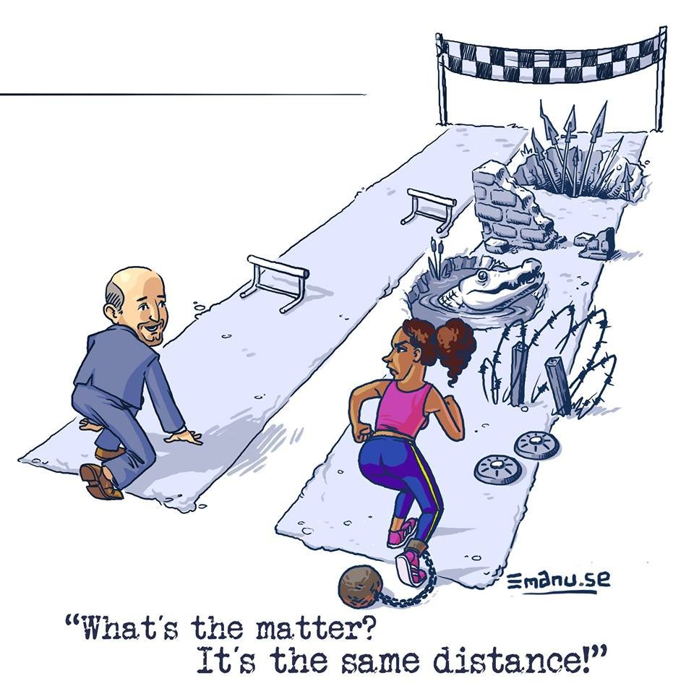

Slide 47
Isaiah 58:10 if you spend yourselves in behalf of the hungry and satisfy the needs of the oppressed, then your light will rise in the darkness, and your night will become like the noonday.

Slide 48
Luke 10:27 “‘Love the Lord your God with all your heart and with all your soul and with all your strength and with all your mind’; and, ‘Love your neighbor as yourself.’”

Slide 49
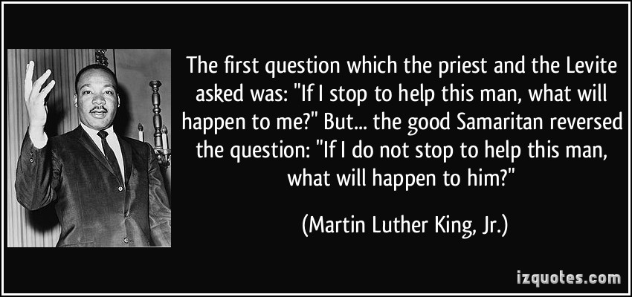

Slide 50
Acts 10:28 (MSV) He said to them: “You are well aware that it is against our law for a white to associate with or visit a black. But God has shown me that I should not call anyone impure or unclean.

Slide 51
Acts 10:44-46 (MSV) While Peter was still speaking these words, the Holy Spirit came on all who heard the message. The whites who had come with Peter were astonished that the gift of the Holy Spirit had been poured out even on blacks. For they heard them speaking in tongues and praising God.

Slide 52
Acts 10:47-48 (MSV) Then Peter said, “Surely no one can stand in the way of their being baptized with water. They have received the Holy Spirit just as we have.” So he ordered that they be baptized in the name of Jesus Christ.

Slide 53
Acts 11:1-4 (MSV) The apostles and the believers throughout Judea heard that the blacks also had received the word of God. So when Peter went up to Jerusalem, the whites criticized him and said, “You went into the house of black men and ate with them.” Starting from the beginning, Peter told them the whole story:

Slide 54
Galatians 2:11 (NIV) When Cephas (Peter) came to Antioch, I opposed him to his face, because he stood condemned.

Slide 55
Galatians 2:12 (NIV) For before certain men came from James, he used to eat with the Gentiles. But when they arrived, he began to draw back and separate himself from the Gentiles because he was afraid of those who belonged to the circumcision group.

Slide 56
Galatians 2:13 (NIV) The other Jews joined him in his hypocrisy, so that by their hypocrisy even Barnabas was led astray.

Slide 57
Galatians 2:14 (NIV) When I saw that they were not acting in line with the truth of the gospel, I said to Cephas in front of them all, “You are a Jew, yet you live like a Gentile and not like a Jew. How is it, then, that you force Gentiles to follow Jewish customs?

Slide 58
Ephesians 2:16 (ESV) His purpose was to create in himself one new humanity out of the two, thus making peace, and in one body to reconcile both of them to God through the cross, by which he put to death their hostility.

