Slide 1
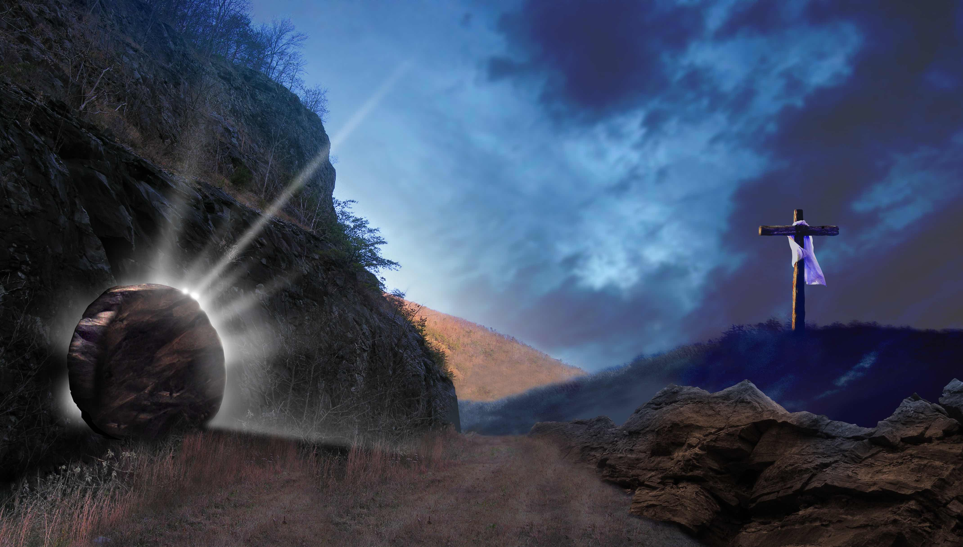
God Who Raises the Dead

Slide 2
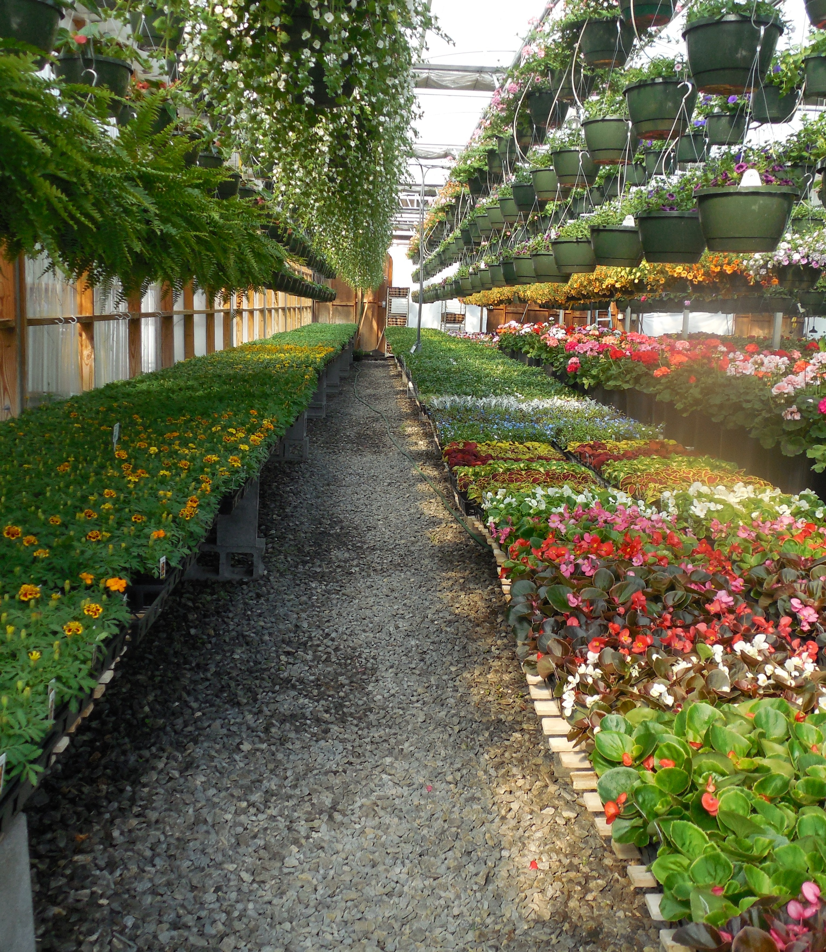
"Suffering is a nursery for the growth of compassion, encouragement, and of intensified hope."

Slide 3
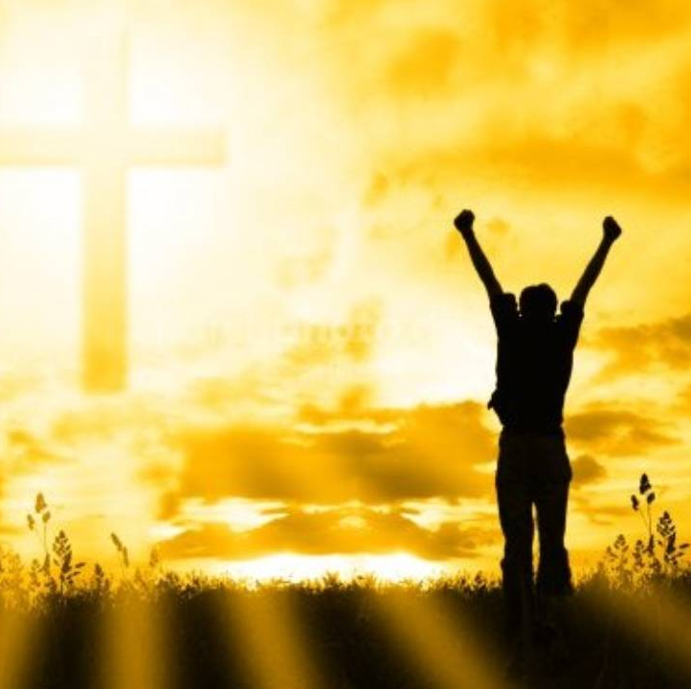
Confronting our problems to gain victory over them.
This Photo by Unknown author is licensed under CC BY.

Slide 4
“For Paul the turning point is the grace of God manifested in the death of Jesus for sinners, whereby God has eliminated every human pretension and all self-sufficiency. Every other form of boasting is thereby abolished.”
-Gordon D. Fee

Slide 5
No discipline seems pleasant at the time, but painful. Later on, however, it produces a harvest of righteousness and peace for those who have been trained by it. Hebrews 12:11 NIV
EAT YOUR VEGETABLES!
TAKE OUT THE TRASH!
DO YOUR HOMEWORK!
CLEAN YOUR ROOM!

Slide 6
We do better together!

