Slide 1
Class starts at 0915

Slide 3
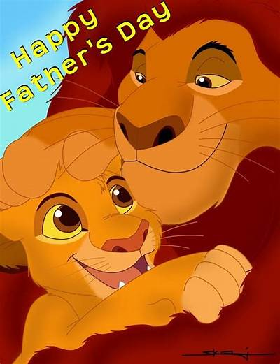

Slide 4
“Repent, for the kingdom of heaven is at hand.”
-- John the Baptist

Slide 5
From that time Jesus began to preach, saying, “Repent, for the kingdom of heaven is at hand.”
-- Jesus

Slide 6
“The Kingdom of Heaven/God”
(Kingdom = The Domain/Dominion of a King)
The Reign/Rule of God in our world.

Slide 7
And he went throughout all Galilee, teaching in their synagogues and proclaiming the gospel of the kingdom and healing every disease and every affliction among the people.
-- Matthew 4:23

Slide 8
“The Spirit of the Lord is upon me, because he has anointed me to proclaim good news to the poor. He has sent me to proclaim liberty to the captives and recovering of sight to the blind, to set at liberty those who are oppressed, to proclaim the year of the Lord’s favor.” -- Luke 4:18,19
-- Isaiah 61:1,2
This is Jesus’ Gospel

Slide 10
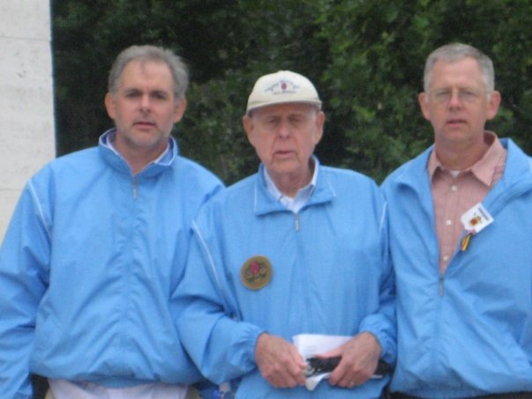
Happy Fathers Day!

Slide 11
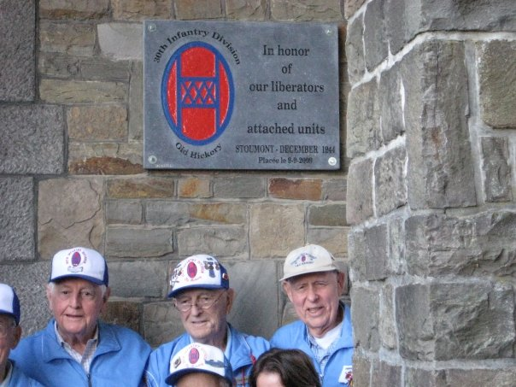

Slide 12
Lib·er·ate /ˈlibəˌrāt/ verb Set (someone) free from a situation, especially imprisonment or slavery, in which their liberty is severely restricted

Slide 13
Victor Neiland
30th Infantry Division
Company 7, 117th Regiment

Slide 14
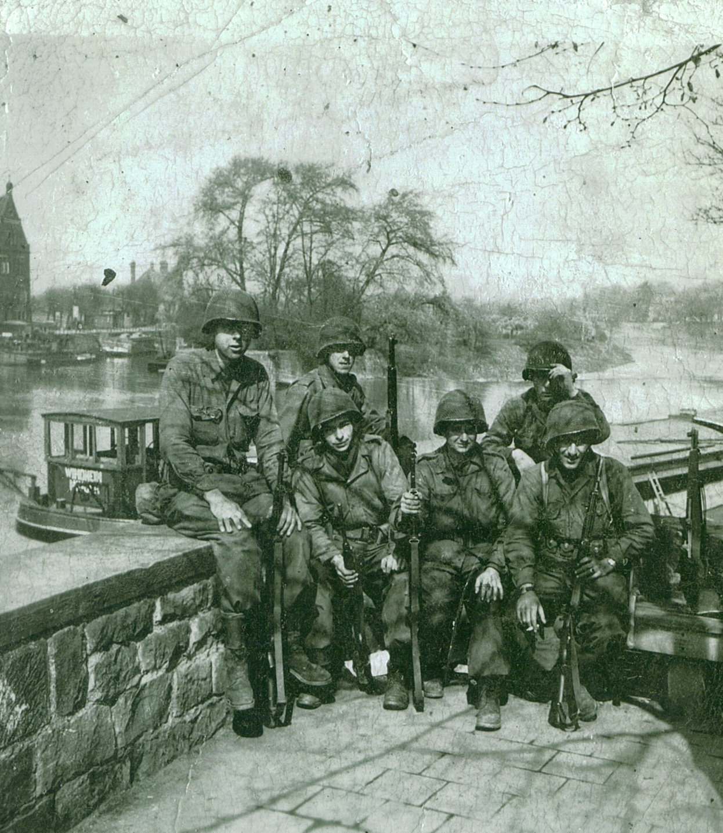

Slide 15
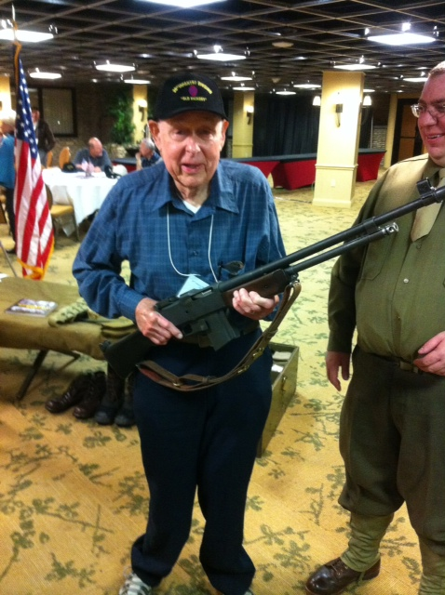
“B.A.R. Man”
18.5 Pound Machine Gun
Tripod Weighed 2+ lbs.
Magazine Fed
1 Person Dedicated to Holding Ammunition
Infantry Squads of 9 Men Were Tactically Organized Around 1 BAR
Vic threw away his tripod (too heavy to carry) and his “ammo guy” was sent home.

Slide 16
Liberation!
Victor Neiland with a Nazi flag he removed from a “warehouse” in Hamlin, Germany that held Jews and others waiting to be transported to a concentration camp.

Slide 17
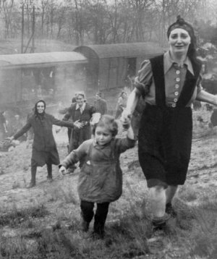
Death Train Near Magdeberg
This train contained 2,500 Jews loaded in freight cars and being transported between 2 concentration camps. This picture is shortly after the train was captured and liberated by the 30th Infantry Division.
Notes:
Overview of the story of this train.
What did the 30th division do here?
What happened to the train survivors?
Discuss the connection the 30th still has with the children from the train.

Slide 18
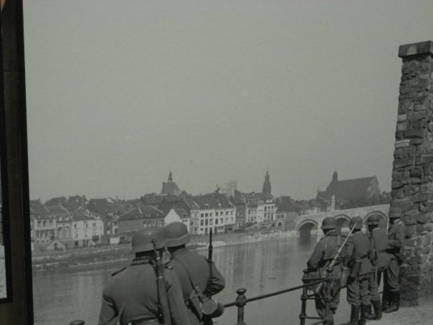
Towns Liberated by the 30th Infantry
Magdeburg
Maastricht
Notes:
How many towns do the 30th liberate and capture?
What was is like entering into a town that might be hostile?
What was your role when you entered a town?
How did you get this Nazi flag?

Slide 19
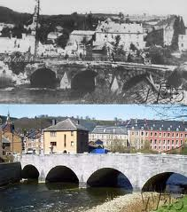
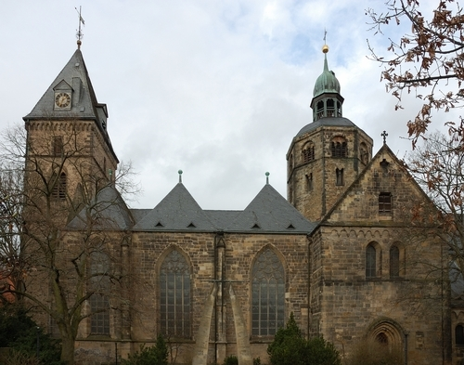
Towns Liberated by the 30th Infantry
Hamelin
Stavelot
Notes:
How many towns do the 30th liberate and capture?
What was is like entering into a town that might be hostile?
What was your role when you entered a town?
How did you get this Nazi flag?

Slide 20
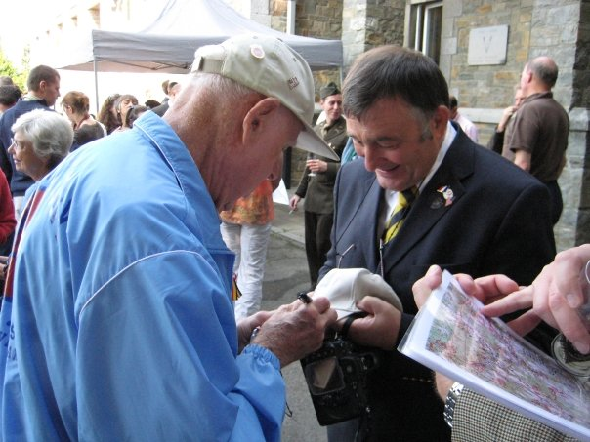
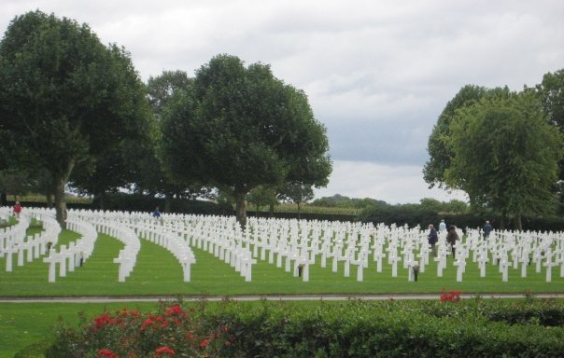
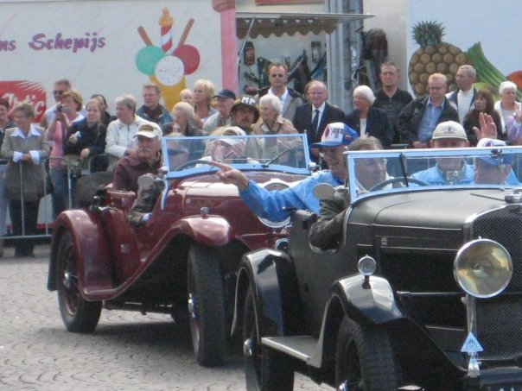
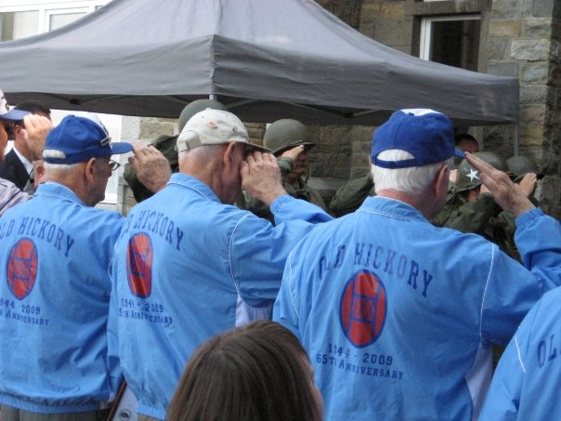
65 Years later….
Notes:
What’s it like going back?
Maybe discuss Margraten.

Slide 21
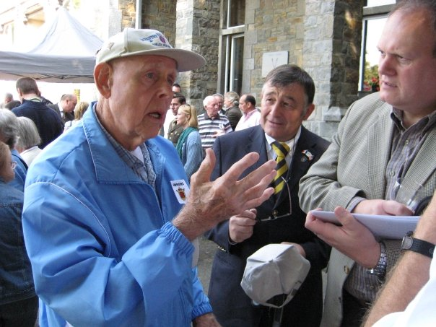
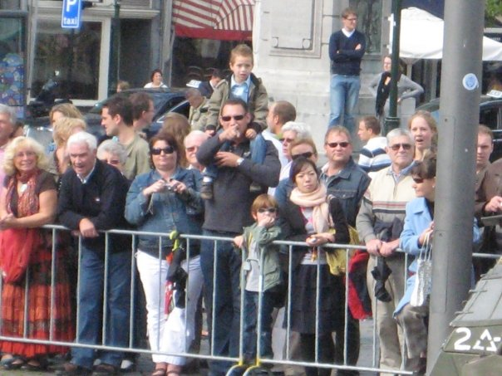
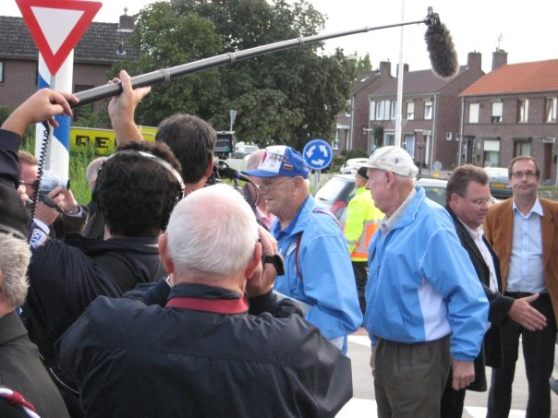
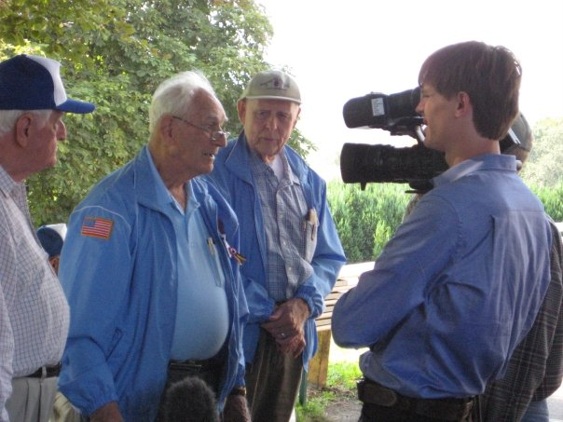

Slide 24
The Spirit of the Lord GOD is upon me, because the LORD has anointed me to bring good news to the poor; he has sent me to bind up the brokenhearted, to proclaim liberty to the captives, and the opening of the prison to those who are bound; to proclaim the year of the LORD's favor, and the day of vengeance of our God; to comfort all who mourn; to grant to those who mourn in Zion—to give them a beautiful headdress instead of ashes, the oil of gladness instead of mourning, the garment of praise instead of a faint spirit; that they may be called oaks of righteousness, the planting of the LORD, that he may be glorified. They shall build up the ancient ruins; they shall raise up the former devastations; they shall repair the ruined cities, the devastations of many generations. -- Isaiah 61:1-4

Slide 25
For Zion's sake I will not keep silent, and for Jerusalem's sake I will not be quiet, until her righteousness goes forth as brightness, and her salvation as a burning torch. The nations shall see your righteousness, and all the kings your glory, and you shall be called by a new name that the mouth of the LORD will give. You shall be a crown of beauty in the hand of the LORD, and a royal diadem in the hand of your God. You shall no more be termed Forsaken, and your land shall no more be termed Desolate, but you shall be called My Delight Is in Her, and your land Married; for the LORD delights in you, and your land shall be married. For as a young man marries a young woman, so shall your sons marry you, and as the bridegroom rejoices over the bride, so shall your God rejoice over you. -- Isaiah 62:1-5

Slide 26
Go through, go through the gates; prepare the way for the people; build up, build up the highway; clear it of stones; lift up a signal over the peoples. Behold, the LORD has proclaimed to the end of the earth: Say to the daughter of Zion, “Behold, your salvation comes; behold, his reward is with him, and his recompense before him.” And they shall be called The Holy People, The Redeemed of the LORD; and you shall be called Sought Out, A City Not Forsaken.
-- Isaiah 62:10-12

Slide 27
Rejoice greatly, O daughter of Zion! Shout aloud, O daughter of Jerusalem! Behold, your king is coming to you; righteous and having salvation is he, humble and mounted on a donkey, on a colt, the foal of a donkey.
-- Zechariah 9:9

Slide 28
The LORD of hosts will protect them, and they shall devour, and tread down the sling stones, and they shall drink and roar as if drunk with wine, and be full like a bowl, drenched like the corners of the altar. On that day the LORD their God will save them, as the flock of his people; for like the jewels of a crown they shall shine on his land. For how great is his goodness, and how great his beauty! Grain shall make the young men flourish, and new wine the young women. -- Zechariah 9:15-17

Slide 29
Most of the crowd spread their cloaks on the road, and others cut branches from the trees and spread them on the road. And the crowds that went before him and that followed him were shouting, “Hosanna to the Son of David! Blessed is he who comes in the name of the Lord! Hosanna in the highest!” And when he entered Jerusalem, the whole city was stirred up, saying, “Who is this?” And the crowds said, “This is the prophet Jesus, from Nazareth of Galilee.” -- Matthew 21:8-11

Slide 30
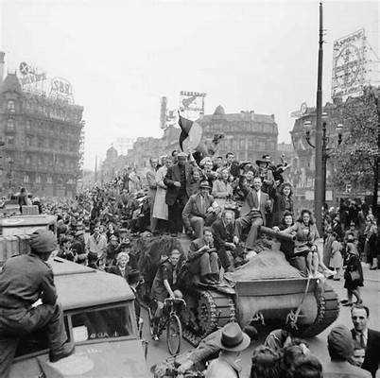
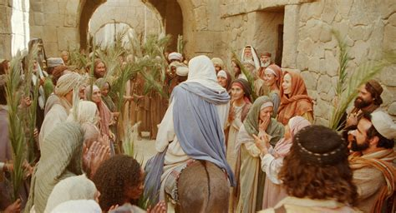

Slide 33
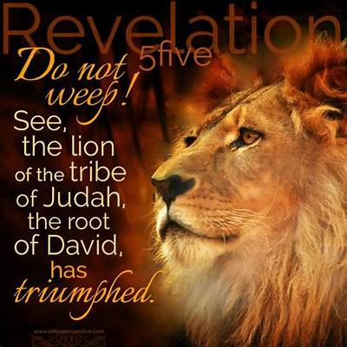

Slide 34
