Slide 1
An Exploration of Authority and Leadership
Our Authority is LOVE
Central Adult Class
13 June 2021

Slide 2
Welcome to class
Email Address: Robert.L.Wade@knology.net
Phone number: 256-651-8416
  Put your full name on any communication, especially the first communication

Slide 3
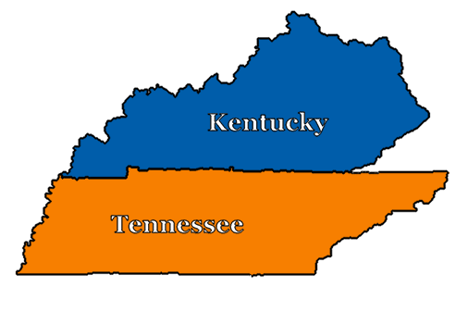
Intro to baseball
Cincinnati
St. Louis
Morehead
K-1st;
3rd – 4th
Mayfield
5th – 12th
Knoxville
Summer between k-1; 2nd

Slide 4
First learned of baseball in Knoxville (rising 2nd grader) with ambitions to become a major league player

Slide 5
A star is born…

Slide 6
After 2nd grade, moved (back) to Morehead within radio/television range of Cincinnati

Slide 7
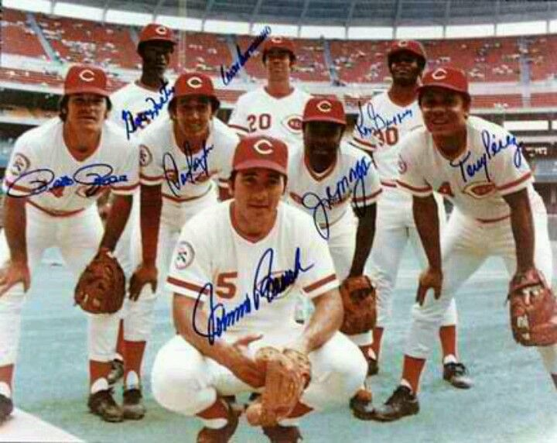

Slide 8
The game, when well played, is pure artistry!

Slide 9
After 4th grade, moved to Mayfield within radio/television range of St. Louis.

Slide 10
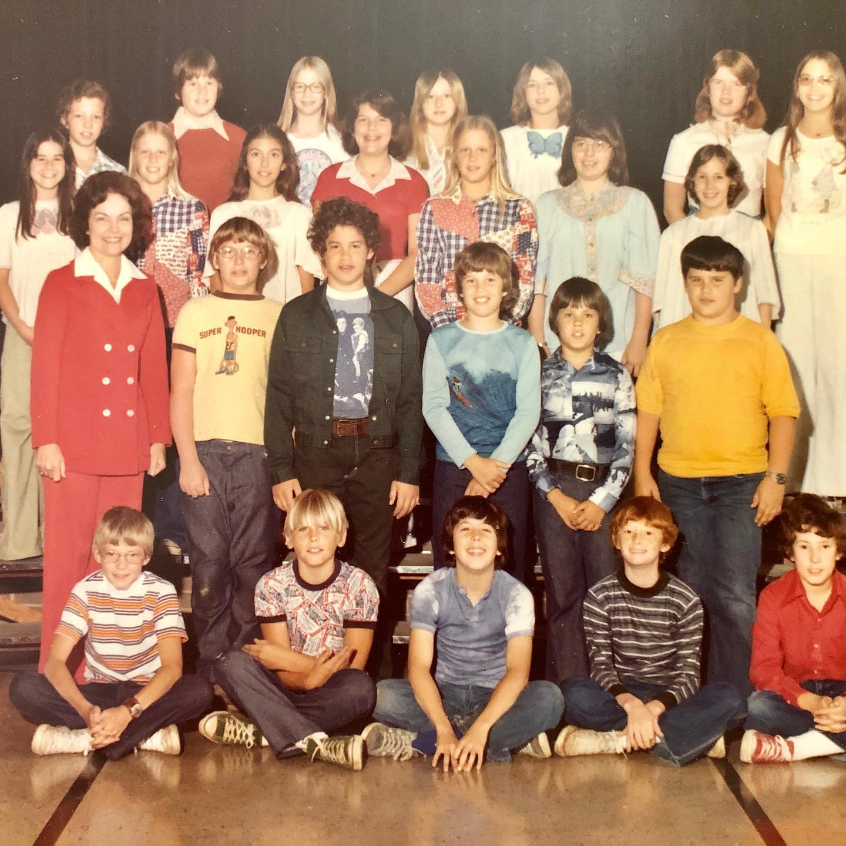

Slide 11
I have had opportunities to attend several games since those days

Slide 12
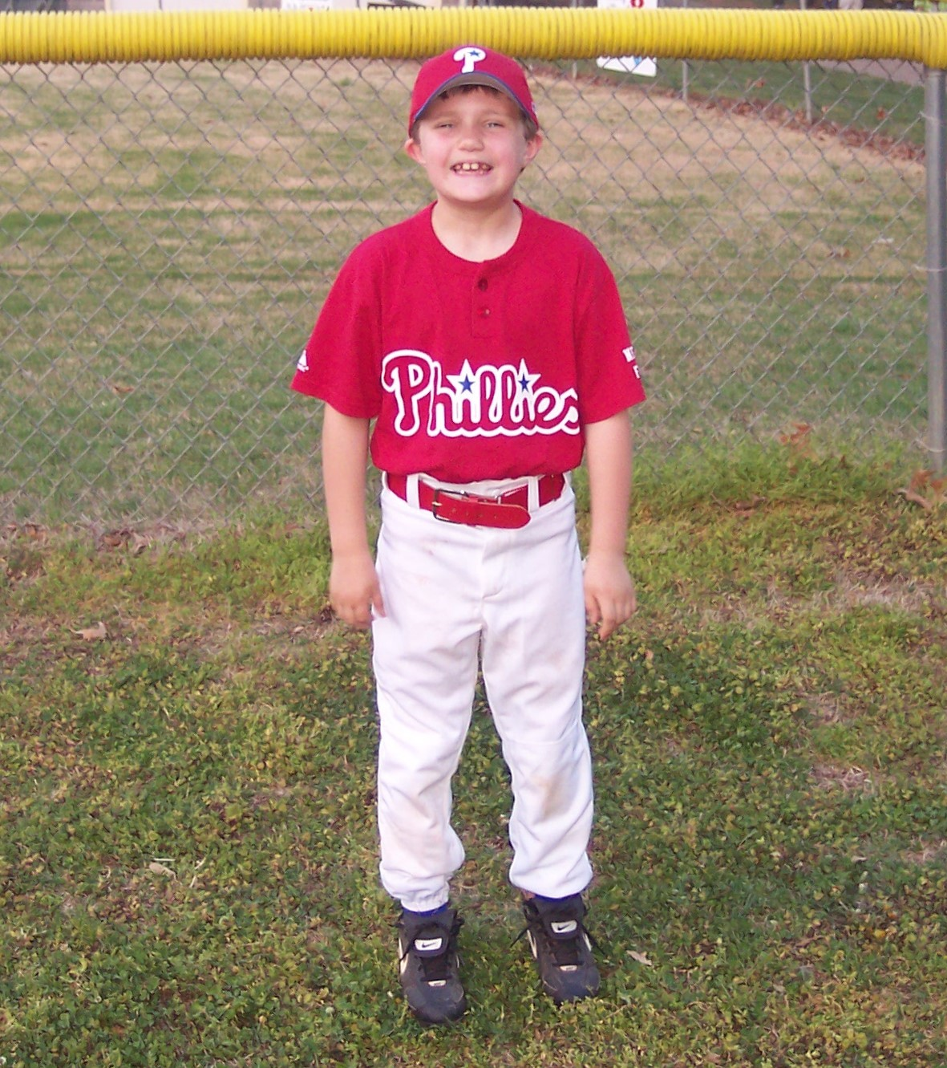
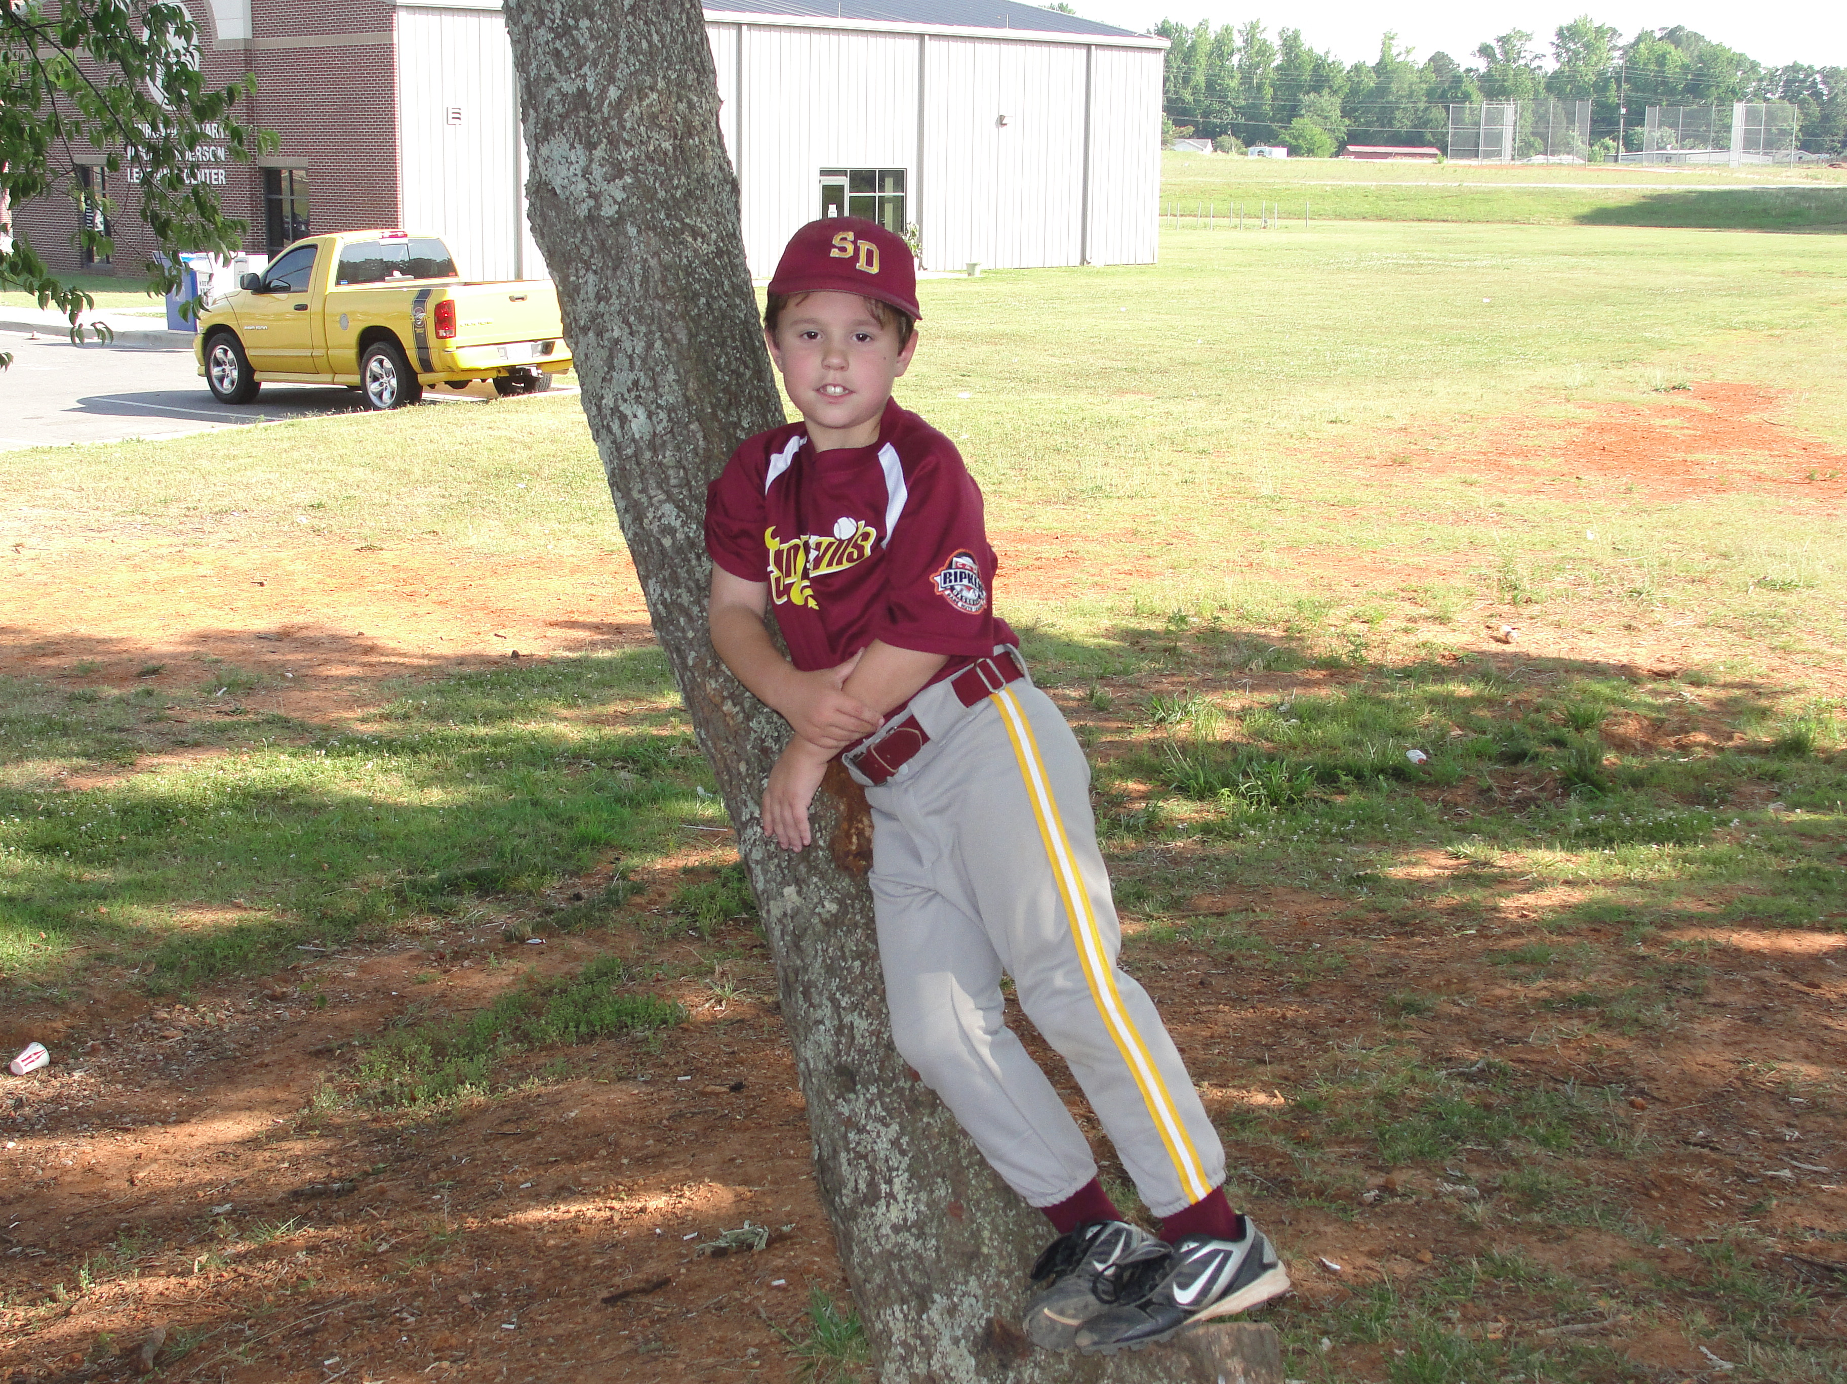
But it was not for the love of baseball

Slide 13
1 Corinthians 13:8-10
⁸ Love never fails. But where there are prophecies, they will cease; where there are tongues, they will be stilled; where there is knowledge, it will pass away. ⁹ For we know in part and we prophesy in part, ¹⁰ but when completeness comes, what is in part disappears.

Slide 14
Hebrews 10:24-26
²⁴ And let us consider how we may spur one another on toward love and good deeds, ²⁵ not giving up meeting together, as some are in the habit of doing, but encouraging one another—and all the more as you see the Day approaching.

Slide 15
Parable of the lost sheep [Matthew 18]
¹² “What do you think? If a man owns a hundred sheep, and one of them wanders away, will he not leave the ninety-nine on the hills and go to look for the one that wandered off? ¹³ And if he finds it, truly I tell you, he is happier about that one sheep than about the ninety-nine that did not wander off. ¹⁴ In the same way your Father in heaven is not willing that any of these little ones should perish.

Slide 16


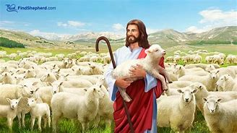
Parable of the Lost Sheep

Slide 17
Lost sheep (observations)
The reason the sheep got lost is not relevant.
The effort expended to recover the sheep is not relevant (e.g. it is never too much)
The “99” got put at risk to search for the lost sheep.

Slide 18
Transitive and commutative properties of authority
Jesus is Authority
God and Jesus are One
God is Love
Jesus is Love
Love is Authority
NOTE. You can do the same process to arrive at the Word is Authority

Slide 19
Robert’s Theme:
Be courageous in heart, Strong in action and endurance, Gentle in thought and speech
Jamie’s Theme:
Seek to do as much as you can for as many as you can, as often as you can.
As much as it is up to you, try to do no harm at all

