Slide 1
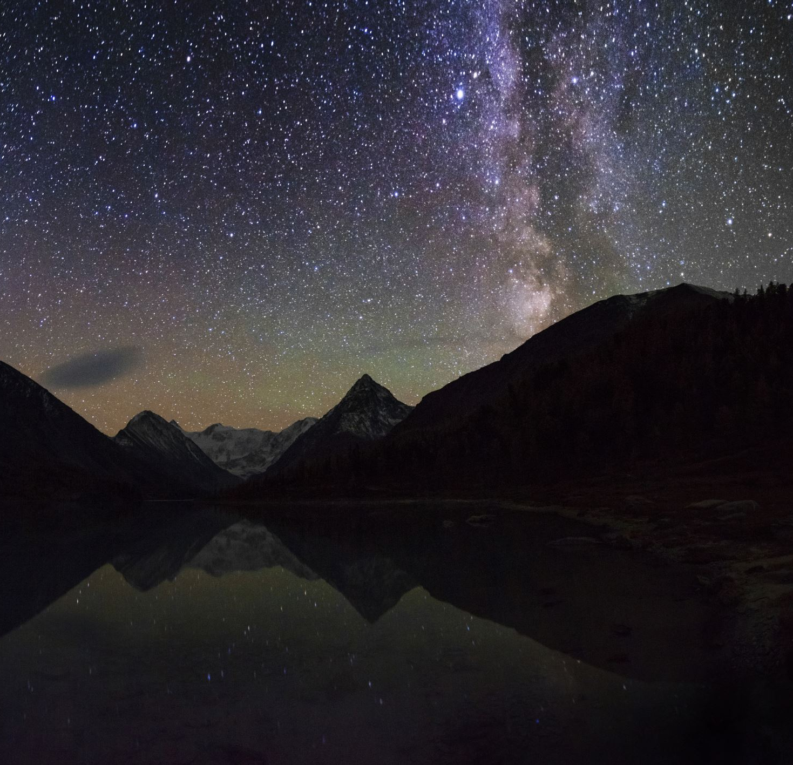
The Strength of a Slain Lamb
Revelation 5:6,7

Slide 2
Then I saw a Lamb, looking as if it had been
slain, standing in the center of the throne, encircled by the four living creatures and the elders. He had seven horns and seven eyes,
which are the seven spirits of God sent out
into all the earth. He came and took
the scroll from the right hand of
him who sat on the throne.
Revelation 5:6,7

Slide 3
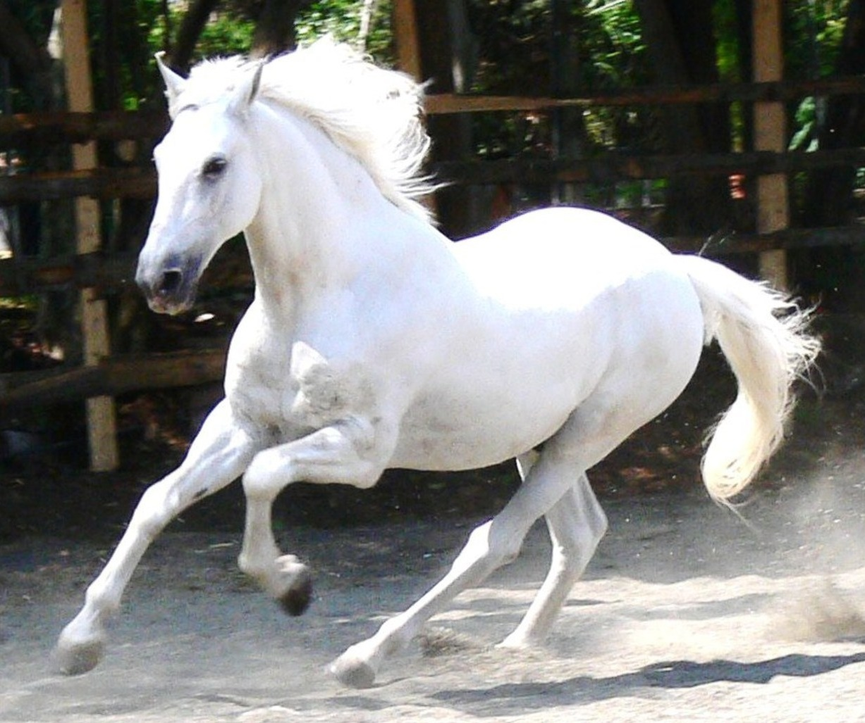
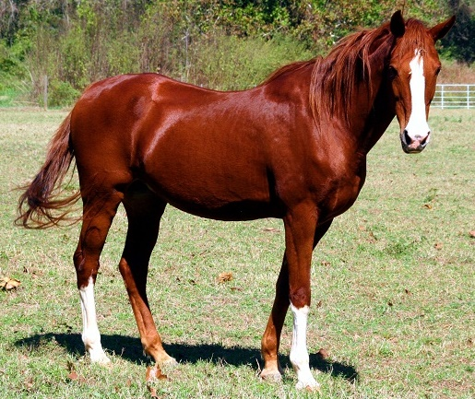
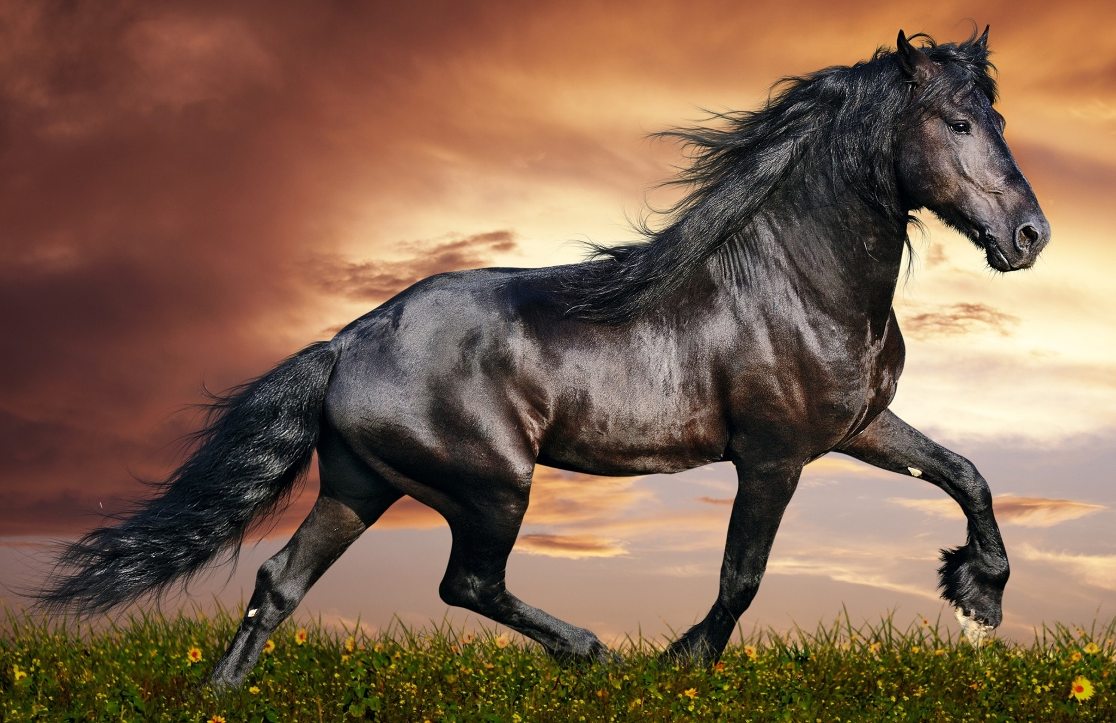
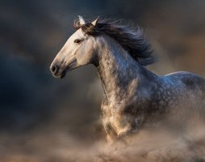
The Seven-Sealed Scroll ~ God’s Will
(What Christians can expect in life)
The spread of the gospel.
Martyrs
Lost their jobs
Natural disasters.
^{5th} - The Redeemed asking: “When will justice take place?”
^{6th} – A judgement

Slide 4
“To this you were called (suffering)
because Christ suffered for you,
leaving you an example, that you
should follow in his steps.
1 Pet. 2:21

Slide 5
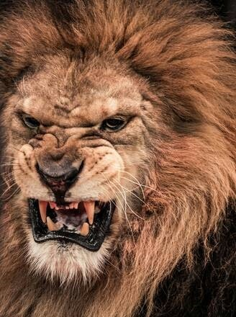
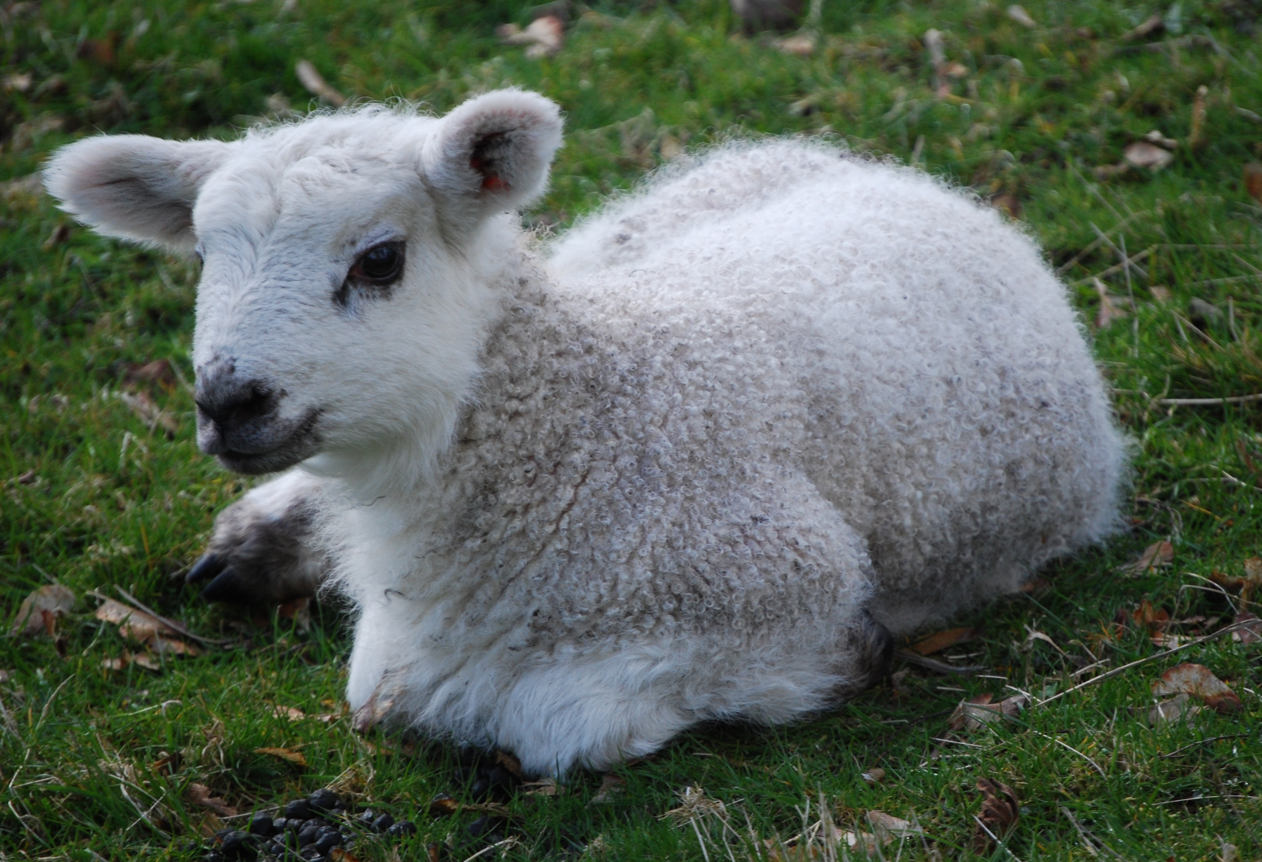
The Paradox of Christ
Lambkin
Slain
Standing
In majesty he is like a firstborn bull; his horns are the horns of a wild ox. With then he will gore the nations – Deut. 33:17
7 Horns ~
7 Eyes
Zech. 4:10

Slide 6
The Lamb of God
Look, the Lamb of God, who takes away the sin of the world!
John 1:29, 36
He was led like a sheep to the slaughter, and as a lamb before the shearer is silent…
Acts 8:32ff
For you know that it was not with perishable things such as silver or gold that you were redeemed…but with the precious blood of Christ, a lamb without blemish or defect
Peter 1:18,19

Slide 7
The Lamb In Revelation
A lamb with authority, victorious, in control
of history, worshiped, there is the wrath of the lamb
and the church is described as the bride of the lamb.
In this passage his cut throat exhibits him
as a sacrificial lamb
The Passover Lamb

Slide 8
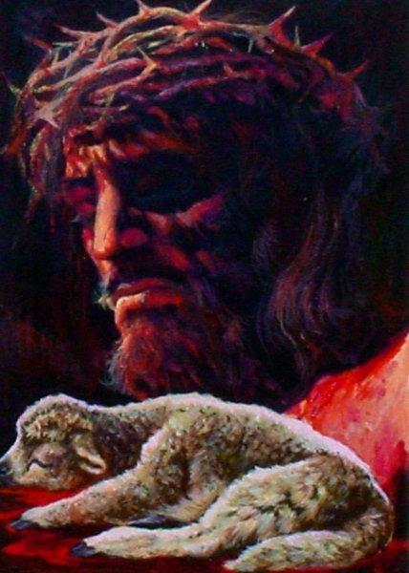
“For Christ, our Passover lamb, has been sacrificed.”
1 Cor 5:17
Why A Sacrifice?
The Horrible Nature of Sin
“There is no one righteous, not even one…all have turned away, they have together become worthless…”

Slide 9
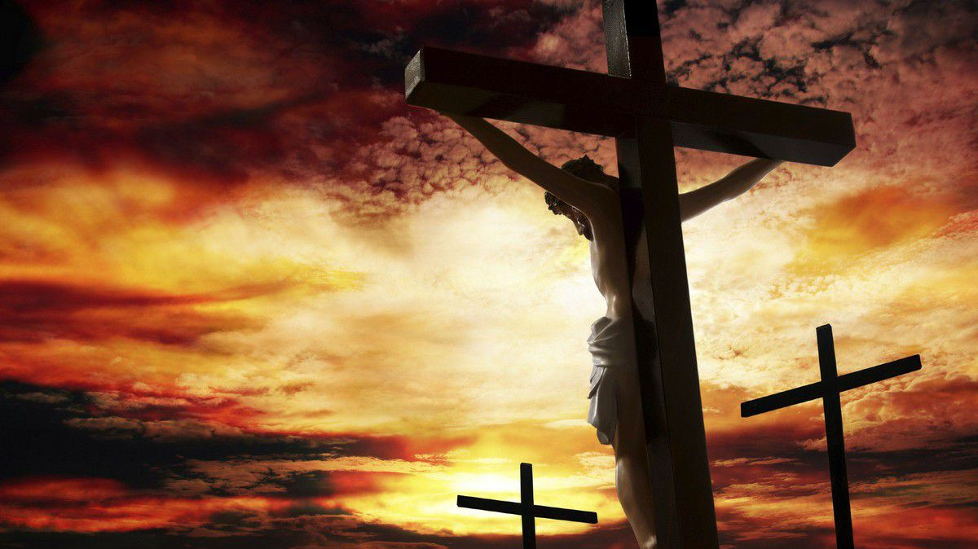
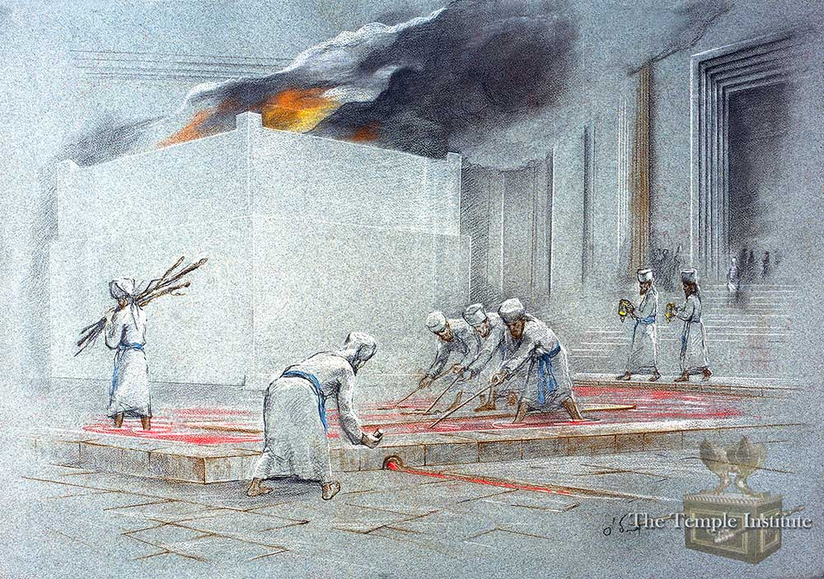
It was the day of Preparation of the Passover, about noon”
John 14:19

Slide 10
“Accepting suffering is the beginning of our liberation, Suffering can be the source of great strength. It gives us the power to resist. It is a gift from God that invites us to change. To start a revolution against the oppression. But for me, the oppressor was no longer the totalitarian communist regime. It’s not even the progressive liberal state. Meeting these hidden heroes started a revolution against the greatest totalitarian ruler of all: myself.”

