Slide 1
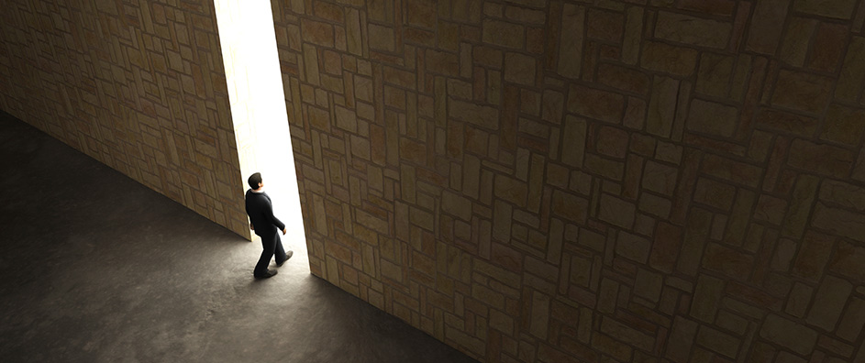
After this I looked and there before me was a door standing open in heaven. And the voice I had first heard speaking to me like a trumpet said, “Come up here, and I will show you what must take place after this. At once I was in the Spirit, and there before me was a throne in heaven with someone sitting on it.
Revelation
4

Slide 2
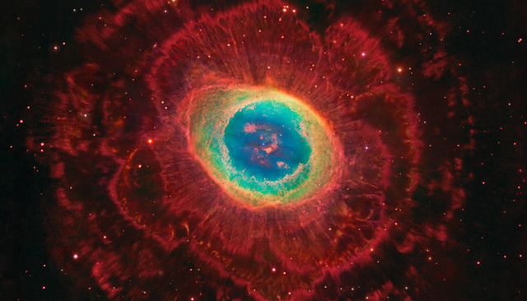
And the one who sat there had the appearance of jasper and carnelian
A rainbow, resembling an emerald, encircled the throne.

Slide 3
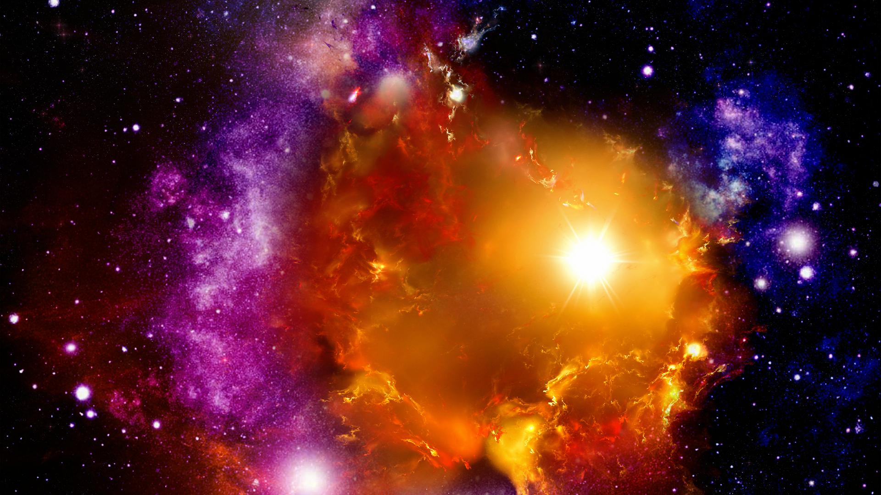
From the throne came flashes of lightning, rumblings and peals of thunder. Before the throne, seven lamps were blazing. These are the seven spirits of God.
Surrounding the throne were twenty-four other thrones, and seated on them were twenty-four elders. They were dressed in white and had crowns of gold on their heads.

Slide 4
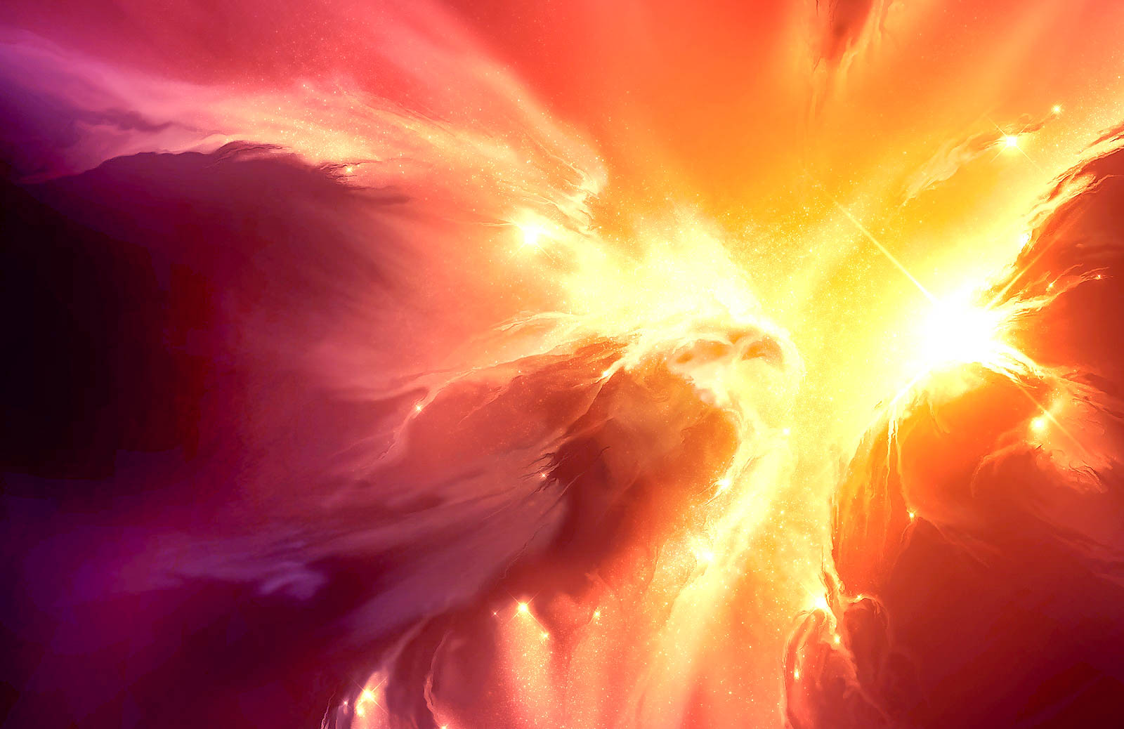
Also before the throne there was what looked
like a sea of glass, clear as crystal.
In the center, around the throne, were four living creatures, and they were covered with eyes,
in front and in back.

Slide 5
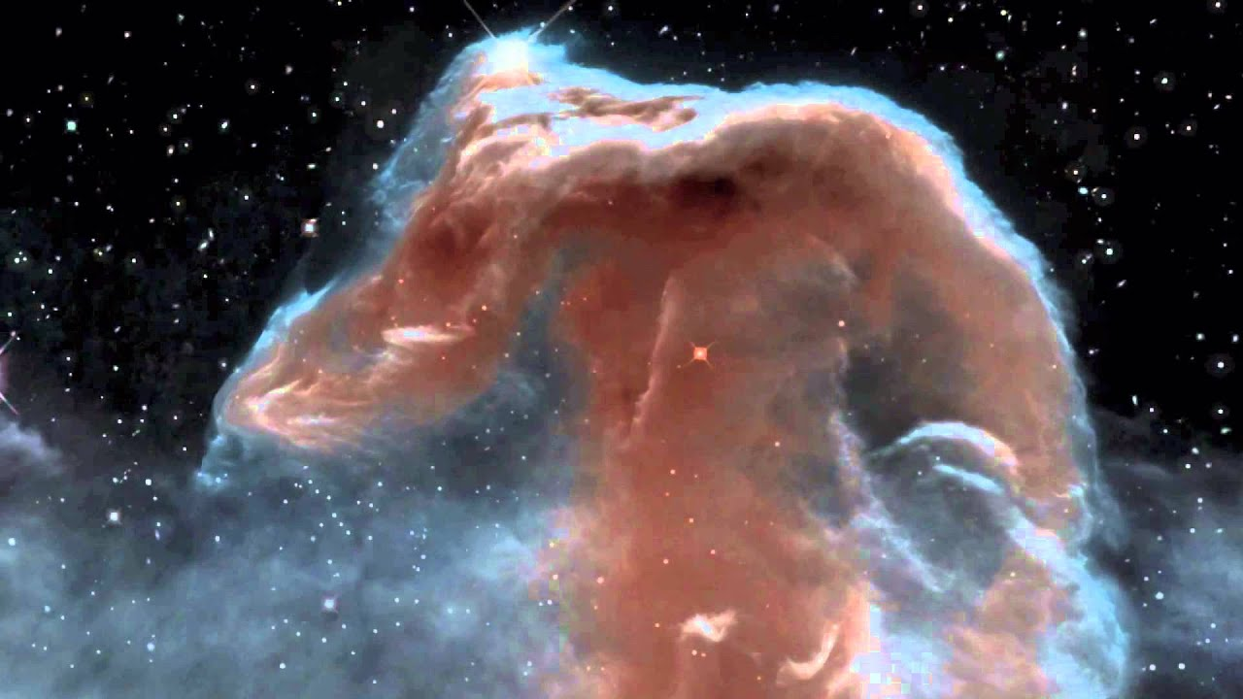
The first living creature was like a lion, the second was like an ox, the third had a face like a man, the fourth was like a flying eagle.
Each of the four living creatures had six wings and was covered with eyes all around, even under his wings.

Slide 6
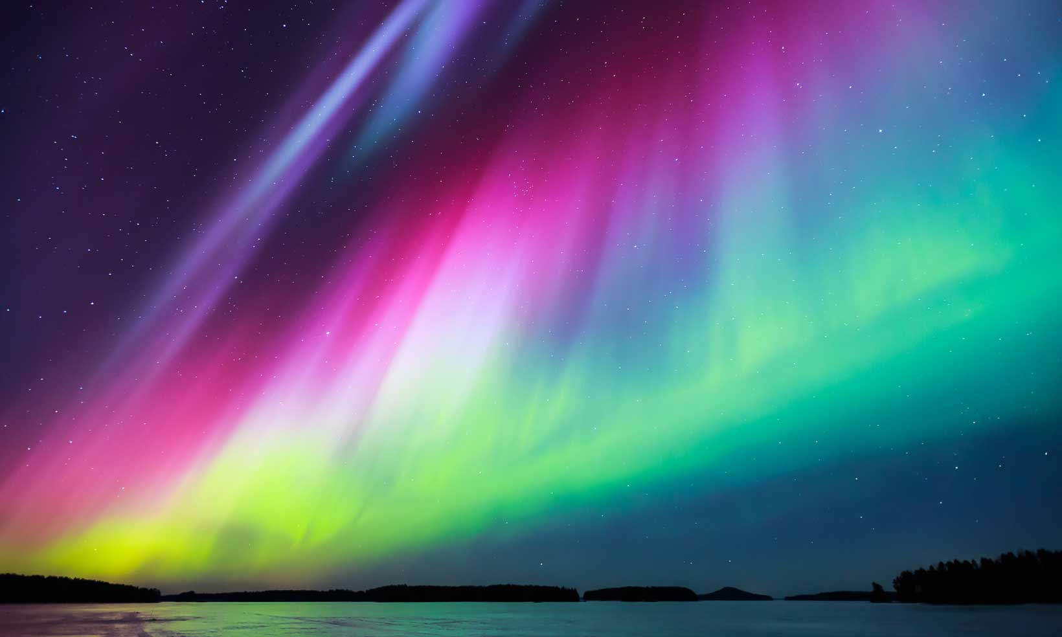
Day and night they never stop saying:
“Holy, holy, holy, is the Lord God Almighty, who was, and is, and is to come.” Whenever the living creatures give glory, honor and thanks to him who sits on the throne and who lives for ever and ever,

Slide 7
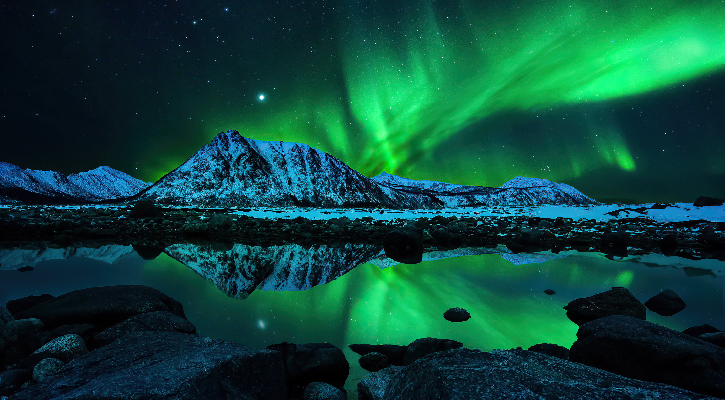
the twenty-four elders fall down before him who sits on the throne, and worship him who lives for ever and ever. They lay their crowns before the throne and say:
“You are worthy, our Lord and God, to receive glory and honor and power, for you created all things, and by your will they were created and have their being.

Slide 8
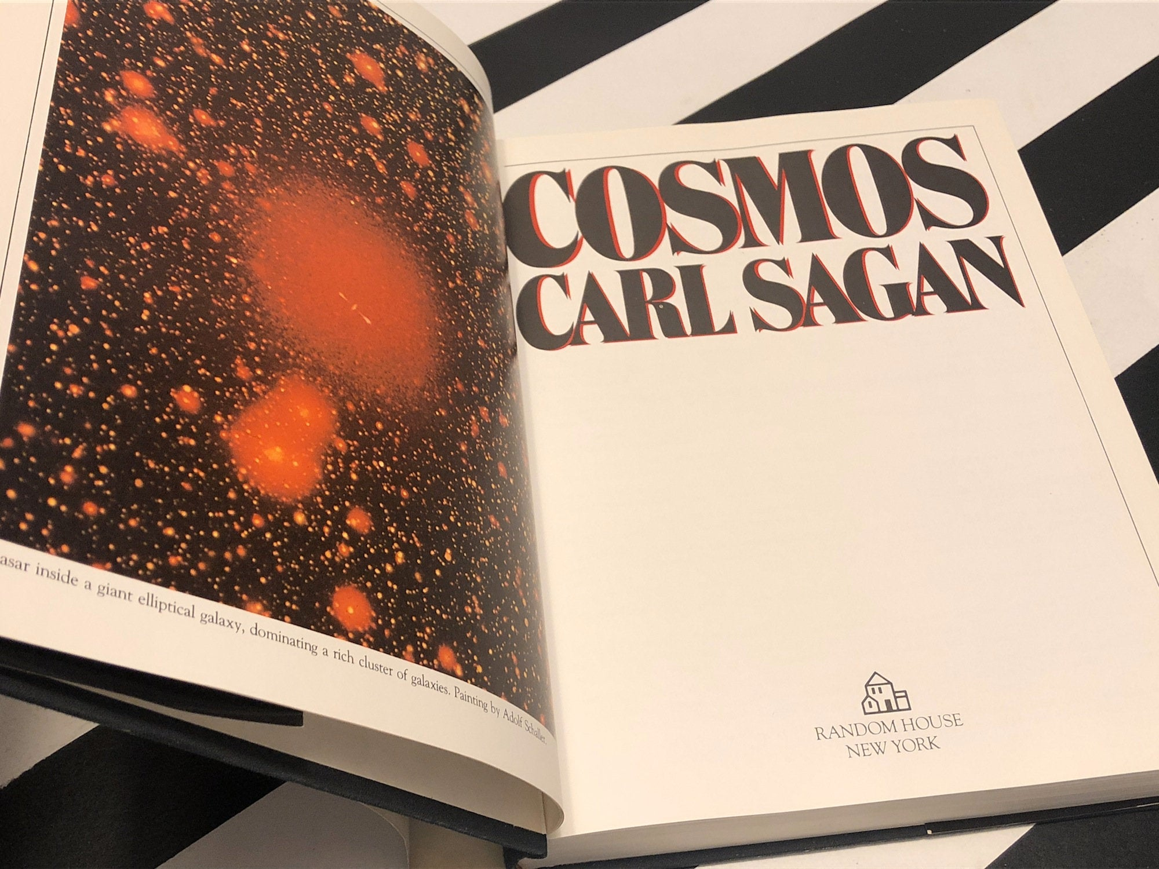
“Holy, holy, holy, is the Lord God Almighty, who was, and is, and is to come.”
“The cosmos is all that is, or ever was, or ever will be.”

Slide 9
After this I looked and…Look!
A door open and still open in heaven. The trumpet-like voice I first heard was talking saying, “Come up here. I will spread out in front of you what absolutely unfolds after this.”

Slide 10
At that instant I was in spirit and look!... a throne set in heaven and on the throne One enthroned. The One who sat there was rock-solid, like stone. Blazing crystal and fiery red and an emerald rainbow were all around the throne.
Around that throne were thrones; twenty-four of them. And seated on those thrones twenty-four aged ones with flowing robes of white and on their heads golden victory crowns.

Slide 11
Out of the depths of the throne:
flashes of lightening! Voices! Thunder!
In front of the throne seven blazing torches –
these are the seven Spirits of God.
Before the face of the throne something sea-like,
see-through as glass resembling crystal.
Circling the throne, in the middle (between the Throne and the 24 thrones) were four living creatures,
filled with eyes in the front and
overflowing with eyes in the back.

Slide 12
The first living creature resembled a lion!
The second a young bullock!
The third having a face like a man!
And the fourth living creature
was like a flying eagle!
The four living creature each were encircled with six wings and deep within the wings overflowing with eyes. Without respite, day and night, they continually lay out the Final Declaration:

Slide 13
Holy!
Sacred Otherness!
Transcendent Perfection! Absolute Master!
The Creator God!
Unrestricted Power
prevailing over all!
The Was!
The Is!
The One forever involved!

Slide 14
Whenever the four living beings bestow infinite worth and value and thanksgiving for grace to the One sitting on the Throne, to the Living One penetrating past times to the times, the twenty-four aged ones will fall down before the One who sits on the Throne who saturates the ages to ages and in worshipful adoration cast their victory crowns before the Throne saying:

Slide 15
Worthy are you! Our Absolute Master and our Creator God forever receiving infinite worth, immeasurable value and unrestricted power because you created each and everything and because of your desire they are and they were brought into being.

Slide 16
And he made known to us the mystery of his will according to his good pleasure, which he purposed in Christ, to be put into effect when the times will have reached their fulfillment – to bring all thing in heaven and on earth together under one head, even Christ. Ephesians 1:9-10

Slide 17
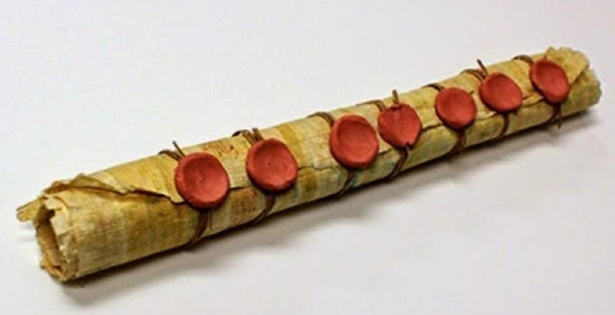
The Scroll: God’s Plan of life
Then I saw in the right hand of him who sat
on the throne a scroll with writing on both sides
and sealed with seven seals. And I saw a mighty
angel proclaiming in a loud voice, “Who is worthy to break the seals and open the scroll?” But no one in heaven or on earth or under the earth could open
the scroll or even look inside it.

Slide 18
The Scroll: God’s Plan of life
I wept and wept because no one was found who was worthy to open the scroll or look inside. Then one of the elders said to me, “Do not weep! See, the Lion of the tribe of Judah, the Root of David, has triumphed. He is able to open the scroll and its seven seals.”
Rev. 5:1-5

Slide 19
God’s will is sealed
No one in the universe is found who can break the seals
Why was it sealed?
Genesis 1:26-28: Mankind to rule and subdue the earth

Slide 20
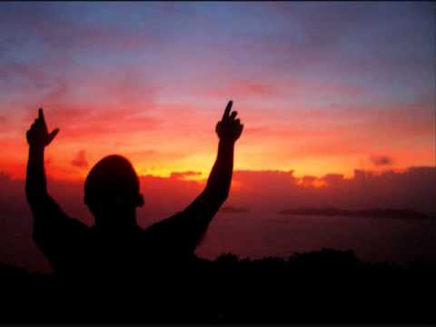
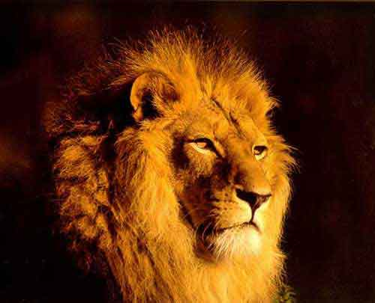
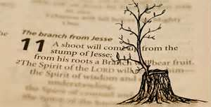
The man who could break the seals
Until “Shiloh” Comes
The Lion of the House of Judah – Gen. 49:8-10

Slide 21
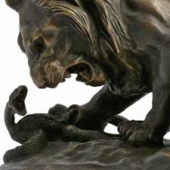
Therefore, just as sin entered the world through one man, and death through sin, and in this way death came to all men because all sinned.
Adam (was) a pattern of the one to come. But the gift is not like the trespass For if the many died by the trespass of the one man, how much more did God’s grace and the gift that came by grace of the one man, Jesus Christ, overflow to the many!

Slide 22
For if, by the trespass of the one man, death reigned through that one man, how much more will those who receive God’s abundant provision of grace and of the gift of righteousness reign in life through the one man, Jesus Christ.
Romans 5:12ff

Slide 23
LOOK!
The Lion of the tribe of Judah, the root of David has conquered! He is worthy, he is able to
open the scroll and
its seven seals!

