Slide 1
An Exploration of Authority and Leadership
Robert’s Class Will Begin At 9:15
Leaders
Central Adult Class
16 May 2021

Slide 2
Robert’s Class Will Begin In
Class – Robert Wade
Notes:
Three Minute Countdown

Slide 3
An Exploration of Authority and Leadership
Leaders
Central Adult Class
16 May 2021

Slide 4
Welcome to class
Email Address: Robert.L.Wade@knology.net
Phone number: 256-651-8416
Put your full name on any communication, especially the first communication

Slide 5
Responsibilities of Elders
Spiritual protectors of the flock: Acts 20:28-31; 1 Peter 5: 1-4; 1 Timothy 5:17-21
Teaching, watching for false teaching
Guidance in the flock’s life decisions (“lead to still waters”)
Physical protectors of the flock: Acts 6; James 5:14
Feeding, healing, comfort
Overseers of the affairs of the church: 1 Timothy 5:17-21
Programs, Ministries, Finances, Facilities, …

Slide 6
Guiding principles of decision making
The church exists 168 hours per week
Not just for 1 hour on Sunday morning
The purpose of the church is to spur one another on to love and good works [Hebrews 10: 24-25]

Slide 7
Guiding principles of decision making
We can never sacrifice Christian principles and we cannot be driven by traditions or the culture.
Consideration should be given to whether our implementation is a stumbling block [Matthew 18:6-7]
If yes, would we choose to give up our preferences?

Slide 8
My observations from the examples
The reliance on the Holy Spirit.
The involvement of the whole congregation in the decision.
The willingness to invoke Biblical principles to establish authority to act.

Slide 9
Challenge to the established church
How to deal with traditions
We all have them – Traditions keep us on track!
But we need to keep traditions in their place: Mark 7:1-13
Need to check our beliefs/practices
Are we living by faith or tradition
How tradition relates to current context

Slide 10
We are not alone
Did the coming of the Holy Spirit replace the casting of lots? (Question sent by email)
Urim and Thummim (Α Ω): see Exodus 28:30; I Samuel 14
With the Urim and Thummim, God left the High Priests the ability to inquire of God; He did not leave His people alone when Moses died.
With the Holy Spirit, God did not leave His people alone when Jesus left this world. [John 14:26-27]

Slide 11
Leaders
The responsibilities of elders are not unique to them
We are all submissive to the Head of the Church
We are all gifted by God
We all have the great commission
We all have the Holy Spirit
But we do not all have the same role [1 Corinthians 12]
¹² Just as a body, though one, has many parts, but all its many parts form one body, so it is with Christ. ¹³ For we were all baptized by one Spirit so as to form one body—whether Jews or Gentiles, slave or free—and we were all given the one Spirit to drink. ¹⁴ Even so the body is not made up of one part but of many.

Slide 12
Servant leaders
Matthew 18:1-5
¹At that time the disciples came to Jesus and asked, “Who, then, is the greatest in the kingdom of heaven?”
² He called a little child to him, and placed the child among them. ³ And he said: “Truly I tell you, unless you change and become like little children, you will never enter the kingdom of heaven. ⁴ Therefore, whoever takes the lowly position of this child is the greatest in the kingdom of heaven. ⁵ And whoever welcomes one such child in my name welcomes me.

Slide 13
Servant leaders
John 13:13-17
¹³ “You call me ‘Teacher’ and ‘Lord,’ and rightly so, for that is what I am. ¹⁴ Now that I, your Lord and Teacher, have washed your feet, you also should wash one another’s feet. ¹⁵ I have set you an example that you should do as I have done for you. ¹⁶ Very truly I tell you, no servant is greater than his master, nor is a messenger greater than the one who sent him. ¹⁷ Now that you know these things, you will be blessed if you do them.

Slide 14
That was really beautiful, but…

Slide 15
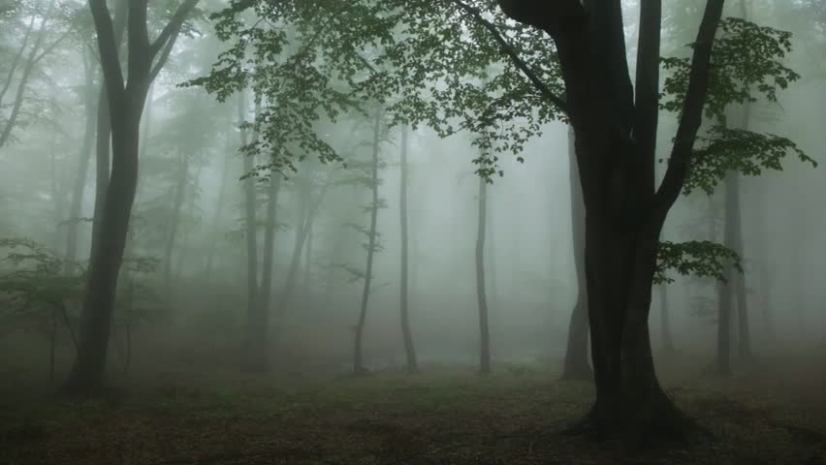
Minister
Overseer
Preacher
Apostle
Pastor
Evangelist
Servant
Teacher
Committee
Elder
Deacon
Deaconess
Prophet

Slide 16
The path is fogged by
Imprecise definition in Scripture
Centuries of traditions of the larger Church
Years of traditions of our own brotherhood
Legal definitions
501.(c).3
Trustee
Employee

Slide 17
Robert’s Theme:
Be courageous in heart, Strong in action and endurance, Gentle in thought and speech
Jamie’s Theme:
Seek to do as much as you can for as many as you can, as often as you can.
As much as it is up to you, try to do no harm at all

