Slide 1
An Exploration of Authority and Leadership
Robert’s Class Will Begin At 9:15
Gatherings
Central Adult Class
4 April 2021

Slide 2
Robert’s Class Will Begin In
Class – Robert Wade
Notes:
Three Minute Countdown

Slide 3
An Exploration of Authority and Leadership
Gatherings
Central Adult Class
4 April 2021

Slide 4
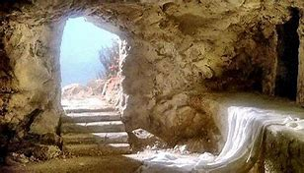
Good Morning!

Slide 5
Welcome to class
Email Address: Robert.L.Wade@knology.net
Phone number: 256-651-8416
Put your full name on any communication, especially the first communication

Slide 6
Foundational understanding (so far) Week 1 (28 February)
Jesus Christ is the living, active head of the church and has all authority [Matthew 28:18]
We, as the church, are both individually and collectively submissive to His authority [Ephesians 1:22; 5:23]
No one, beyond no one, stands in between any of us and Him. [1 Timothy 2:5]

Slide 7
Foundational understanding (so far) Week 2-3 (7, 14 March)
Our objective is to build on the foundation of Jesus Christ, not on any person or group of people (church) in order to bring glory to our Lord.
We should strive to do as the Lord wants but remember that our motives to honor the Lord are more important than being right.
I grew up understanding that there are right ways. And those not right are wrong. I do not now believe that this is absolute.
Do not weep over a “shrunken temple”.

Slide 8
Foundational understanding (so far) Week 4-5 (21, 28 March)
Our Savior has given all of us a vision and tasks [Matthew 28:18-20]
Our Savior has given every believer gifts to execute His vision [Matthew 25:14-30; 1 Corinthians 12:11]
Our Savior has given every believer power, in the Holy Spirit, to use those gifts to perform those tasks. [John 14: 15-28]
Our Savior has assembled groups of believers together to work as a body to accomplish for God’s glory. [Romans 12: 3-8]

Slide 9
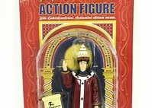
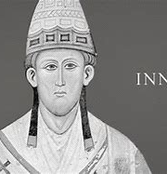
Pope Innocent III (1160 – 1216)

Slide 10
Seven sacraments of the Catholic Church
Each sacrament was foundational to Christian theology and could only be administered by the church via its priests/bishops.
[Initiation: Baptism, Confirmation, Eucharist]
[Healing: Penance, Anointing of the sick (last rites)]
[Service: Marriage, Holy Orders]

Slide 11
Imagine the power of the priest / church
The influence of fear as a motivator
Dependency upon men and/or self
Correct actions performed by authorized people will lead you to heaven. Incorrect actions or those performed by usurpers lead to condemnation.

Slide 12
Have we as a brotherhood ever really abandoned the Catholic model
Participation in acts of worship conducted by authorized men.
Dependency upon men is no dependency or trust in Jesus
Always in fear about whether we did it right.

Slide 13
My experience with being “official”

Slide 14
The reformation and the restoration
Challenged the idea of only the priests had authority but what was not as questioned was
Does the authority exist?
In other words, was the authority to perform given only to subset of people?
THOUGHT: You cannot usurp someone’s authority if they do not have the authority.

Slide 15
True authority versus implied authority
Therefore, what God has joined together, no person is to separate.” [Matthew 19:6]
And the Lord was adding to their number day by day those who were being saved. [Acts 2:47]

Slide 16
Authority for the Seven
Authority for each to exist came from Christ
But authority to perform came only from the church
If an unauthorized person “performed” one the sacraments then it was invalid.
Example – annulment of the marriage

Slide 17
Be courageous in heart,
Strong in action and endurance,
Gentle in thought and speech

