Slide 1
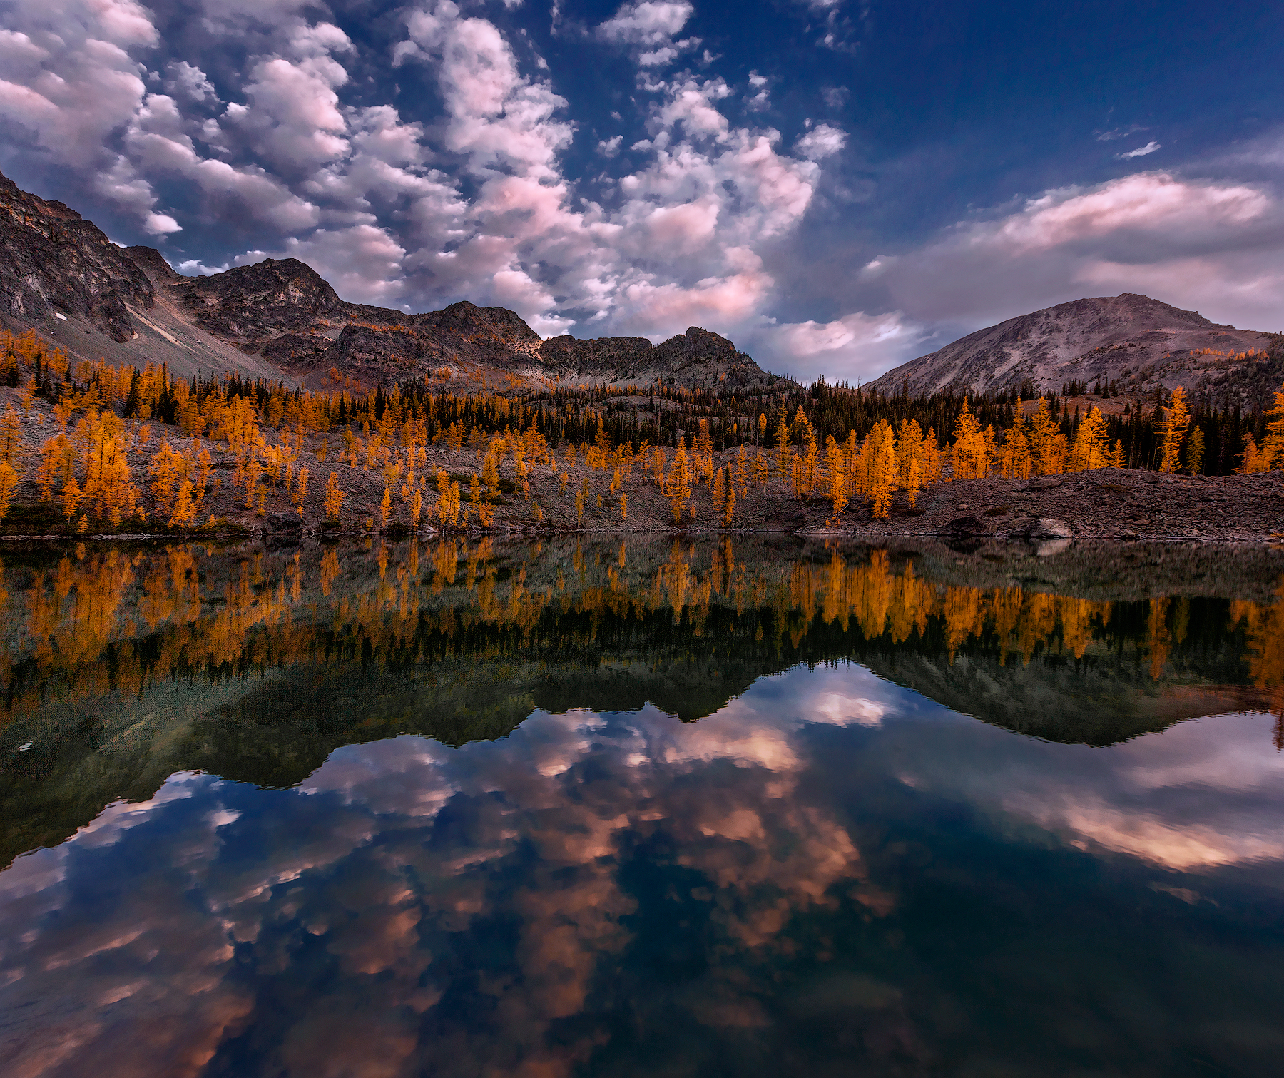
Two
Realities
Revelation
4:1,2

Slide 2
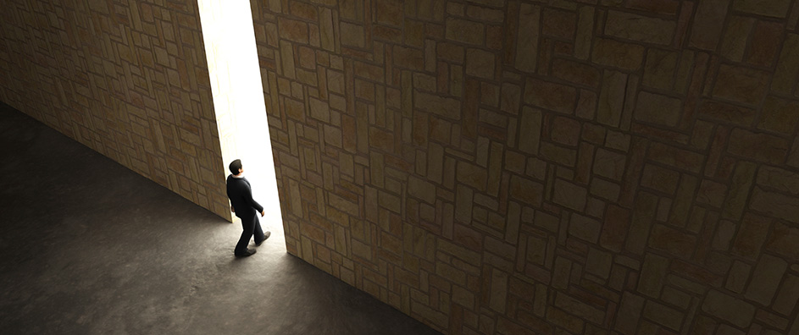
After this I looked and there before me was a door standing open in heaven. And the voice I had first heard speaking to me like a trumpet said, “Come up here, and I will show you what must take place after this. At once I was in the Spirit, and there before me was a throne in heaven with someone sitting on it.
Revelation
4:1,2

Slide 3
Our Cultural Reality
2021
2045
2060
Totalitarianism
Persecution
Political Marxism 1920’s
Cultural Marxism
Critical Race Theory
Dualistic Thinking

Slide 4
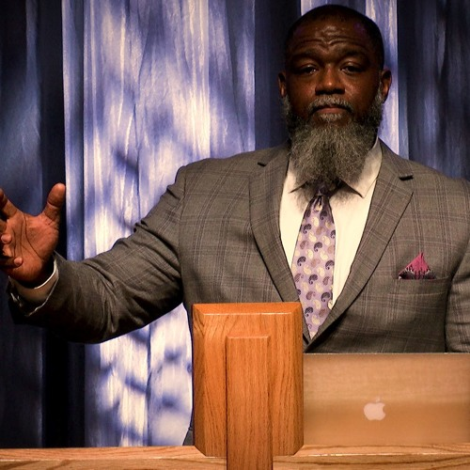
Biblical Justice vs Social Justice
Racial Reconciliation
Cultural Marxism
We Must Fight
Critical Race Theory
Voddie Baucham

Slide 5
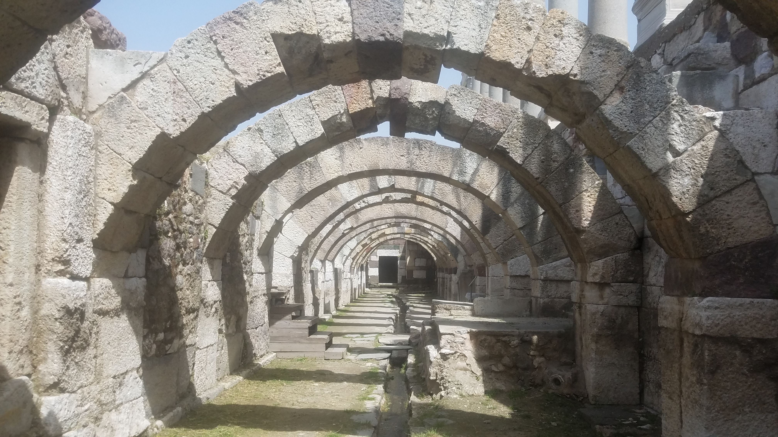
Our Spiritual Reality
Revelation 2,3
“Christians in Turmoil”
Smyrna:
“I know your afflictions and your poverty (Physical Reality)
“yet, you are rich!”
(Spiritual Reality)

Slide 6
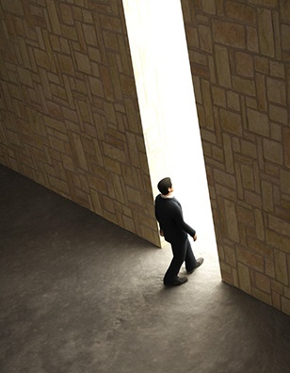
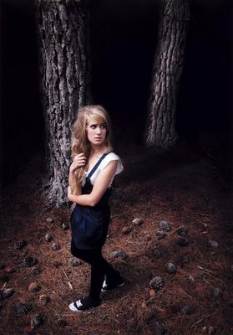
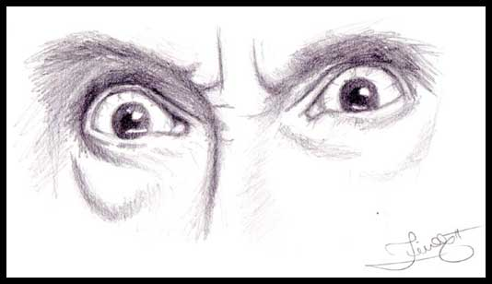
“A door open in heaven”
2 Kings 6
“O my lord, what shall we do?
“and now still is open”

Slide 7
“We do have such a high priest, who sat down at the
right hand of the throne of the Majesty in heaven…Let
us fix our eyes on Jesus…who sat down at the right
hand of the throne of God” Heb. 8:1, 12:2
Power, rule, authority, control,
righteousness, justice.
Psalm 47
JOY!
“And there before me was a throne in heaven
with someone sitting on it.”

Slide 8
“In fact, everyone who wants to live a godly life
in Christ Jesus will be persecuted, while evil men
and impostors will go from bad to worse,
deceiving and being deceived.”
2 Timothy 3:12,13

Slide 9
