Slide 1
RELATIONSHIP RULES

Slide 2
RELATIONSHIP RULES
Class Will Begin In
Sermon – Allen Wright
Notes:
Three Minute Countdown

Slide 3
RELATIONSHIP RULES

Slide 4
The General Rule
“Do Unto Others as They Have Done Unto You”
They
Reactive

Slide 5
“You have heard that it was said, ‘An eye for an eye and a tooth for a tooth.’ But I say to you, Do not resist the one who is evil. But if anyone slaps you on the right cheek, turn to him the other also.” – Matthew 5:38,39

Slide 6
“You have heard that it was said, ‘You shall love your neighbor and hate your enemy.’ But I say to you, Love your enemies and pray for those who persecute you, so that you may be sons of your Father who is in heaven.”
– Matthew 5:43-45a

Slide 7
You therefore must be perfect, as your heavenly Father is perfect. – Matthew 5:48

Slide 8
RELATIONSHIP RULES

Slide 9
The General Rule
“Do Unto Others as They Have Done Unto You”
The Golden Rule
“Do Unto Others as You Would Have Them do Unto You”
They
You
Reactive
Reflective

Slide 10
You shall not take vengeance or bear a grudge against the sons of your own people, but you shall love your neighbor as yourself: I am the Lord. – Leviticus 19:18

Slide 11
“As you would have people do to you, do to them; and what you dislike to be done to you, don’t do to them”
- Muhammad
Kitab al-Kafi, vol.2 p.146

Slide 12
“What you do not wish for yourself, do not to others”
- Confucius

Slide 13
“By making dharma your main focus, treat others as you treat yourself”
- Hinduism

Slide 14
RELATIONSHIP RULES

Slide 15
The General Rule
“Do Unto Others as They Have Done Unto You”
The Golden Rule
“Do Unto Others as You Would Have Them do Unto You”
They
You
Reactive
Reflective
The Gospel Rule
“Do Unto Others as God Has Done Unto You”
God
Revelational

Slide 16
Beloved, if God so loved us, we also ought to love one another. – 1 John 4:11

Slide 17
Happy Valentine’s Day

Slide 18
For God so loved the world, that he gave his only Son, that whoever believes in him should not perish but have eternal life.
– John 3:16

Slide 19
By this we know love, that he laid down his life for us, and we ought to lay down our lives for the brothers.
– 1 John 3:16

Slide 21
In this is love, not that we have loved God but that he loved us and sent his Son to be the propitiation for our sins. Beloved, if God so loved us, we also ought to love one another. – 1 John 4:10,11

Slide 22
We love because he first loved us. If anyone says, “I love God,” and hates his brother, he is a liar; for he who does not love his brother whom he has seen cannot love God whom he has not seen. And this commandment we have from him: whoever loves God must also love his brother. – 1 John 4:19-21

Slide 23
Anyone who does not love does not know God, because God is love. – 1 John 4:8

Slide 24
Love is
a choice,
a decision,
a commitment

Slide 25
Love is an unconditional commitment to the best interest of another.

Slide 26
God loves in covenant not necessarily in sentiment.

Slide 27
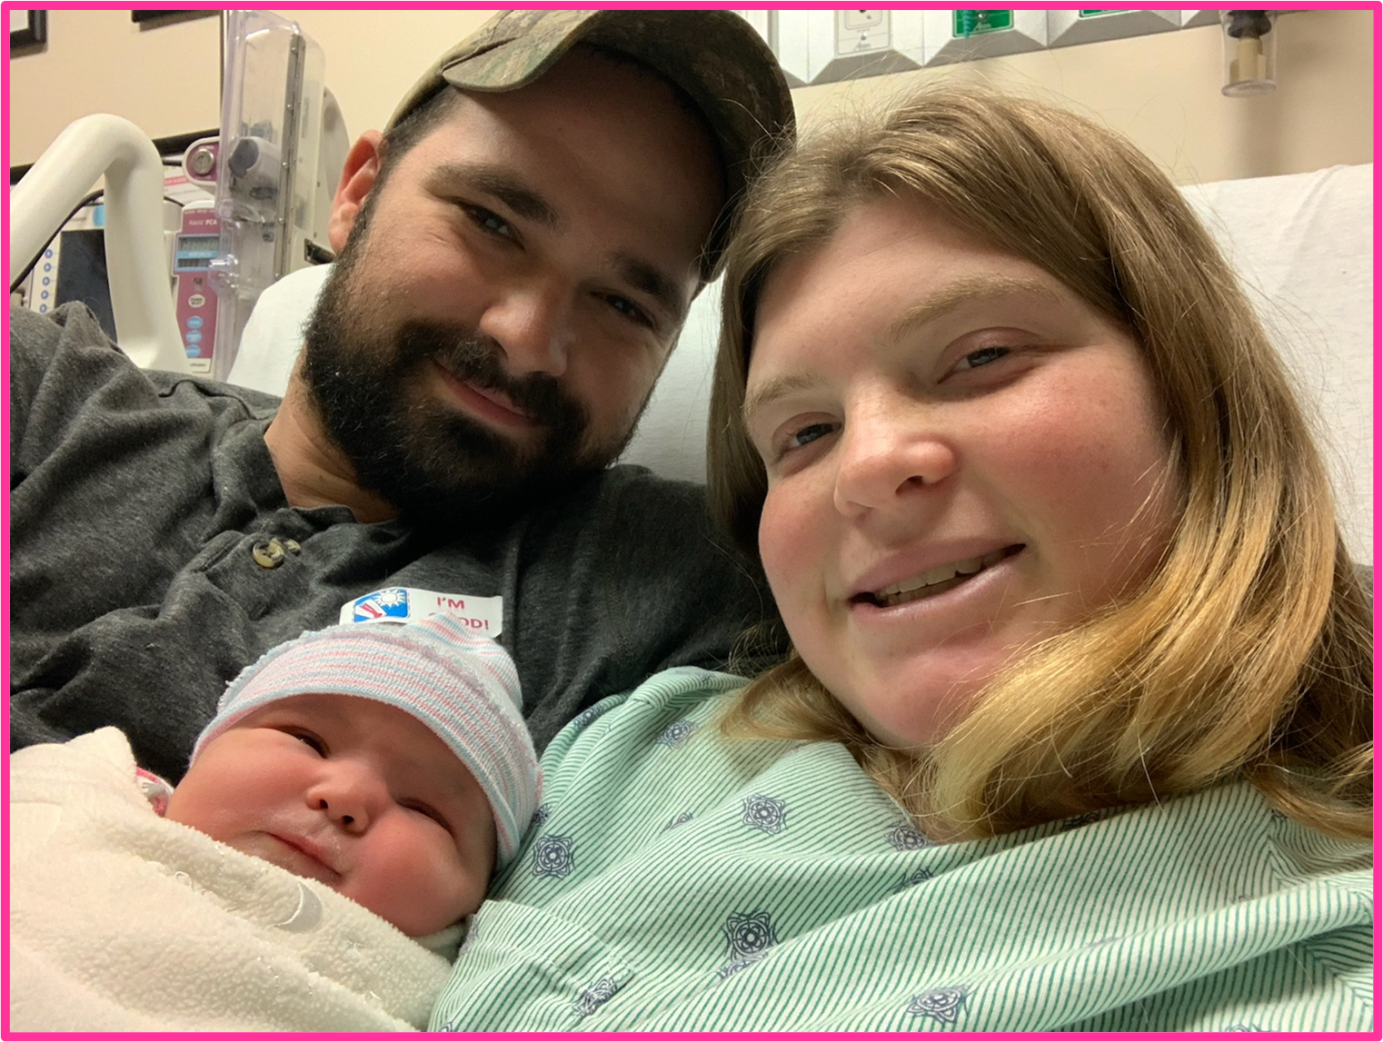

Slide 28
MIND
CHOICES/
DECISIONS
FEELINGS

Slide 29
We Know What Love is
Q. Who loves you the most?
Q. How do you know?

Slide 30
LOVE is NORMAL

