Slide 1
Return To Normalcy
Unity Based on Love
Central Adult Class
31 January 2021

Slide 2
Return To Normalcy
Class Will Begin In
Unity Based on Love
Central Adult Class
31 January 2021

Slide 3
Return To Normalcy
Strength to Withstand
Central Adult Class
07 February 2021

Slide 4
The class theme
Christ came into this world to return man to a normal state. But what Christ calls normal, the world calls abnormal. And what the world calls normal, Christ calls abnormal.

Slide 5
The class theme
A Christian’s desire to return to normal is not to return to pre-COVID habits. It is to return to the state of what we were created to be. And Christ showed us what we were created to be.

Slide 6
John 17: 9-11
⁹ I pray for them. I am not praying for the world, but for those you have given me, for they are yours. ¹⁰ All I have is yours, and all you have is mine. And glory has come to me through them. ¹¹ I will remain in the world no longer, but they are still in the world, and I am coming to you. Holy Father, protect them by the power of your name, the name you gave me, so that they may be one as we are one.

Slide 7
John 17: 12-13
¹² While I was with them, I protected them and kept them safe by that name you gave me. None has been lost except the one doomed to destruction so that Scripture would be fulfilled.
¹³ “I am coming to you now, but I say these things while I am still in the world, so that they may have the full measure of my joy within them.

Slide 8
John 17: 14-19
¹⁴ I have given them your word and the world has hated them, for they are not of the world any more than I am of the world. ¹⁵ My prayer is not that you take them out of the world but that you protect them from the evil one. ¹⁶ They are not of the world, even as I am not of it. ¹⁷ Sanctify them by the truth; your word is truth. ¹⁸ As you sent me into the world, I have sent them into the world. ¹⁹ For them I sanctify myself, that they too may be truly sanctified.

Slide 9
One of the last prayers of Jesus
Jesus and the Eleven have just left the “Last Supper”
Last prayer with the Eleven
Four days earlier Jesus had raised Lazarus from the dead [John 11]
Three days earlier Jesus entered Jerusalem to shouts of Hosanna [John 12]
In a few hours, the Eleven will abandon him, Jesus will be tried and nailed to the cross
Jesus knows this.

Slide 10
Prayer of protection not avoidance
We are not asked to leave this world, even though we would like to
We are subject to its pains and decay
Discipline (e.g. hardship) is required for inheritance [Hebrews 12:7-8]

Slide 11
Hebrews 12:7-8
⁷ Endure hardship as discipline; God is treating you as his children. For what children are not disciplined by their father? ⁸ If you are not disciplined—and everyone undergoes discipline—then you are not legitimate, not true sons and daughters at all.

Slide 12
Forehead of flint
Would we rather avoid being hit in the head or would we want the ability to withstand the blow?

Slide 13
Ezekiel 3:4-9
⁴ He then said to me: “Son of man, go now to the people of Israel and speak my words to them. ⁵ You are not being sent to a people of obscure speech and strange language, but to the people of Israel— ⁶ not to many peoples of obscure speech and strange language, whose words you cannot understand. Surely if I had sent you to them, they would have listened to you. ⁷ But the people of Israel are not willing to listen to you because they are not willing to listen to me, for all the Israelites are hardened and obstinate. ⁸ But I will make you as unyielding and hardened as they are. ⁹ I will make your forehead like the hardest stone, harder than flint. Do not be afraid of them or terrified by them, though they are a rebellious people.”

Slide 14
Do not be afraid
There is a reason that this expression is repeated dozens of times in Scripture
There are threats to our well-being.
Some because of our faith
Some because of our humanity

Slide 15
Joshua 1:9
⁹ Have I not commanded you? Be strong and courageous. Do not be afraid; do not be discouraged, for the Lord your God will be with you wherever you go.”

Slide 16
Don’t we know that we are supermen and superwomen

Slide 17
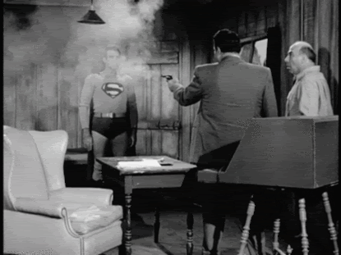
The courage of Superman

Slide 18
We are immortal but sometimes we forget

Slide 19
Be courageous in heart,
Strong in action,
Gentle in thought and speech

