Slide 1
Return To Normalcy
Defending Our Rights
Central Adult Class
10 January 2021

Slide 2
The class theme
Christ came into this world to return man to a normal state. But what Christ calls normal, the world calls abnormal. And what the world calls normal, Christ calls abnormal.

Slide 3
The class theme
A Christian’s desire to return to normal is not to return to pre-COVID habits. It is to return to the state of what we were created to be. And Christ showed us what we were created to be.

Slide 4
Matthew 5: 38-42
³⁸ “You have heard that it was said, ‘Eye for eye, and tooth for tooth.’ [Leviticus 24: 20] ³⁹ But I tell you, do not resist an evil person. If anyone slaps you on the right cheek, turn to them the other cheek also. ⁴⁰ And if anyone wants to sue you and take your shirt, hand over your coat as well. ⁴¹ If anyone forces you to go one mile, go with them two miles. ⁴² Give to the one who asks you, and do not turn away from the one who wants to borrow from you.

Slide 5
The unalienable rights
We hold these truths to be self-evident, that all men are created equal, that they are endowed by their Creator with certain unalienable Rights, that among these are Life, Liberty and the pursuit of Happiness…
Declaration of Independence

Slide 6
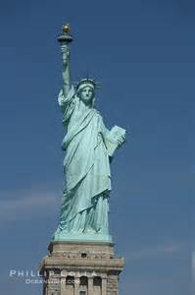
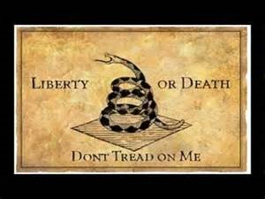
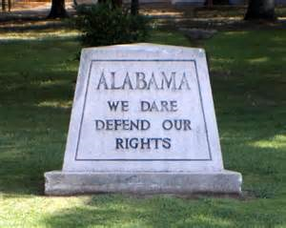
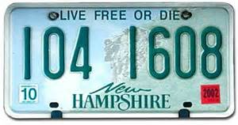
The world’s emphasis

Slide 7
Let’s look at what Jesus was quoting…
Leviticus 24: 17-22
¹⁷ “‘Anyone who takes the life of a human being is to be put to death. ¹⁸ Anyone who takes the life of someone’s animal must make restitution—life for life. ¹⁹ Anyone who injures their neighbor is to be injured in the same manner: ²⁰ fracture for fracture, eye for eye, tooth for tooth. The one who has inflicted the injury must suffer the same injury. ²¹ Whoever kills an animal must make restitution, but whoever kills a human being is to be put to death. ²² You are to have the same law for the foreigner and the native-born. I am the Lord your God.’”

Slide 8
The existence of rights is not questioned
The respect of our rights is clearly implied in the Law of Moses
They lead to good relationships
They lead to good citizenship

Slide 9
The existence of rights is not questioned
The respect of our rights is clearly implied in the Law of Moses
They lead to good relationships
They lead to good citizenship

Slide 10
What Jesus calls us to do
Willingly relinquish our rights of out love
Not fear
Not because we have no other choice
Just as Jesus showed us.

Slide 11
The marketing of the Savior to the world
We often market (sell) the world on the Savior with the positives of our faith
Restored relationships
Restored health
Restored finances
Overcoming struggles
And these are all valid

Slide 12
But the cost is world’s repercussions of Unconditional Love
Love without conditions

Slide 13
We do not use the word “unless” in our love
Unless
They started it
They are unworthy
They represent evil
You think I support their evil or position
They did not live up to their Christian claims
…

Slide 14
My love for my passions and beliefs must never exceed my love for you or the people in the world
I Corinthians 6
¹ If any of you has a dispute with another, do you dare to take it before the ungodly for judgment instead of before the Lord’s people? … ⁶ But instead, one brother takes another to court—and this in front of unbelievers!
⁷ The very fact that you have lawsuits among you means you have been completely defeated already. Why not rather be wronged? Why not rather be cheated?

