Slide 1
Welcome
We’re glad you’re with us!
GO

Slide 2
Class Will Begin In
The star of Bethlehem
Central class time
3 January 2021

Slide 3
The Return to Normalcy
The star of Bethlehem
Central class time
3 January 2021

Slide 4
Welcome
First class of the new year!
Continue to discussion started by Tom on how we, as people of faith, seek a return to TRUE normalcy.
TRUE normalcy is in direct contrast (and conflict) with what the world sees as normal
However, indulge me a mild tangent.

Slide 5
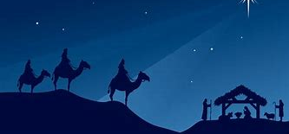
The Star of Bethlehem

Slide 6
Matthew 2:1-12
The real story of the star of Bethlehem is more fascinating than the traditional story. And more significant.
Shepherds and wise men did not show up the same night.
Wise men did not find Jesus (and Joseph/Mary) in the barn
This passage is the only place that this story is told.
Neither Mark nor John’s accounts even mention the birth of Jesus
Luke does not mention the wise men or the star.
Matthew’s gospel is focused on the Davidic kingship of Jesus.

Slide 7
The calling of the Magi (wise men) [Matthew 2:1-2]
Magi are Zoroastrian priests from Persia (modern day Iran). Hence “the east”.
Notice how specific the star’s meaning is given.
Born
King
Jews
That is a lot of information in a star!
The inquiry to King Herod implies
They expected King Herod to know that a king has been born and expected him to be joyful.
There has been some meaningful passage of time from the birth of Jesus to this inquiry.
The Magi no longer see the star or else they would follow it directly.
All these implications will need to be reinforced with Scripture
¹After Jesus was born in Bethlehem in Judea, during the time of King Herod, Magi from the east came to Jerusalem ² and asked, “Where is the one who has been born king of the Jews? We saw his star when it rose and have come to worship him.”

Slide 8
Herod seeks an answer to the inquiry [Matthew 2:3-6]
Upon hearing from the Magi that a Jewish king has been born, he assumes that the king being sought is the Messiah.
He probably realized that the king sought by the Magi was not born in Herod’s house.
That makes the newborn king a threat or usurper to King Herod.
The chief priests quote Micah 5:2,4 that the Messiah will be born in Bethlehem.
Presumably, the Magi did not consider the political ramifications of telling King Herod another king has been born.
Interestingly, the Magi (e.g., Gentiles) are excited about the Messiah but the Jewish king is not (as we shall soon see).
³When King Herod heard this he was disturbed, and all Jerusalem with him. ⁴ When he had called together all the people’s chief priests and teachers of the law, he asked them where the Messiah was to be born. ⁵ “In Bethlehem in Judea,” they replied, “for this is what the prophet has written:
⁶ “‘But you, Bethlehem, in the land of Judah, are by no means least among the rulers of Judah; for out of you will come a ruler who will shepherd my people Israel.”

Slide 9
What other scriptures from the OT describe the star? [Numbers 24:17-19]
This is just about all the prophecies concerning a star.
It references a person
No description of the star
Not enough information for the Magi to recognize what they saw with such specificity.
Then the question remains, how did the Magi recognize a star as “born, king, Jews”?
¹⁷ “I see him, but not now; I behold him, but not near. A star will come out of Jacob; a scepter will rise out of Israel. He will crush the foreheads of Moab, the skulls of all the people of Sheth. ¹⁸ Edom will be conquered; Seir, his enemy, will be conquered, but Israel will grow strong. ¹⁹ A ruler will come out of Jacob and destroy the survivors of the city.”

Slide 10
Herod seeks the date the Magi first saw the star [Matthew 2: 7-8]
It is interesting to note that the gospel account does not provide the answer given by the Magi to King Herod over the star’s first sighting.
King Herod, presumably with the date of the star answered, sends the Magi to Bethlehem with instructions to report to King Herod the Messiah’s location.
King Herod’s stated purpose is to worship the Messiah
King Herod’s true purpose was to murder the Messiah.
⁷ Then Herod called the Magi secretly and found out from them the exact time the star had appeared. ⁸ He sent them to Bethlehem and said, “Go and search carefully for the child. As soon as you find him, report to me, so that I too may go and worship him.”

Slide 11
The star appears a second time to the Magi [Matthew 2: 9-11]
The star now reappears to the Magi and stopped over the house that Joseph and Mary are now living in.
They then gave kingly gifts to Jesus.
⁹ After they had heard the king, they went on their way, and the star they had seen when it rose went ahead of them until it stopped over the place where the child was. ¹⁰ When they saw the star, they were overjoyed. ¹¹ On coming to the house, they saw the child with his mother Mary, and they bowed down and worshiped him. Then they opened their treasures and presented him with gifts of gold, frankincense and myrrh.

Slide 12
Both the Magi and Joseph are warned to flee King Herod [Matthew 2: 12-15]
The Magi return to Persia by a different route without responding to King Herod.
Joseph is warned in a dream to flee to Egypt which he does that very night.
Joseph, Mary, and Jesus will stay in Egypt until King Herod dies.
About a year.
What did they live on while in Egypt?
Gold, frankincense, and myrrh
In a tirade, King Herod murders all of the boys in Bethlehem 2-years old and younger according to the time the Magi first saw the star.
It is a reasonable assumption that King Herod increased the age of the boys to give a margin of error. In other words, it was probably less than 2 years since the Magi first saw the star.
¹² And having been warned in a dream not to go back to Herod, they returned to their country by another route.
¹³ When they had gone, an angel of the Lord appeared to Joseph in a dream. “Get up,” he said, “take the child and his mother and escape to Egypt. Stay there until I tell you, for Herod is going to search for the child to kill him.”
¹⁴ So he got up, took the child and his mother during the night and left for Egypt, ¹⁵ where he stayed until the death of Herod. And so was fulfilled what the Lord had said through the prophet: “Out of Egypt I called my son.”

Slide 13
Serious questions remain
Did the star first appear to the Magi on the very night Jesus was born? Earlier? Later?
How did the Magi know to interpret the star as a sign that the Messiah has been born?
Why would the Magi care?
Was the star miraculous in that God altered the physics of the world to cause the star to appear OR was the star the result of natural, albeit well timed, events?
What was the star exactly?
The questions have physical answers, but the spiritual question is this – Why did God tell the Persians that the Messiah has been born?

Slide 14
Star worship and sign seeking was forbidden under the Law of Moses
Deuteronomy 4:19
And when you look up to the sky and see the sun, the moon and the stars—all the heavenly array—do not be enticed into bowing down to them and worshiping things the Lord your God has apportioned to all the nations under heaven.
Jeremiah 8:2
They will be exposed to the sun and the moon and all the stars of the heavens, which they have loved and served and which they have followed and consulted and worshiped. They will not be gathered up or buried, but will be like dung lying on the ground.

Slide 15
And yet, God has spoken to foreign kings and foolish Jewish kings through such methods.
I Samuel 28
³ Now Samuel was dead, and all Israel had mourned for him and buried him in his own town of Ramah. Saul had expelled the mediums and spiritists from the land.
⁴ The Philistines assembled and came and set up camp at Shunem, while Saul gathered all Israel and set up camp at Gilboa. ⁵ When Saul saw the Philistine army, he was afraid; terror filled his heart. ⁶ He inquired of the Lord, but the Lord did not answer him by dreams or Urim or prophets. ⁷ Saul then said to his attendants, “Find me a woman who is a medium, so I may go and inquire of her.”
“There is one in Endor,” they said.
Ezekiel 21:21
For the king of Babylon will stop at the fork in the road, at the junction of the two roads, to seek an omen: He will cast lots with arrows, he will consult his idols, he will examine the liver.

Slide 16
God is speaking through the mythology/religion of the Gentiles.
The Jews were not prepared to read signs in the stars but the Gentiles (in this case, Persians) were able to read the star sign.
The Jews were given a different sign that the Messiah has arrived.
The angels called the shepherds.

Slide 17
I believe that the star was not a sign to the Jews that the Messiah has arrived. It was a sign to the Gentiles to come to the Savior.

Slide 18
The Star of Bethlehem: Miracle or Natural Occurrence?
I want to be clear. I believe that the star was deliberately placed in the sky in order to call the Gentiles to come to the Savior.
The question I have is this: Did God intervene and suspend the laws of physics to place the star OR did God use a natural event to be the star?
This question cannot be answered with Scripture. There is no answer, only speculation.
However, I offer this thought.

Slide 19
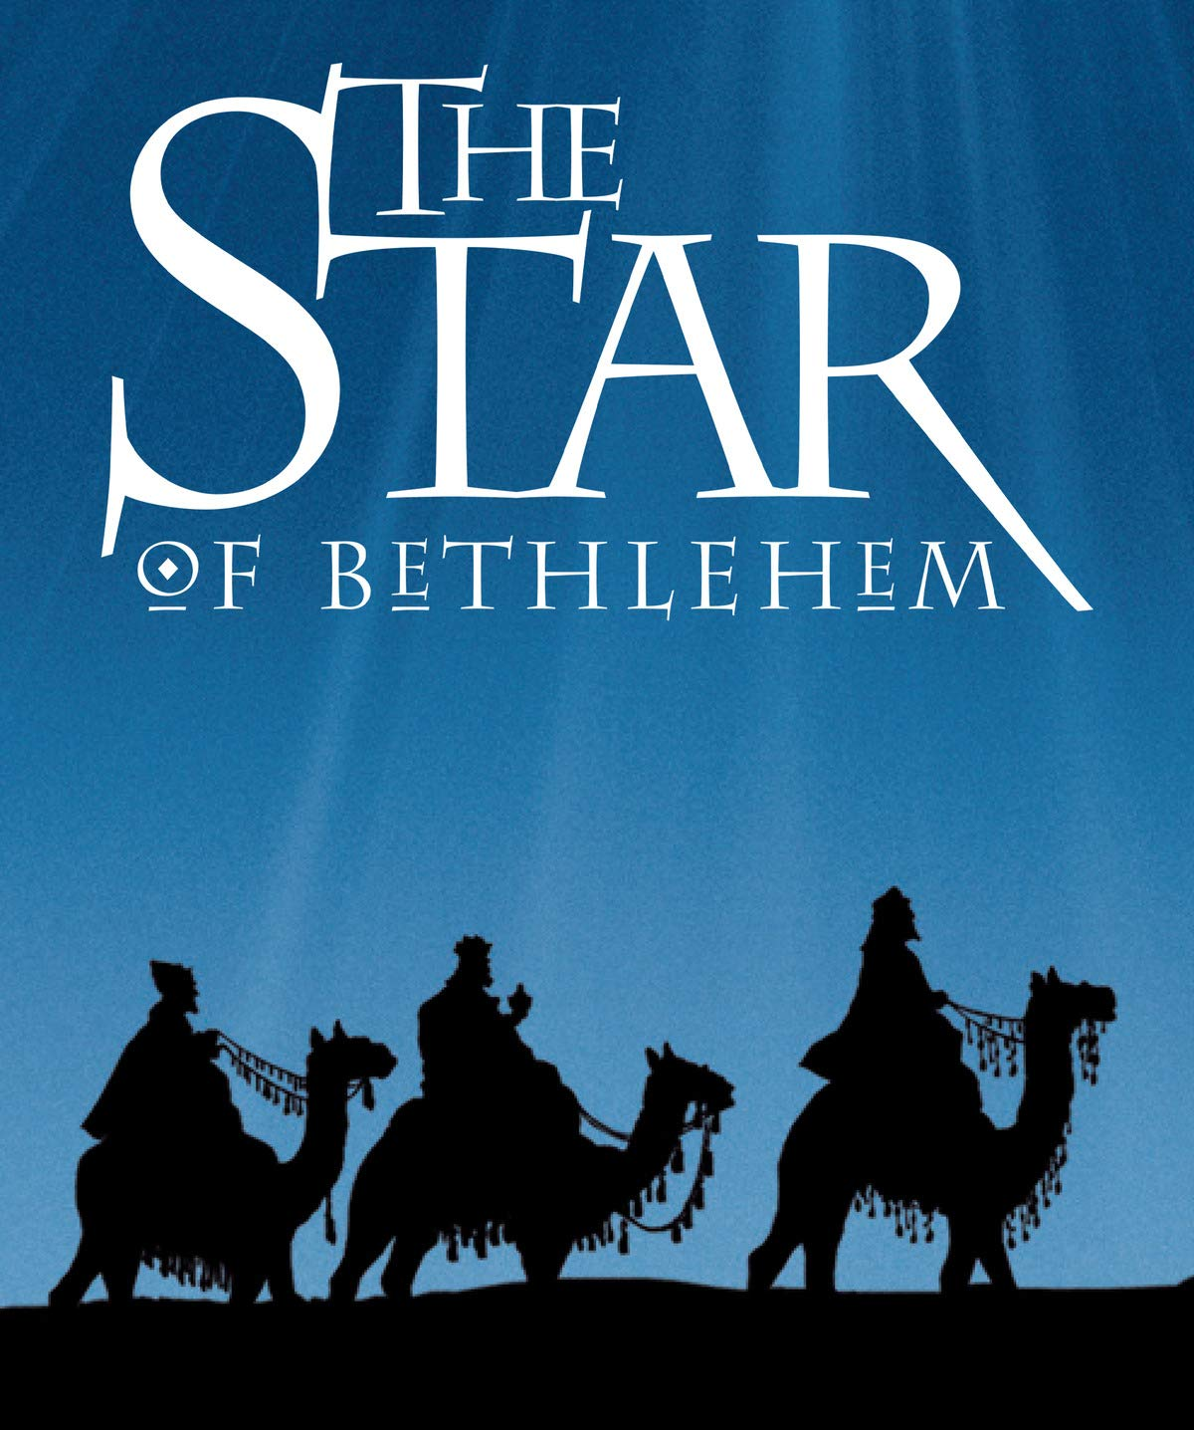
A case for the star being a natural event
Recommendation for your consideration.
“The Star of Bethlehem” video by Rick Larson
Makes the case for the star being a combination of planets and constellations appearing at the same time.
I personally take the view that the star was a natural event.

Slide 20
I believe that the star was a natural occurring event.
If true, it means that when God created the Universe, he set in motion the planets and stars to appear in the sky over the middle east the night that Jesus was born. God was planning on Jesus coming to save Man before Man was even created.

Slide 21
To the Jew first, and then the Gentile
Romans 1: 16-17
¹⁶ For I am not ashamed of the gospel, because it is the power of God that brings salvation to everyone who believes: first to the Jew, then to the Gentile. ¹⁷ For in the gospel the righteousness of God is revealed—a righteousness that is by faith from first to last, just as it is written: “The righteous will live by faith.”

Slide 22
Normal is that the descendants of Adam live in harmony with God, not just the descendants of Jacob.
Romans 1: 16-17
¹⁶ For I am not ashamed of the gospel, because it is the power of God that brings salvation to everyone who believes: first to the Jew, then to the Gentile. ¹⁷ For in the gospel the righteousness of God is revealed—a righteousness that is by faith from first to last, just as it is written: “The righteous will live by faith.”

