Slide 1
Welcome
We’re glad you’re with us!
GO

Slide 2
Class Will Begin In
Sermon – Allen Wright
Notes:
Three Minute Countdown

Slide 3
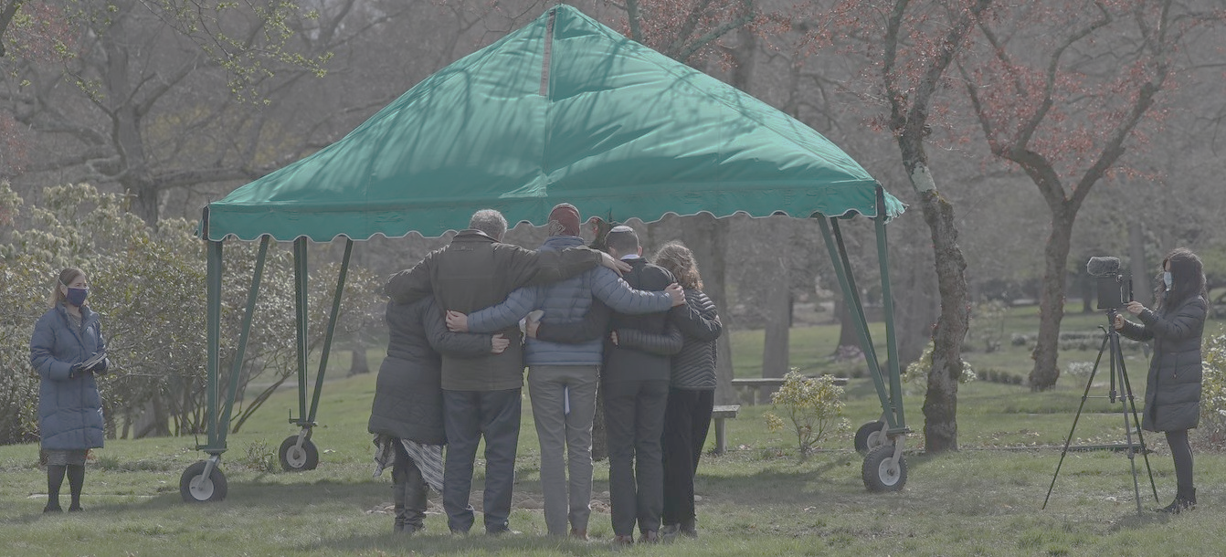
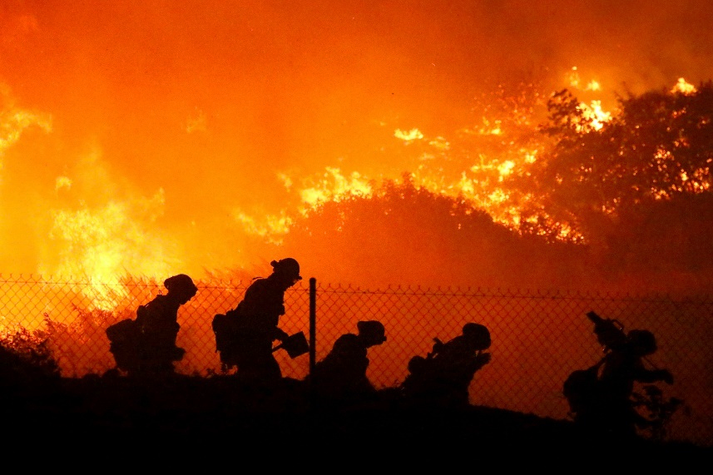
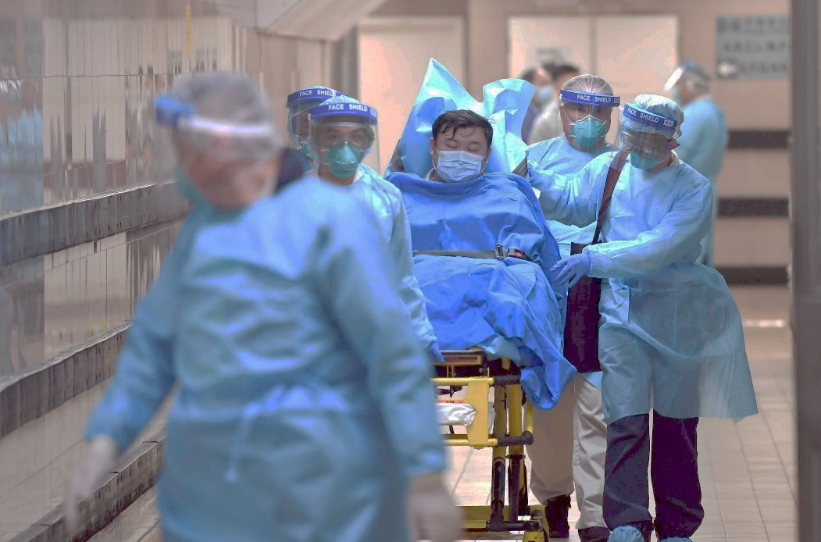
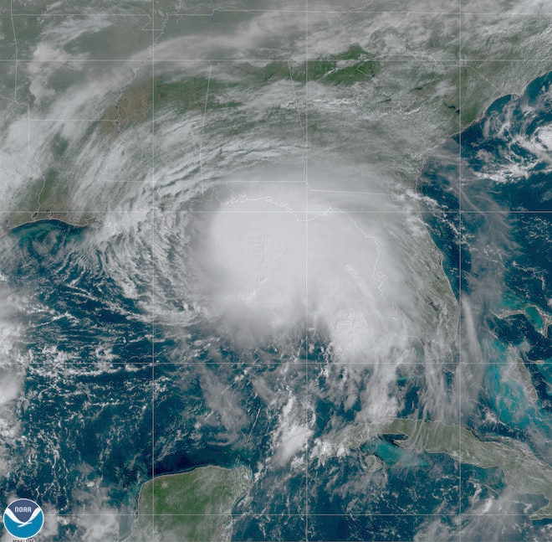
A Spiritual Debrief of our Social Crisis

Slide 9
“Joseph, son of David, do not fear to take Mary as your wife, for that which is conceived in her is from the Holy Spirit. She will bear a son, and you shall call his name Jesus, for he will save his people from their sins.”
Matthew 1:20-21

Slide 10
“Behold, the virgin shall conceive and bear a son, and they shall call his name Immanuel” (which means, God with us). Matthew 1:23
Isaiah 7:14

Slide 11
“For God so loved the world, that he gave his only Son, that whoever believes in him should not perish but have eternal life.” John 3:16

Slide 12
Jesus is God’s Normal

Slide 13
Jesus is the “With Us” God

Slide 14
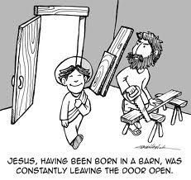
Jesus is the “With Us” God in
a) Charity
And she gave birth to her firstborn son and wrapped him in swaddling cloths and laid him in a manger, because there was no place for them in the inn. Luke 2:7

Slide 15
Jesus is the “With Us” God in
a) Charity
b) Compassion
And a leper came to him, imploring him, and kneeling said to him, “If you will, you can make me clean.” Moved with pity, he stretched out his hand and touched him and said to him, “I will; be clean.” And immediately the leprosy left him, and he was made clean Mark 1:40-42

Slide 16
Jesus is the “With Us” God in
a) Charity
b) Compassion
c) Comfort
Even though I walk through the valley of the shadow of death, I will fear no evil,
for you are with me; your rod and your staff, they comfort me. Psalm 23:4
And I will ask the Father, and he will give you another Helper, to be with you forever John 14:16
“These things I have spoken to you while I am still with you. But the Helper, the Holy Spirit, whom the Father will send in my name, he will teach you all things and bring to your remembrance all that I have said to you. Peace I leave with you; my peace I give to you. Not as the world gives do I give to you. Let not your hearts be troubled, neither let them be afraid. John 14:25-27

Slide 17
Jesus is the “With Us” God in
a) Charity
b) Compassion
c) Comfort
d) Continually
Be strong and courageous. Do not fear or be in dread of them, for it is the Lord your God who goes with you. He will not leave you or forsake you.” Deuteronomy 31:6
teaching them to observe all that I have commanded you. And behold, I am with you always, to the end of the age.” Matthew 28:20

Slide 18
Jesus is the “With Us” God in
a) Charity
b) Compassion
c) Comfort
d) Continually

Slide 20
God’s Normal is Jesus, the “With Us” God who calls us to “With Us” ministry.

