Slide 1
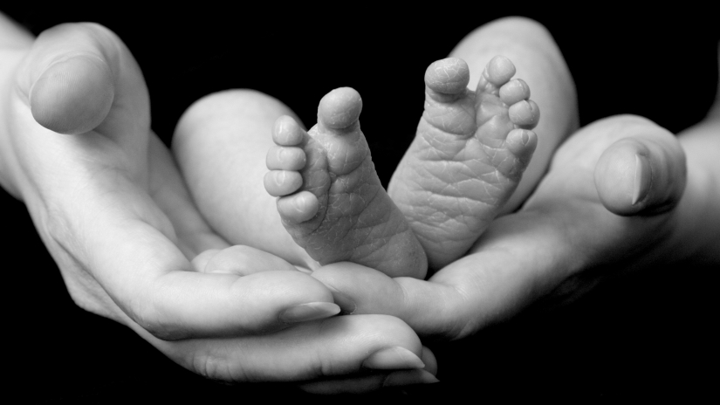
God’s Good is God’s Best
What God wants in your life
Romans 8:29-30

Slide 2
For those God foreknew he also predestined to be conformed to the likeness of his Son, that he might be the firstborn among many brothers. And those he predestined, he also called; those he called, he also justified; those he justified, he also glorified.
Romans 8:29-30

Slide 3
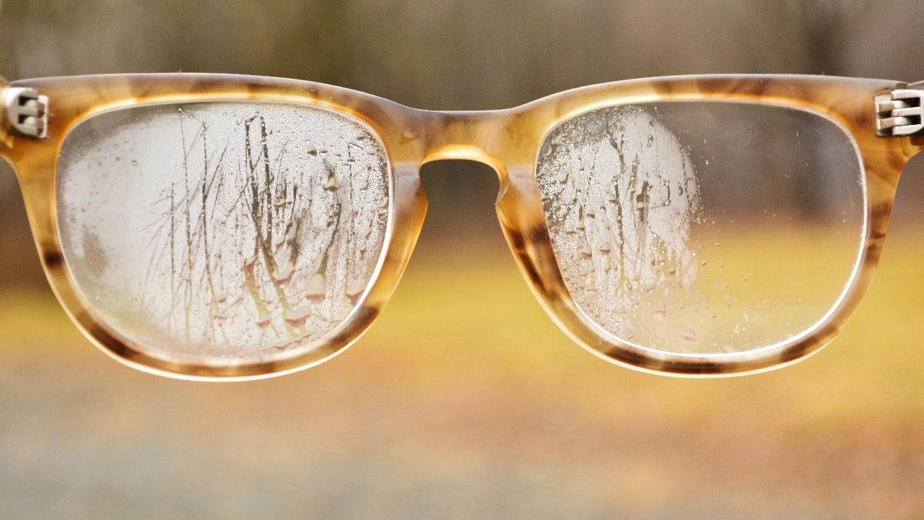
Two Traditional Understandings
Calvinistic
Arminius
God “foreordained” everyone’s eternal destiny
Everyone is a sinner
God draws them
to himself
God “predestined” that a select group would be saved.
People must choose
Everyone is a born sinner

Slide 4
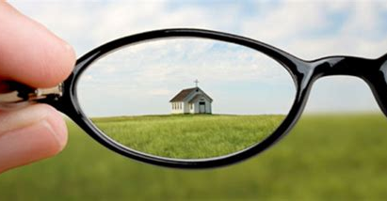
Based on context: “for” a linking word tying it to v. 28
3rd Option
An understanding of these verses should be encouraging
Diverting into ‘theology’ doesn’t make sense

Slide 5
“Foreknew”
Known before: Acts 26:5; 2 Pet. 3:17
“Predestined”
Pre-determined a certain thing
“Called”
3rd Option
Summon, invite
“Justified”
Just as if you had never sinned
Key: Past Tense
Talking about the godly
recorded in Old Testament
“Glorified”
Honor, value

Slide 6
“Conformed to the likeness of his Son”
These were all commended for their faith, yet none of them received what had been promised. God had planned
something better for us so that only together with us would they be made perfect ~ Heb. 11:39,40
God’s Good is God’s Best
Let us fix our eyes on Jesus, the author and perfecter of our faith~ Heb. 12:2
Conformity is learning to “mirror” the character of Christ

Slide 7
I urge, then, first of all, that petitions, prayers,
intercession and thanksgiving be made for all people - for kings and all those in authority, that we may live peaceful and quiet lives in all godliness and holiness.
This is good, and pleases God our Savior,
who wants all people to be saved and to come to a knowledge of the truth. For there is one God and one mediator between God and mankind, the man Christ Jesus, who gave himself as a ransom for all people.
1 Timothy 2:1-6

Slide 8
On top of all this we know that God blends together everything in our lives; all the ups and downs,
from the sublime to the horrid and like a
Master Chef his final product for us is “Good.”
This is for God-lovers, those who have heard God’s call and are day-by-day and step-by-step moving
resolutely toward his ultimate purpose.
v. 28

Slide 9
Here’s proof: observe those God knew in times past.
He determined that their behavior would change
into a mirror-like resemblance of his Son. His Son would thus lead a numberless family of brothers and sisters who would follow in his wake
v. 29

Slide 10
These ones whom God previously determined
to live in such a way, he invited and summoned them into this relationship. Those “called ones” he thus credited them with the status of “just-as-if-they-had-never-sinned” and these “saved ones” he deemed “glorious,” highly esteemed and of great value.
v.30

