Slide 1
Welcome
We’re glad you’re with us!
GO

Slide 2
Class Will Begin In
Sermon – Allen Wright
Notes:
Three Minute Countdown

Slide 3
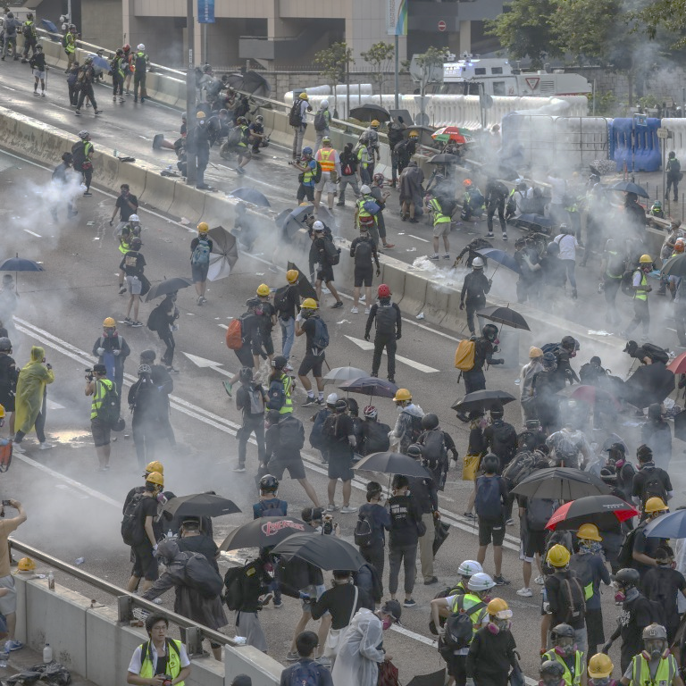
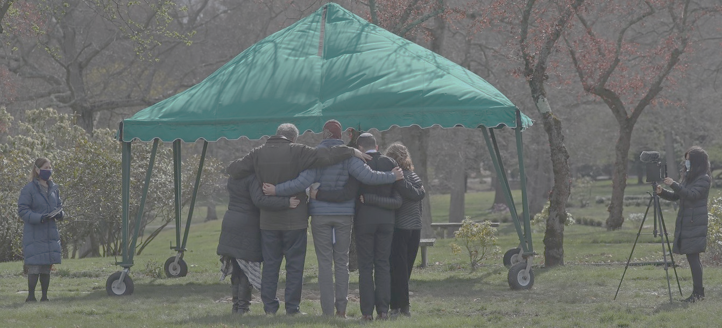
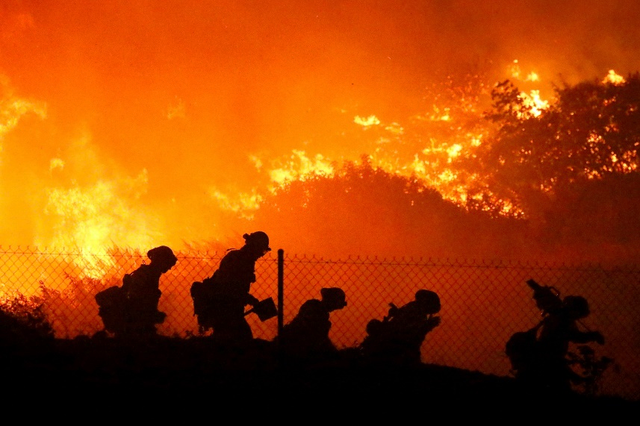
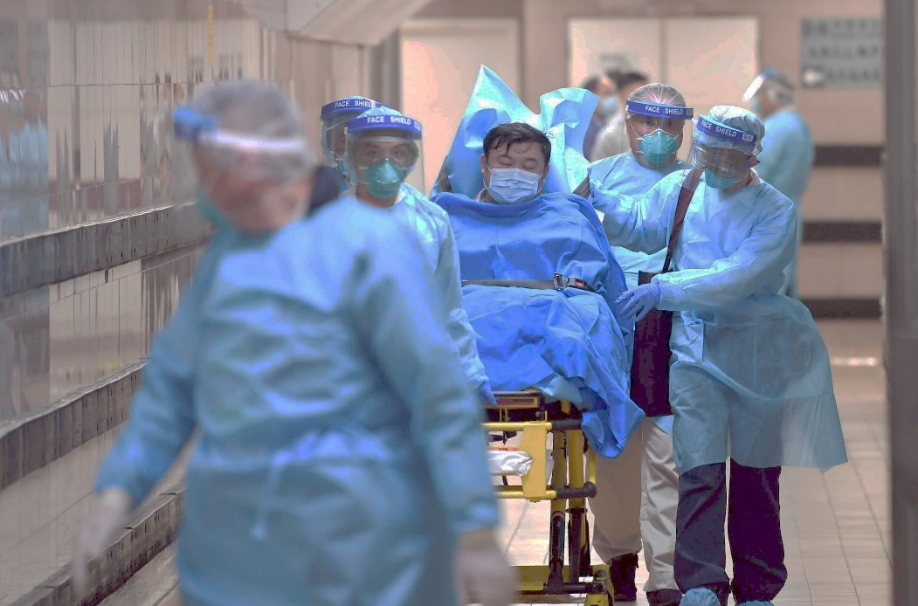
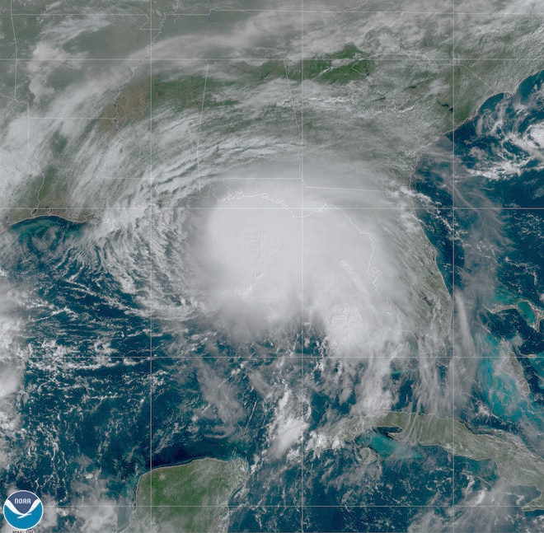
A Spiritual Debrief of our Social Crisis

Slide 4
“The Normal Christian Life”

Slide 5
What is Normal?

Slide 6
Suffering Is Normal

Slide 7
Beloved, do not be surprised at the fiery trial when it comes upon you to test you, as though something strange were happening to you. But rejoice insofar as you share Christ's sufferings, that you may also rejoice and be glad when his glory is revealed. 1 Peter 4:12,13

Slide 8
From that time Jesus began to show his disciples that he must go to Jerusalem and suffer many things from the elders and chief priests and scribes, and be killed, and on the third day be raised. And Peter took him aside and began to rebuke him, saying, “Far be it from you, Lord! This shall never happen to you.” But he turned and said to Peter, “Get behind me, Satan! You are a hindrance to me. For you are not setting your mind on the things of God, but on the things of man.” Matthew 16:21-23
Then Jesus told his disciples, “If anyone would come after me, let him deny himself and take up his cross and follow me. For whoever would save his life[a] will lose it, but whoever loses his life for my sake will find it. For what will it profit a man if he gains the whole world and forfeits his soul? Or what shall a man give in return for his soul?.” Matthew 16:24-26
“The Path to Glory is Through Suffering”

Slide 9
“The Path to Glory is Through Suffering”
But we see him who for a little while was made lower than the angels, namely Jesus, crowned with glory and honor because of the suffering of death, so that by the grace of God he might taste death for everyone. For it was fitting that he, for whom and by whom all things exist, in bringing many sons to glory, should make the founder of their salvation perfect through suffering. Hebrews 2:9,10
And he said to them, “O foolish ones, and slow of heart to believe all that the prophets have spoken! Was it not necessary that the Christ should suffer these things and enter into his glory?” And beginning with Moses and all the Prophets, he interpreted to them in all the Scriptures the things concerning himself. Luke 24:25-27

Slide 10
“The Path to Glory is Through Suffering”
Acts 17:3 – explaining and proving that it was necessary for the Christ to suffer and to rise from the dead, and saying, “This Jesus, whom I proclaim to you, is the Christ.”
Acts 3:8 – “that His Christ would suffer”
Acts 26:23 – that the Christ must suffer and that, by being the first to rise from the dead, he would proclaim light both to our people and to the Gentiles.

Slide 11
For to this you have been called, because Christ also suffered for you, leaving you an example, so that you might follow in his steps. He committed no sin, neither was deceit found in his mouth. When he was reviled, he did not revile in return; when he suffered, he did not threaten, but continued entrusting himself to him who judges justly. 1 Peter 2:21-23

Slide 12
From Suffering to Glory
A. Suf fering Reveals Glory
Do all things without grumbling or disputing, that you may be blameless and innocent, children of God without blemish in the midst of a crooked and twisted generation, among whom you shine as lights in the world Philippians 2:14,15
“When we long for life without difficulties, remind us that oaks grow strong in contrary winds and diamonds are made under pressure” – Peter Marshall (Chaplain of U.S. Senate 1947-1949)

Slide 14
From Suffering to Glory
A. Suf fering Reveals Glory
B. Suffering Prepares for Glory
Although he was a son, he learned obedience through what he suffered. Hebrews 5:8
C. Suf fering Anticipates Glory
From now on, therefore, we regard no one according to the flesh. Even though we once regarded Christ according to the flesh, we regard him thus no longer. Therefore, if anyone is in Christ, he is a new creation. The old has passed away; behold, the new has come. All this is from God, who through Christ reconciled us to himself and gave us the ministry of reconciliation; 2 Corinthians 5:16-18
“This is God’s universal purpose for all Christian suffering: More contentment in God and less satisfaction in the world.”

Slide 15
Consider it pure joy, my brothers and sisters, whenever you face trials of many kinds, because you know that the testing of your faith produces perseverance. Let perseverance finish its work so that you may be mature and complete, not lacking anything.. James 1:2-4

Slide 16
Jesus is God’s Original Normal for Us.

