Slide 1
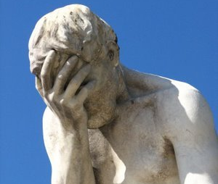
Hopeful Groaning
Romans 8:22-25

Slide 2
We know that the whole creation has been groaning
as in the pains of childbirth right up to the present time. Not only so, but we ourselves, who have the firstfruits of the Spirit, groan inwardly as we wait eagerly for our adoption as sons, the redemption
of our bodies. For in this hope we were saved.
But hope that is seen is no hope at all.
Who hopes for what he already has?
But if we hope for what we do not
yet have, we wait for it patiently.
Romans
Romans
8:22-25
8:22-25

Slide 3
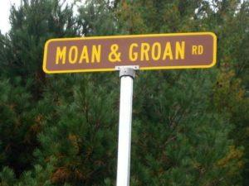
He looked up to heaven and with a deep sigh said to him….Mark 7:34
“All the creation is groaning together in a great symphony of sighs.”
Don’t grumble with each other… James 5:9
Childbirth ~ Not death throes
Obey them so that their world will be a joy, not a burden Heb. 13:17
What kind of groaning
is going
on?

Slide 4
Firstfruits of the Spirit
Our
Great
Hope
Causes a great longing
HOPE:
look forward with great expectation
Our Adoption
The Redemption
of our Bodies

Slide 5
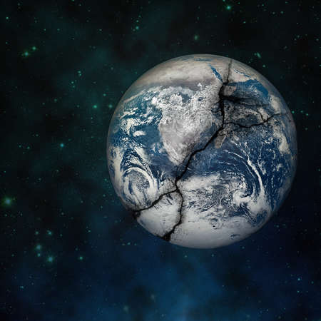
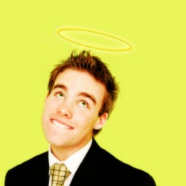
So heavenly focused that we are of no earthly good?

Slide 6
Now, on the basis of hope, the creation lives in a sure and certain expectation that it will be emancipated from this slavery of decay and destruction that now runs rampant all through its system and will one day merge into the freedom of the glory of the children of God.
For it is as plain as the nose on your face that every
part of creation is intensely unsettled in a chorus of groanings and sighs, like early contractions anticipating childbirth…
and it’s happening right now.

Slide 7
Not only the creation but even more, we ourselves! While possessing the Spirit as a ‘first-fruits,’ a foretaste of what is to come, we have a heartache and a longing; an “I-can’t-wait-for-it-to-happen” excitement for our final adoption to be completed by that glorious ransoming of our bodies.

Slide 8
For when we were saved, we were convinced of these wonderous expectations. We call it “hope.” And don’t expect in this world to see these expectations – it wouldn’t be expectation any longer, would it?
If, however, we can’t see what we know is going to happen,
we can bravely endure trying times while waiting in such excitement that we can hardly sit still.

