Slide 1
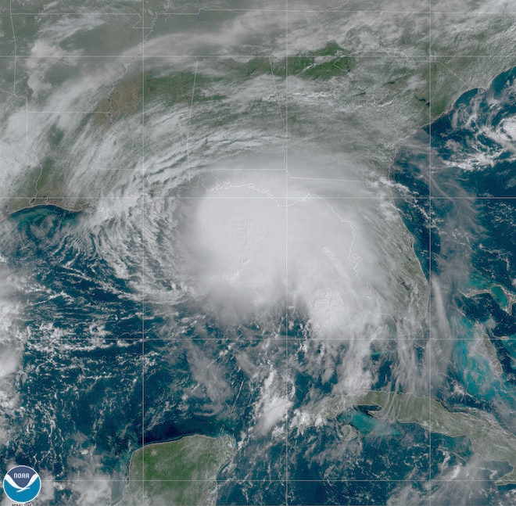
A Spiritual Debrief of our Social Crisis

Slide 2
Until we all attain to the unity of the faith and of the knowledge of the Son of God, to mature manhood, to the measure of the stature of the fullness of Christ, so that we may no longer be children, tossed to and fro by the waves and carried about by every wind of doctrine, by human cunning, by craftiness in deceitful schemes
-- Ephesians 4:13-14

Slide 3
If any of you lacks wisdom, let him ask God, who gives generously to all without reproach, and it will be given him. But let him ask in faith, with no doubting, for the one who doubts is like a wave of the sea that is driven and tossed by the wind. For that person must not suppose that he will receive anything from the Lord; he is a double-minded man, unstable in all his ways. -- James 1:5-8

Slide 4
We have this as a sure and steadfast anchor of the soul, a hope that enters into the inner place behind the curtain, where Jesus has gone as a forerunner on our behalf, having become a high priest forever after the order of Melchizedek. -- Hebrews 6:19,20

Slide 5
“Anchor Versus Cultural Currents”

Slide 7
Therefore we must pay much closer attention to what we have heard, lest we drift away from it.
-- Hebrews 2:1

Slide 8
“Anchor Versus Cultural Currents”

Slide 9
“Anchor Versus Heart Winds”

Slide 10
“Some of us measure our insides to everyone else’s outsides”

Slide 11
“Anchor Deep In Jesus”

Slide 12
Blessed is the man who
WALKS not in the counsel of the wicked, nor
STANDS in the way of sinners, nor SITS in the seat of scoffers; -- Psalm 1:1

Slide 13
but his delight is in the law of the Lord, and on his law he meditates day and night. -- Psalm 1:2

Slide 14
He is like a tree planted by streams of water that yields its fruit in its season, and its leaf does not wither.
In all that he does, he prospers. -- Psalm 1:3

Slide 15
The wicked are not so but are like chaff that the wind drives away.
-- Psalm 1:4

Slide 16
“Let Jesus Be The Anchor of Your Soul.”

