Slide 1
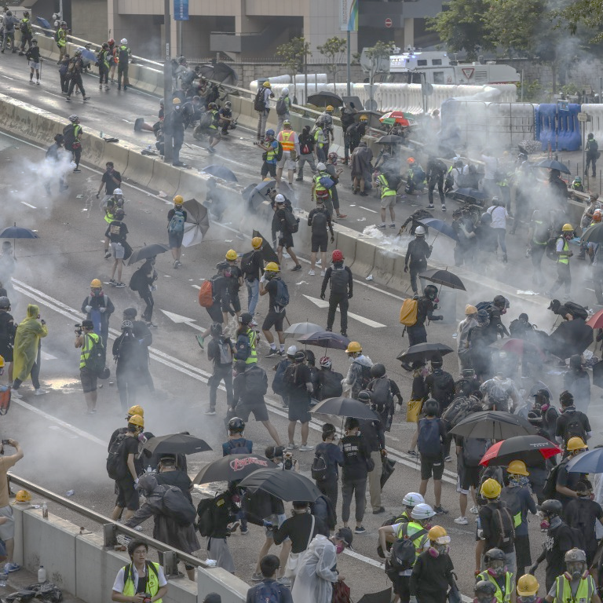
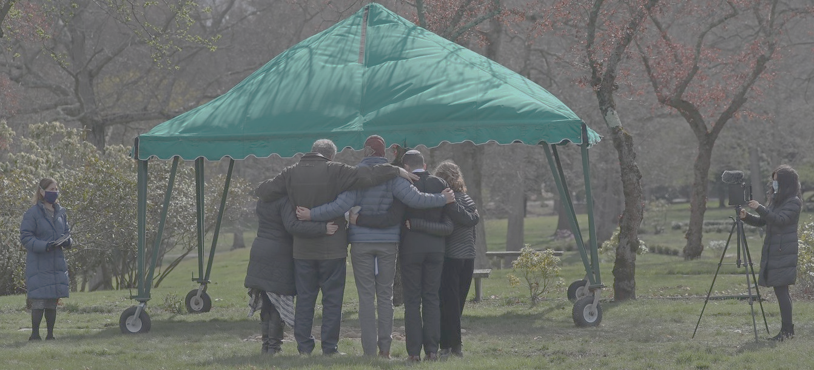
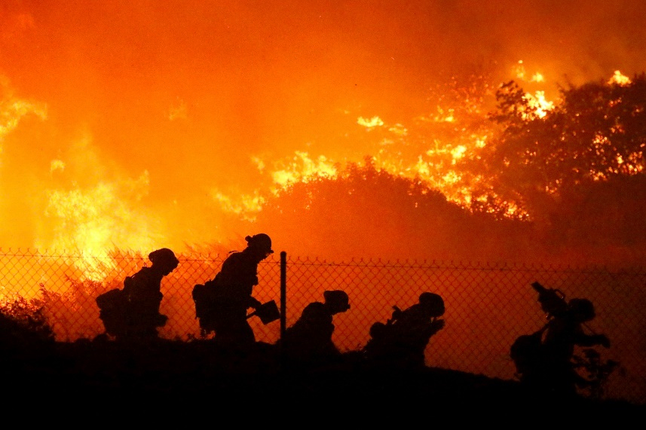
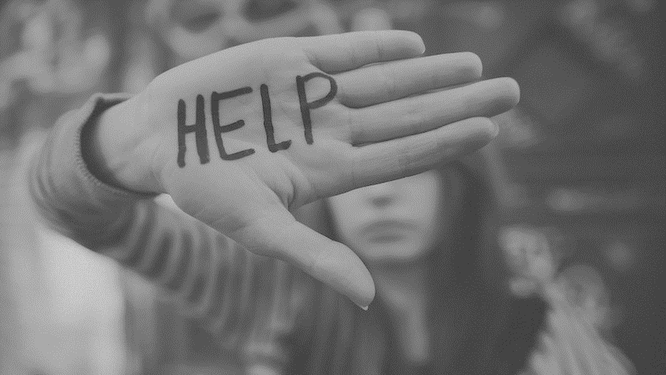
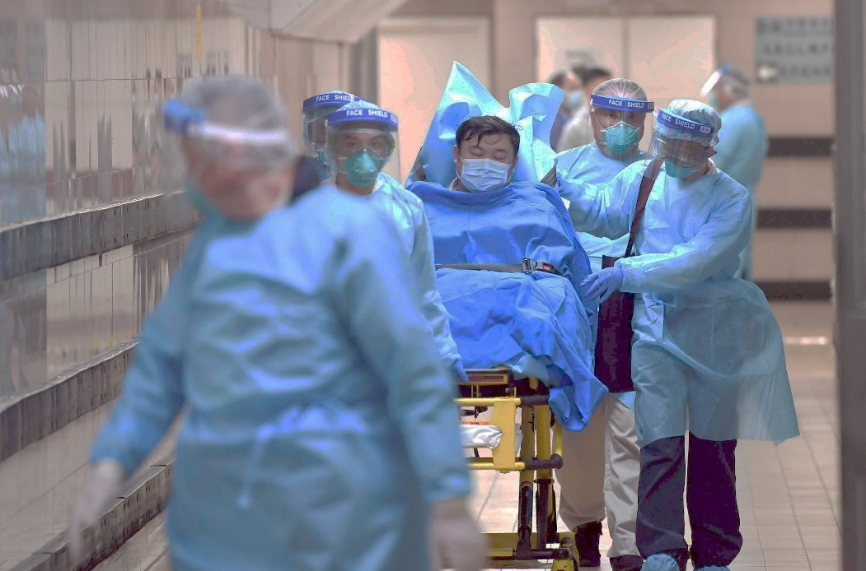
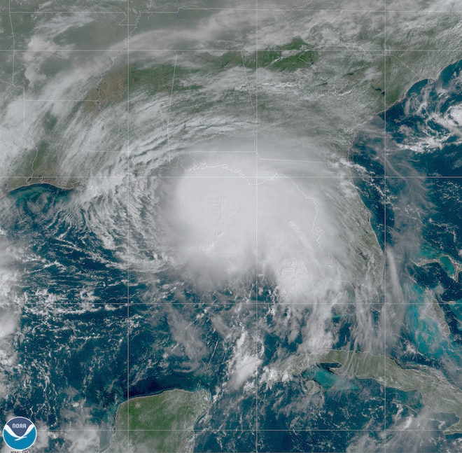
A Spiritual Debrief of our Social Crisis

Slide 2
“Sovereign Lord, who made the heaven and the earth and the sea and everything in them, -- Acts 4:24

Slide 3
And now, Lord, look upon their threats and grant to your servants to continue to speak your word with all boldness, while you stretch out your hand to heal, and signs and wonders are performed through the name of your holy servant Jesus -- Acts 4:29,30

Slide 4
“Look around and be distressed, Look within and be depressed, Look to Jesus and be at rest.”
- Corrie Ten Boom
Author: “The Hiding Place”
Holocaust Survivor

Slide 5
Addiction is when the consumer becomes consumed

Slide 6
For whatever overcomes a person, to that he is enslaved.
-- II Peter 2:19

Slide 7
What Consumes You?

Slide 8
The light shines in the darkness, and the darkness has not overcome it. -- John 1:5

Slide 9
I have said these things to you, that in me you may have peace. In the world you will have tribulation. But take heart; I have overcome the world. -- John 16:33

Slide 10
Will you be overcome or will you overcome through Him?

Slide 11
For everyone who has been born of God overcomes the world. And this is the victory that has overcome the world--our faith. Who is it that overcomes the world except the one who believes that Jesus is the Son of God? -- I John 5:4-5

Slide 12
God, for it is written, “Vengeance is mine, I will repay, says the Lord.” To the contrary, “if your enemy is hungry, feed him; if he is thirsty, give him something to drink; for by so doing you will heap burning coals on his head.” Do not be overcome by evil, but overcome evil with good.
-- Romans 12:16-21

Slide 13
No, in all these things we are more than conquerors through him who loved us. For I am sure that neither death nor life, nor angels nor rulers, nor things present nor things to come, nor powers, nor height nor depth, nor anything else in all creation, will be able to separate us from the love of God in Christ Jesus our Lord.
-- Romans 8:37-39

Slide 14
Is Jesus Your Lord?

