Slide 1
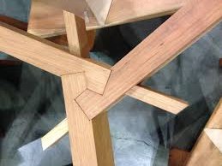
Joint witnesses; Joint Heirs;
Joint Sufferers;
Joint Glory
Romans 8:16-17
Witnesses
Heirs
Glory
Sufferers

Slide 2
How Do I Know I’m A Child Of God?
“Live according to the Spirit” and “led by the Spirit”
Your conduct
2) “Abba, Father”
Your emotional response

Slide 3
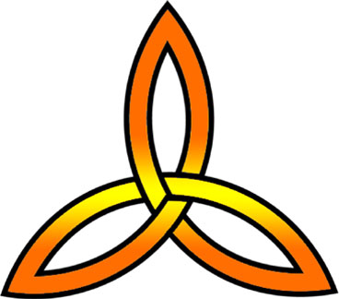
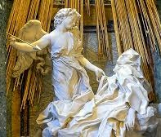
“With” or “to”?
Father
Joint witnesses
Son
“With”
our spirit is testifying along with the HS (perhaps to God and perhaps to others) that we are sons of God.
Holy Bible
The Spirit himself testifies with our spirit that we are God’s children 8:16
“To”
For the Holy Spirit makes God’s fatherhood real to us as he whispers into our innermost being, “You are God’s beloved child!

Slide 4
Joint Heirs
Not “iffy” but certainty
Whatever Christ inherited
we inherit ~ Heb. 1:2,4
Now if we are children, then we are heirs – heirs of God and co-heirs with Christ 8:17a
Dear friends, now we are children of God, and what we will be has not yet been made known. But we know that when he appears, we shall be like him, for we shall see him as he is.
~ 1 John 3:2

Slide 5
Joint Sufferers
Not “iffy” but certainty
You cannot live without suffering
For it is commendable if a man bears up under the pain of unjust sufferings because he is conscious of God…but if you suffer for doing good and you endure it, this is commendable before God...to this you were called, because Christ suffered for you, leaving you an example, that you should follow in his steps ~ 1 Pet. 2:19-23
…if indeed we share in his sufferings… 8:17b

Slide 6
What is my spirit saying?
What does the Holy Spirit say?
Are we joined in agreement?

Slide 7
When my heart was grieved and my spirit embittered,
I was senseless and ignorant; I was a brute beast before you.
Yet I am always with you; you hold me by my right hand.
You guide me with your counsel,
and afterwards you will take me into glory.
Whom have I in heaven but you?
And earth has nothing I desire besides you.
My flesh and my heart may fail,
but God is the strength of my heart and my portion forever
Psalms 73:21-26

Slide 8
For all those who are walking hand-in-hand
with the Spirit, going from one daily fight with
Self to the next, ever moving toward Christlikeness – these (and only these) are sons and daughters of God.

Slide 9
Because you are sons and daughters of God you absolutely did not clasp, as you once did,
to a disposition of slavish fear.
On the contrary, you embraced the
temperament of an adoptive child in which
the whole of your being swells up in a cry of joy,
“Oh, Daddy, Father!”

Slide 10
The Holy Spirit himself daily stands as a co-witness with our spirit in the court of heaven and earth declaring: “Children of God!”
Since we are indeed children of God, we have an inheritance – a portion of God himself! We have a joint inheritance with Christ as we jointly suffer with him to the culminating time of joint glorification with him.

