Slide 1
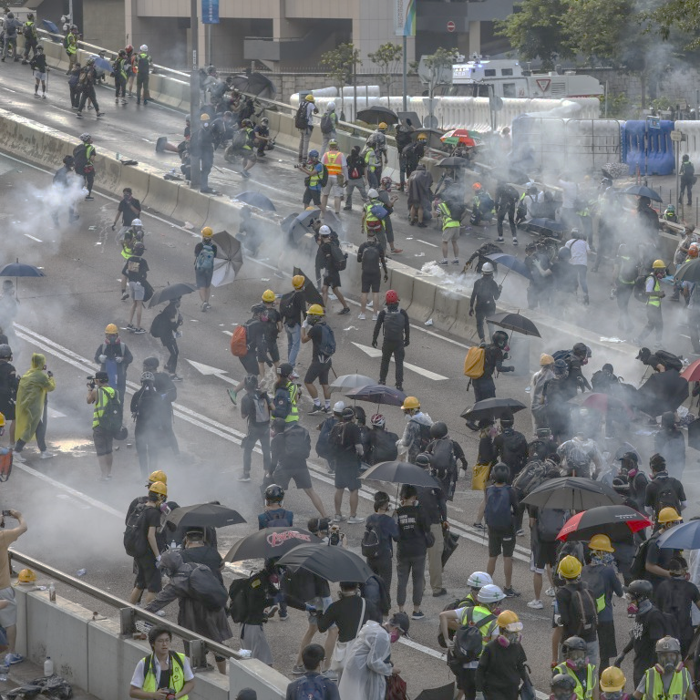
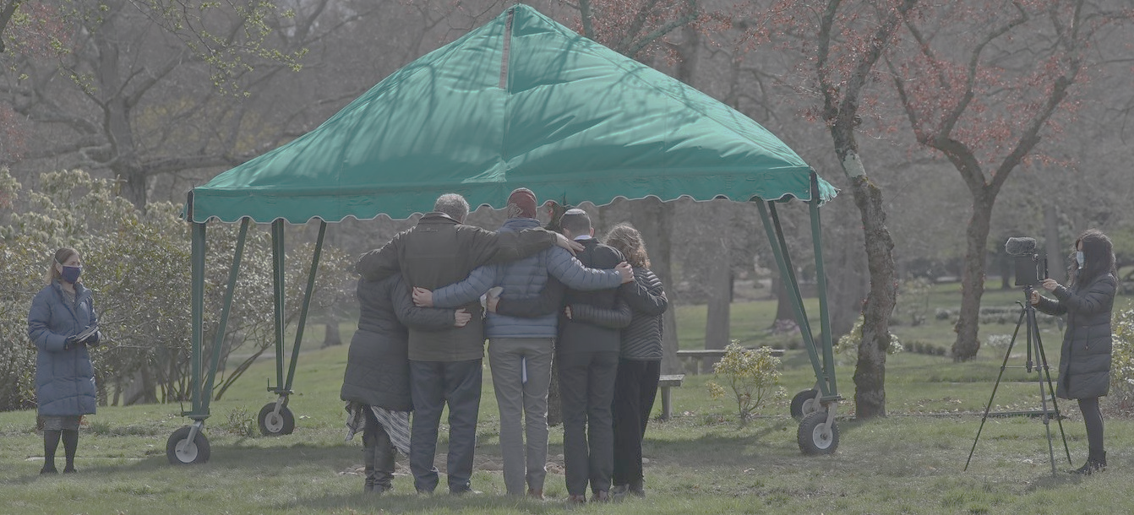
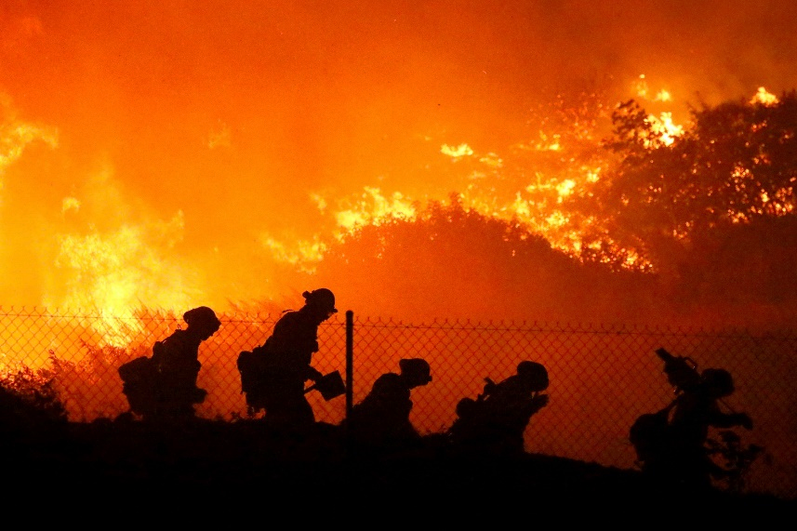
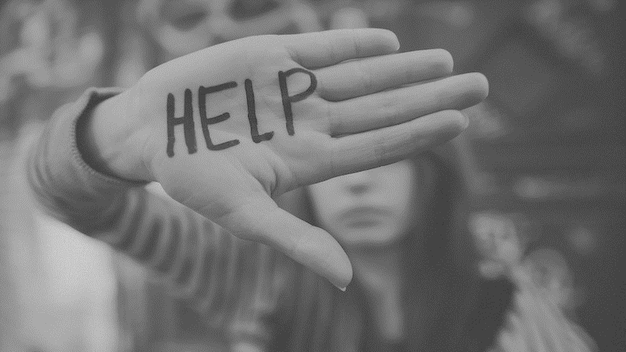
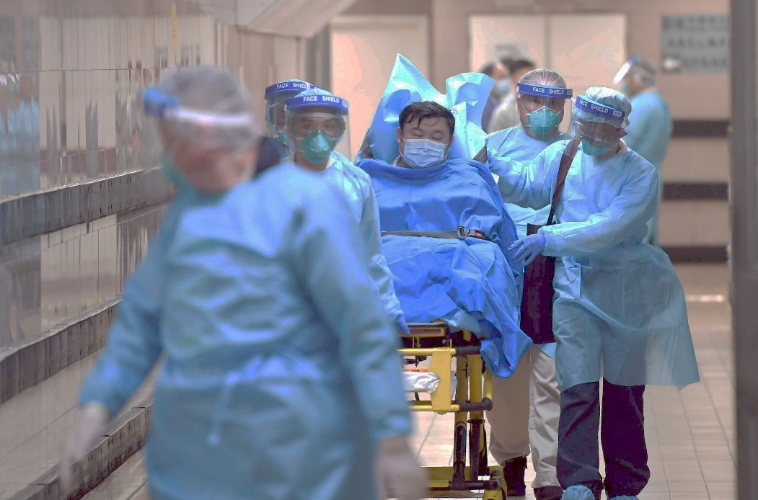
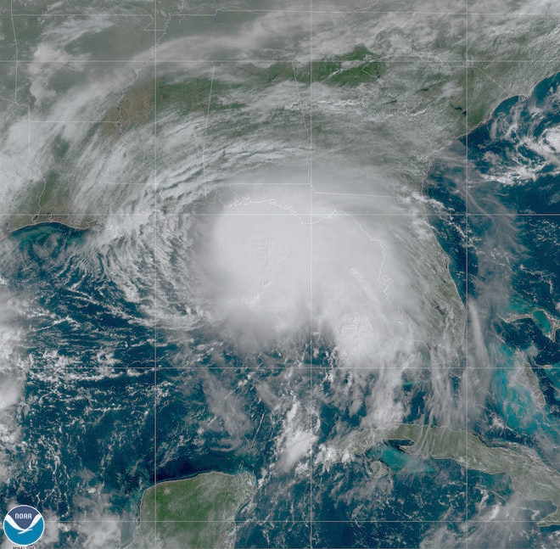
A Spiritual Debrief of our Social Crisis

Slide 2
You Live What You Believe

Slide 3
Global Pandemic
(99% mild) (1% serious, critical)
Deaths Worldwide : 1,130,550
COVID Cases : 41,094,667
US : 219,499
Cases : 8,188,585

Slide 4
He also who had received the one talent came forward, saying, ‘Master, I knew you to be a hard man, reaping where you did not sow, and gathering where you scattered no seed, so I was afraid, and I went and hid your talent in the ground. Here, you have what is yours.’
– Matthew 25:24,25

Slide 5
But his master answered him, ‘You wicked and slothful servant! You knew that I reap where I have not sown and gather where I scattered no seed? – Matthew 25:26

Slide 6
Paralyzing Fear is what leads to Addiction

Slide 7
What Should We Do With Our Fear?

Slide 8
Have I not commanded you? Be strong and courageous. Do not be frightened, and do not be dismayed, for the Lord your God is with you wherever you go.” – Joshua 1:9

Slide 9
Courage is not the absence of Fear but the confronting of Fear with Faith

Slide 10
Then David said to the Philistine, “You come to me with a sword and with a spear and with a javelin, but I come to you in the name of the Lord of hosts, the God of the armies of Israel, whom you have defied. This day the Lord will deliver you into my hand, and I will strike you down and cut off your head. And I will give the dead bodies of the host of the Philistines this day to the birds of the air and to the wild beasts of the earth, that all the earth may know that there is a God in Israel, – 1 Samuel 17:45,46

Slide 11
You Live What You Believe
“Then if you want to change your Living you must change what you are believing”

Slide 12
Your life reveals your faith.

Slide 13
fear not, for I am with you; be not dismayed, for I am your God; I will strengthen you, I will help you, I will uphold you with my righteous right hand. -- Isaiah 41:10

Slide 14
Fear Not . . .
Presence :
“For I am with you.”

Slide 15
Even though I walk through the valley of the shadow of death, I will fear no evil, for you are with me; your rod and your staff, they comfort me -- Psalm 23:4

Slide 16
Have I not commanded you? Be strong and courageous. Do not be frightened, and do not be dismayed, for the Lord your God is with you wherever you go.” -- Joshua 1:9

Slide 17
Fear Not . . .
Prominence :
“I am your God.”

Slide 18
But the Lord is in his holy temple; let all the earth keep silence before him.” -- Habakkuk 2:20

Slide 19
Fear Not . . .
Power :
“I will strengthen you.”

Slide 20
Little children, you are from God and have overcome them, for he who is in you is greater than he who is in the world. -- 1 John 4:4
and what is the immeasurable greatness of his power toward us who believe, according to the working of his great might that he worked in Christ when he raised him from the dead and seated him at his right hand in the heavenly place -- Ephesians 1:19,20
that according to the riches of his glory he may grant you to be strengthened with power through his Spirit in your inner being. -- Ephesians 3:16

Slide 21
Fear Not . . .
Provision :
“I will help you.”

Slide 22
“Give us this day our daily bread” -- Matthew 6:11
Jesus said to them, “I am the bread of life; whoever comes to me shall not hunger, and whoever believes in me shall never thirst” -- John 6:35

Slide 23
Fear Not . . .
Protection :
“I will uphold you.”

Slide 24
At that time the disciples came to Jesus, saying, “Who is the greatest in the kingdom of heaven?” And calling to him a child, he put him in the midst of them and said, “Truly, I say to you, unless you turn and become like children, you will never enter the kingdom of heaven. Whoever humbles himself like this child is the greatest in the kingdom of heaven -- Matthew 18:1-4

Slide 25
“Sovereign Lord, who made the heaven and the earth and the sea and everything in them, -- Acts 4:24

Slide 26
And now, Lord, look upon their threats and grant to your servants to continue to speak your word with all boldness, while you stretch out your hand to heal, and signs and wonders are performed through the name of your holy servant Jesus, -- Acts 4:29,30

Slide 27
“May the Sovereign Lord Fill You with Boldness As You Face Your Fears In Faith”

