Slide 1
Holding God’s Hand – Being led by the Spirit
Romans 8:14

Slide 2
…because those who are led
by the Spirit of God are sons of God
Romans 8:14

Slide 3
“Are being
led along “
Those who kill sin in their lives are being led by the Spirit

Slide 4
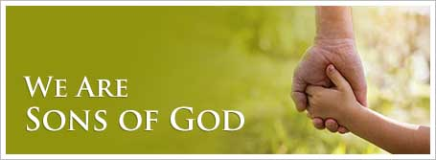
and daughters
We are his sons and daughters:
this is motivation for living according to the Spirit
and not according to the flesh.

Slide 5
Don’t let your primary leading of the spirit be urges or feelings.
Your primary leading is through reading Scripture and applying it in the moment
When you do have an urge or feeling make sure it doesn’t conflict with Scriptures
Know that being led doesn’t always result in what I think are positive results

Slide 6
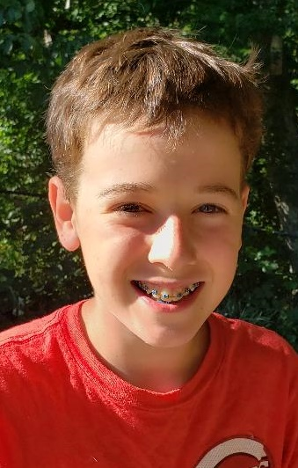
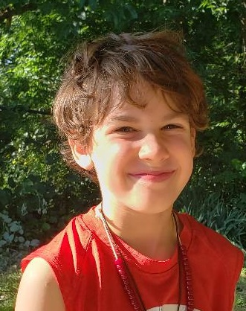
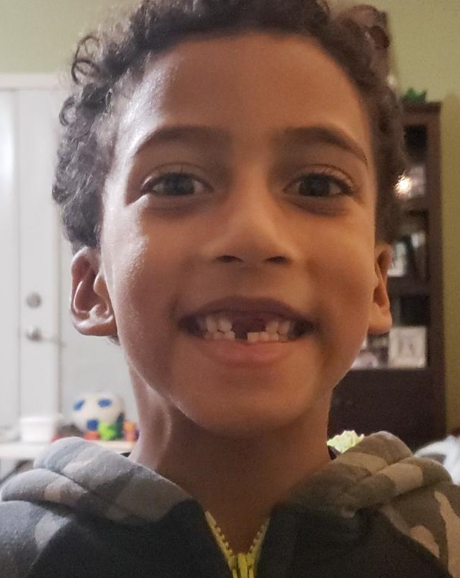
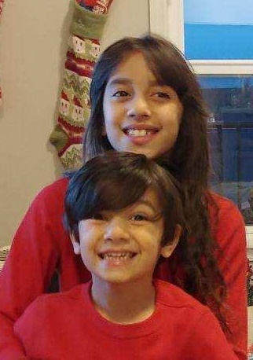
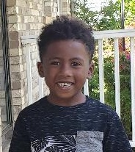
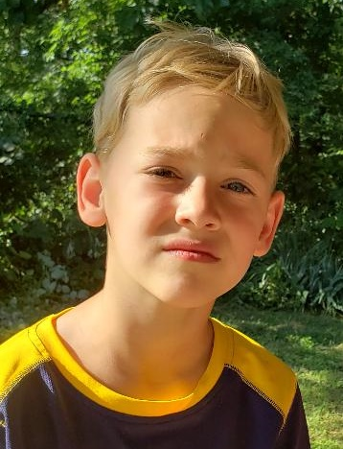

Slide 8
So, then – We are in debt!
We don’t owe our Selfish and Self-centered Self a nickel. We don’t deserve or owe anything to Me!
For if one lives and exists for Me, then that person is knocking on the door of Death.

Slide 9
But the one who is outward focused toward
God’s Spirit and his ways are in a constant battle.
You continually put up a fight to the death
each time Selfish Me raises its head in defiance of God. And this daily battle isn’t through one’s own power
but by the Spirit’s strength in you.
By fighting Selfish Me, you will live

Slide 10
For all those who are walking hand-in-hand
with the Spirit, going from one daily fight with
Self to the next, ever moving toward Christlikeness – these (and only these) are sons and daughters of God.

