Slide 1
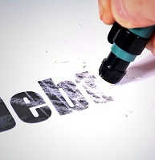
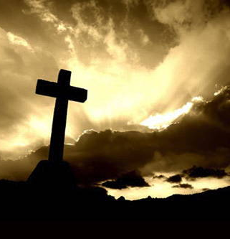
The debt Christ doesn’t pay
“We are Debtors”
Romans 8:12,13

Slide 2
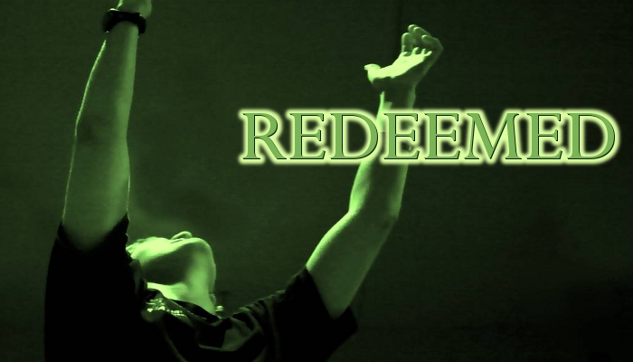
You were bought with a price
1 Cor. 7:23
We were enslaved to sin.
We weren’t free people who had a debt; we were instead slaves who needed freeing.

Slide 3
Therefore, brothers, we have an obligation – but
it is not to the sinful nature, to live according
to it. For if you live according to the
sinful nature, you will die; but if by the Spirit
you put to death the misdeeds of the body,
you will live
Romans 8:12,13

Slide 4
~ “No condemnation” v. 1
~ We live under “Spirit of Life” & set free from the old power or sin and death v. 2
~ Right relationship with God made possible by Christ’s sacrifice v3,4
~ “According to the Spirt” v. 4
~ We have a new direction of life v. 5
~ “Life and peace” v 6
~ We live “in Spirit” v.7 and thus our
spirits are alive, even as our physical
bodies are dying 9,10
~ We have a hope of a future resurrection
~God’s Spirit actually lives in us v. 11
A Double Emphasis
So, then
Now! Therefore, therefore! – We are in debt!
Why are we debtors?

Slide 5
We live in debt
“We are under obligation”
“To live According to it”
Day-by-day way of life.
FLESH
You are about to
Die

Slide 6
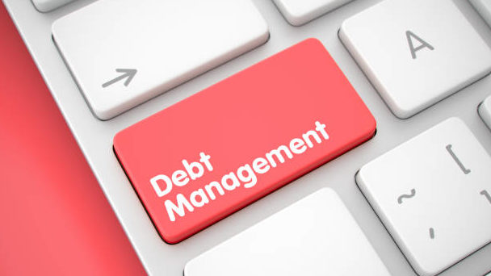
The Debt We Owe
It is not for salvation,
but because of salvation.
How do we pay this debt?
By putting to death the misdeeds of the body
Every day – continually
This is not done through our own power.
It is “by the Spirit” that we fight our battles

Slide 7
So, then – We are in debt!
We don’t owe our Selfish and Self-centered Self a nickel. We don’t deserve or owe anything to Me!
For if one lives and exists for Me, then that person is knocking on the door of Death. But the one who is outward focused toward God’s Spirit and his ways
are in a constant battle. You continually put up a fight
to the death each time Selfish Me raises its head in
defiance of God. And this daily battle isn’t through
one’s own power but by the Spirit’s strength in you.

