Slide 1
Me-Centered & Spirit-Centered Living
Romans 8:5-11

Slide 2
1-7
Therefore, there is now no condemnation for those who are in Christ Jesus.
“I feel condemned”
Chapters
Misunderstand the passage
Not in Christ

Slide 3
Those who live according to the sinful nature have their minds set on what that nature desires;
but those who live in accordance with the Spirit
have their minds set on what the Spirit desires.
The mind of the sinful man is death, but the mind controlled by the Spirit is life and peace;
the sinful mind is hostile to God. It does not
submit to God’s law, nor can it do so. Those
controlled by the sinful nature cannot please God.

Slide 4
You, however, are controlled not by the sinful nature but by the Spirit, if the Spirit of God lives in you. And if anyone does not have the Spirit of Christ, he does not belong to Christ. But if Christ is in you, your body is dead because of sin, yet your spirit is alive because of righteousness. And if the Spirit of him who raised Jesus from the dead is living in you, he who raised Christ from the dead will also give life to your mortal bodies through his Spirit, who lives in you.
Romans 8:5-11

Slide 5
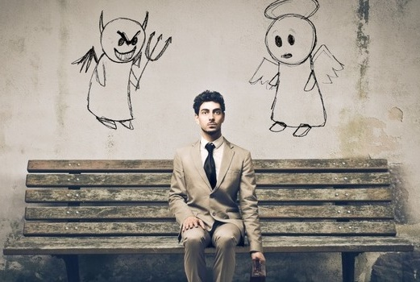
Flesh/Spirit
Two Mindsets
Doing bad things, sinning, struggling with sin, not overcoming sins.
Reads Bible, prays, goes to church, hardly ever sins.
Not-so-good Christian
Spiritual
Christian

Slide 6
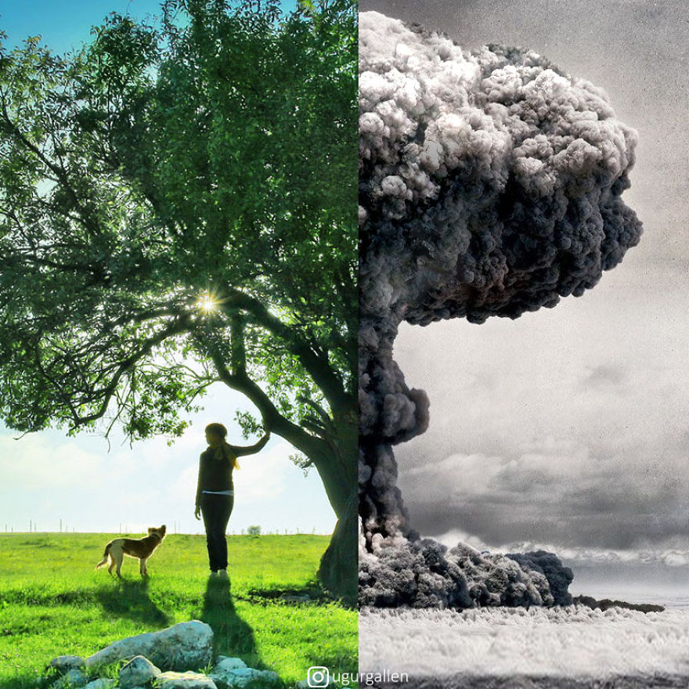
Flesh Spirit
Two Contrasts
Way of Your Thinking 8:5
State of Your Being 8:6
Condition of Your Emotions 8:7
Your Condition 8:8

Slide 7
YOU!
Your Place – A spiritual reality 8:9
Your Place – A physical reality 8:10
Your Place – A future reality 8:11

Slide 8
Therefore, do not lose heart.
Though outwardly we are wasting away, yet inwardly we are being renewed day by day. For our light and momentary troubles are achieving for us an eternal glory that far outweighs them all. So we fix our eyes not on what is seen, but on what is unseen.
For what is seen is temporary,
but what is unseen is eternal.
2 Cor. 4:16-18

Slide 9
Indeed, those who are wrapped up in self-centered
living can only see life centered around themselves. They are ‘gods’ in their own little universe.
But those who look outward to the Spirit
and who are shaped by the breath of God,
his Word, have a worldview bent
toward Him and see things in the clear light
of what the Spirit desires.

Slide 10
For those whose mind-set is centered in Me: Death!
But those who are swayed and bent by the
gentle breath of God’s Spirit: Life and Peace!
On account of that, the one whose mindset
is centered in Self is at war with God;
“Me-centered” cannot follow God’s way
or imitate his character; with sight focused
in “Me”, he has no power to see God.

Slide 11
Indeed those who exist in the realm of “Me”
have no idea how to please or serve God.
You, on the other hand, are not centered in Self
but centered in the Spirit since the Spirit of God
has made his home in you.
However, those not centered
in the Spirit of Christ are not a part of him.

Slide 12
Moreover we affirm if Christ is in you,
the physical body is dead, wearing out, because of sin. However, our spirit, Life!... on account of righteousness.
On top of all this, if the Spirit who raised Jesus
from death has made his home in you,
he who raise Christ Jesus from his grave will
one day infuse Life in your mortal body
because his Spirit is currently inhabiting you!

