Slide 1
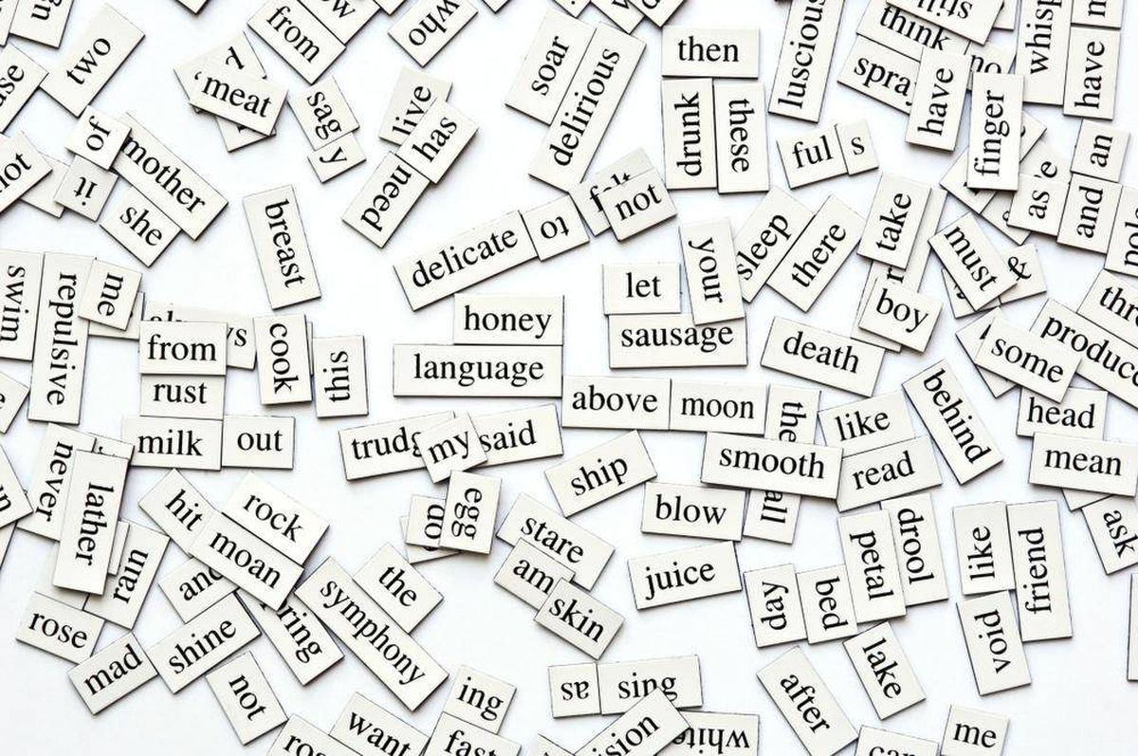
It’s Only Words…
But words matter
Romans 8:5-8

Slide 2
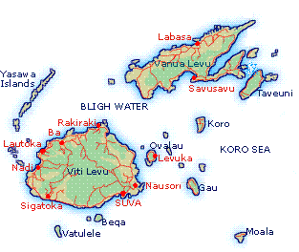
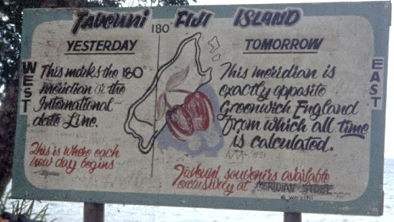
International Dateline

Slide 3
…who do not live according to the sinful nature but according to the Spirit. Those who live according to the sinful nature have their minds set on what that nature desires; but those who live in accordance with the Spirit have their minds set on what the Spirit desires. The mind of the sinful man is death, but the mind controlled by the Spirit is life and peace;
the sinful mind is hostile to God. It does not
submit to God’s law, nor can it do so. Those
controlled by the sinful nature cannot please God.
Romans 8:4b-8

Slide 4
HELPS for difficult passages
1) Don’t dismiss a difficult passage
2) Remember that this is God’s word so honor it.
3) Look at it from a broad perspective without getting into the details.

Slide 5
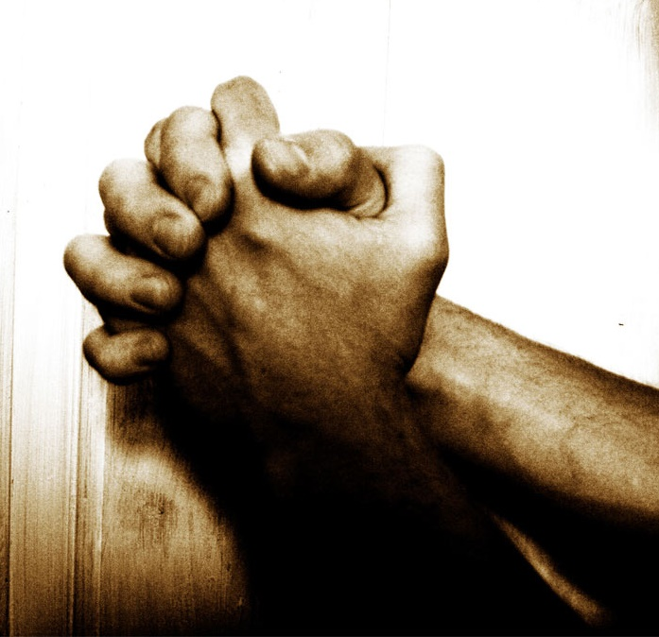
“Lord, I don’t understand fully what this passage is saying but I ask that you mature me so that I have a mind controlled by the Spirit where there is life and peace and not by the mind of the sinful man that is death. When I react in ways that can be termed as “death” help me realize in that moment that my mind is of the sinful man and lead me to change those actions so that I can walk in life and peace.”

Slide 6
HELPS for difficult passages
1) Don’t dismiss a difficult passage
2) Remember that this is God’s word so honor it.
3) Look at it from a broad perspective without getting into the details.
4) Be patient with the preacher

Slide 7
condemned sin
the righteous requirements of the law might be fully met in us.
The absolute good news is centered in what God did in initiating salvation, continuing salvation and completing salvation.

Slide 8
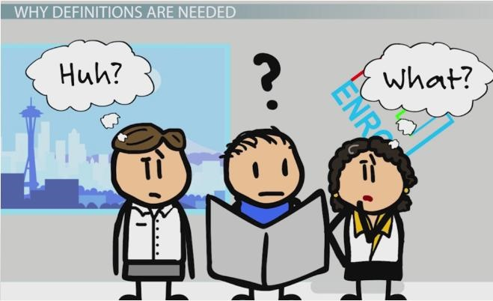
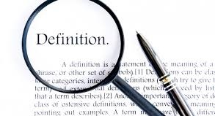
George Orwell 1984 –
“If thought corrupts language, language can also corrupt thought”
Hippopotomonstrosesquipedaliophobia

Slide 9
“Flesh” – Sarx
“Carnal nature, sinful man, sinful nature”
“Sarx”
Physical flesh and blood functioning with physical feelings and
reactions and emotions.
Cravings selfish desires, gratification
George Orwell 1984 –
“If thought corrupts language, language can also corrupt thought”
“Sarx”
Selfish, self-centered living;
a me-centered life

Slide 10
“Spirit” – pneuma
“Spirt or spirit?”
“Pneuma”
Breeze, a gentle blast of air, breath, wind or spirit – the energy or power that cause of human body to think, will, decide, rational
Live according to the breath of God ~
2 Tim 3:16
George Orwell 1984 –
“If thought corrupts language, language can also corrupt thought”
“Pneuma”
Selfless, God-centered living;
a Spirit-centered life

Slide 11
“Mind”
Three Words
“Nous”
What initiates thoughts Romans 7:25
“Dianoia”
Process, understand
and reflect
George Orwell 1984 –
“If thought corrupts language, language can also corrupt thought”
“Phroneo”
Bent of life, world-view, direction of life

Slide 12
The whole purpose of this was so that you
could stand in the courtroom of Justice and by God himself be declared, not only acquitted, but right
with God; thus measuring up to the Law’s perfect standard. This is granted to those whose day-by-day walk through life is no longer in human, self-centered living but is a day-by-day life centered in God’s Spirit.

Slide 13
Indeed, those who are wrapped up in self-centered
living can only see life centered around themselves. They are ‘gods’ in their own little universe.
But those who look outward to the Spirit
and who are shaped by the breath,
the Word of God, have a worldview bent
toward Him and see things in the clear light
of what the Spirit desires.

Slide 14
For those whose mind-set is centered in Me: Death!
But those who are swayed and bent by the
gentle breath of God’s Spirit: Life and Peace!

