Slide 1
Living for Christ
with a perplexed heart
A disconcerting sentence
Romans 7:25b

Slide 2
A disconcerting sentence

Slide 3
Chapter 7
7:4 – You died to the law through the body of Christ
7:15-19
Frustration!
The Missing Piece
7:24
Wretched!
7:25a
Thank God!

Slide 4
So then, I myself in my mind am a slave to God’s law, but in the sinful nature a slave to the law of sin
7:25b
“So, then (or therefore, therefore) I myself truly with the mind I serve (or am a slave) to God’s law, but in the flesh, sin’s law.
The Missing Piece

Slide 5
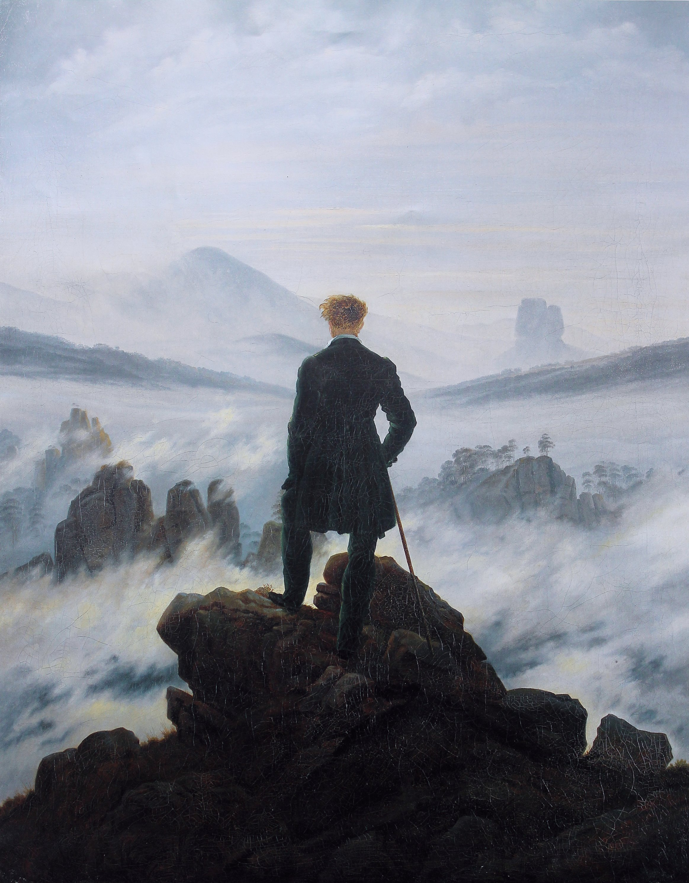
The romanticizing of life

Slide 6
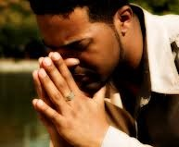
The reality of life
in my mind
I come to the garden alone while the dew is still on the roses, And the voice I hear falling on my ear, The Son of God discloses
And He walks with me and He talks with me, And He tells me I am his own; And the joy we share as we tarry there, None other has ever known

Slide 7
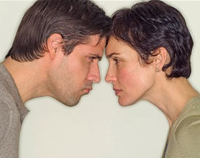
The reality of life
in my mind
The reality of life
in my flesh
Therefore, there is now no condemnation for those who are in Christ Jesus!

Slide 8
Run to your source of power
Thanks be to God through Jesus Christ our Lord,
there is now no condemnation!

