Slide 1
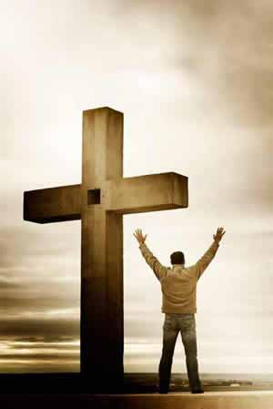
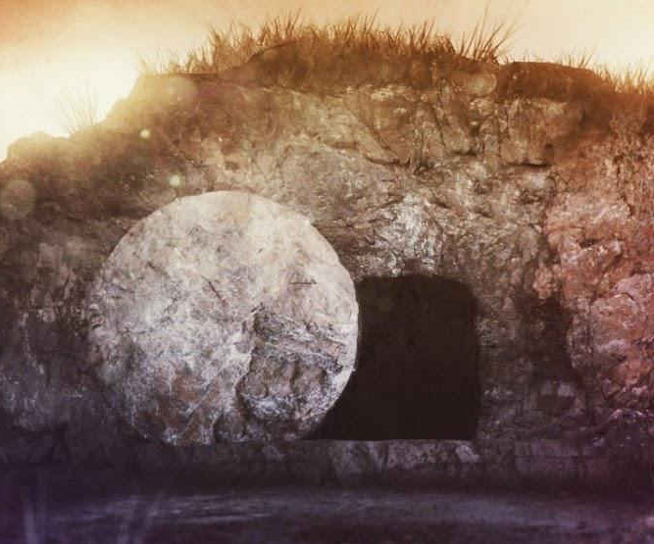
Romans – Free in Christ
Romans 8:1

Slide 2
Therefore,
there is now no condemnation for those who are in Christ Jesus

Slide 3
Therefore
For in the gospel a righteousness from God is revealed , a righteousness that is by faith from first to last, just as it is written: “The righteousness will live by faith.”
Romans 1:17
You, therefore, have no excuse, you who pass judgment on someone else, for at whatever pont you judge the other, you are condemning yourself, because…you do the same things
Romans 2:1
GOOD NEWS!
I am not ashamed of the gospel, because it is the power of God for the salvation of everyone who believes…Romans 1:16

Slide 4
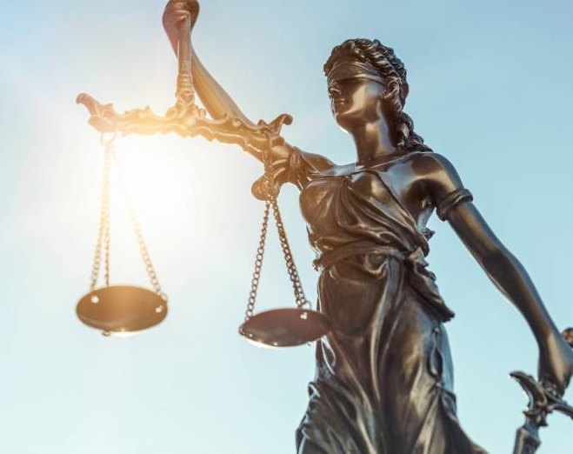
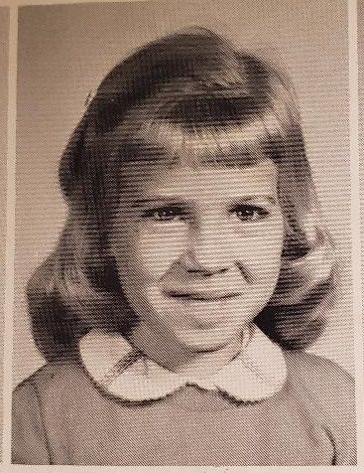
Therefore
But now a righteousness from God, apart from law, has been made known…This righteousness from God comes through faith in Jesus Christ to all those who believe. There is no difference, for all have sinned and fall short of the glory of God and are justified freely by his grace though the redemption that came by Christ Jesus. God presented him as a sacrifice of atonement, through faith in his blood. He did this to demonstrate his justice …at the present time, so as to be just and the one who justifies those who have faith in Jesus Romans 3:21-26
Romans 2:1-3:20
We all want Justice!
No one will be declared righteous in his sight by observing the law; rather, through the law we become conscious of sin – Romans 3:20

Slide 5
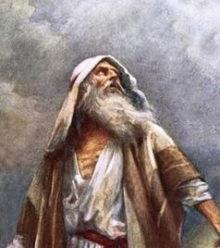
Therefore
It was not through law that Abraham and his offspring received the promise…but through the righteousness that comes by faith
Romans 4:13
The Promise:
Blessed are they whose transgressions are forgiven; whose sins are covered. Blessed is the man who sin the Lord
will never count against him
Romans 4:7,8
Abraham:
Saved by faith, not by goodness

Slide 6
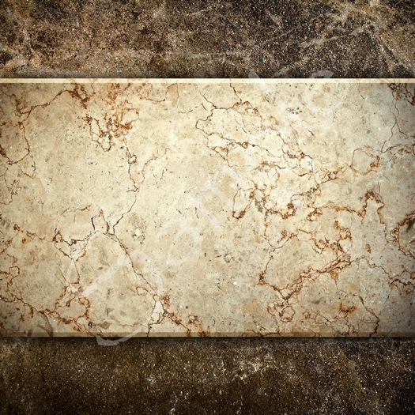
Therefore
CHAPTER 5
CHAPTER 7
CHAPTER 6
Therefore, since we have been justified though faith, we have peace with God through our Lord Jesus Christ
Romans 5:1
You also died to the law through the body of Christ, that you might belong to another…in order that we might bear fruit to God
Romans 7:4
Raised to a new life: the Grace Dimension
Count yourselves dead to sin but alive to God in Christ Jesus…do not let sin reign in your mortal body…off yourselves to God,
as those who have been brought from death to life…
Romans 6:11-13

Slide 7
Romans – Free in Christ
Free from
Wrath
Free from
Sin
Free from
Law
Free from
Death
Therefore
there is now no condemnation for those in Christ Jesus.

Slide 8
Rock of Ages, cleft for me, let me hide myself in thee; let the water and the blood, from thy wounded side which flowed, be of sin the double cure; save from wrath and make me pure.
Nothing in my hand I bring, simply to the cross I cling; naked, come to thee for dress; helpless, look to thee for grace; foul, I to the fountain fly; wash me, Savior, or I die.
Not the labors of my hands can fulfill thy law's commands; could my zeal no respite know, could my tears forever flow, all for sin could not atone; thou must save, and thou alone

