Slide 1
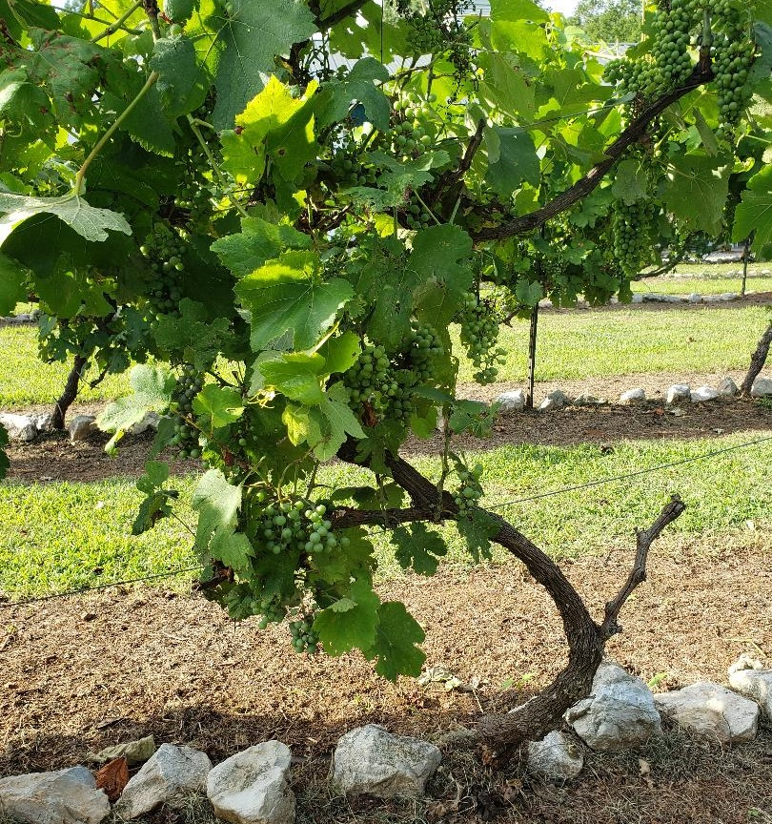
I am the True Vine
Remaining in him
John 15:1-11

Slide 2
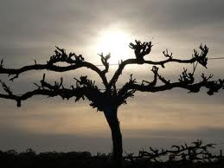
The primary function of the branch:
Remain
REMAIN – “meno”
to stay, dwell, lodge, rest, settle, to last,
to continue, to be in a close and settled union.
To live with someone – be at home with someone

Slide 3
Gospel of John
Where are you staying?” - 1:38
“I saw the Spirit…remain (meno) on him - 1:32
“nor does his (the Father’s) word
dwell (meno) in you - 5:38
“work…for food that endures (meno)
to eternal life…” - 6:27

Slide 4
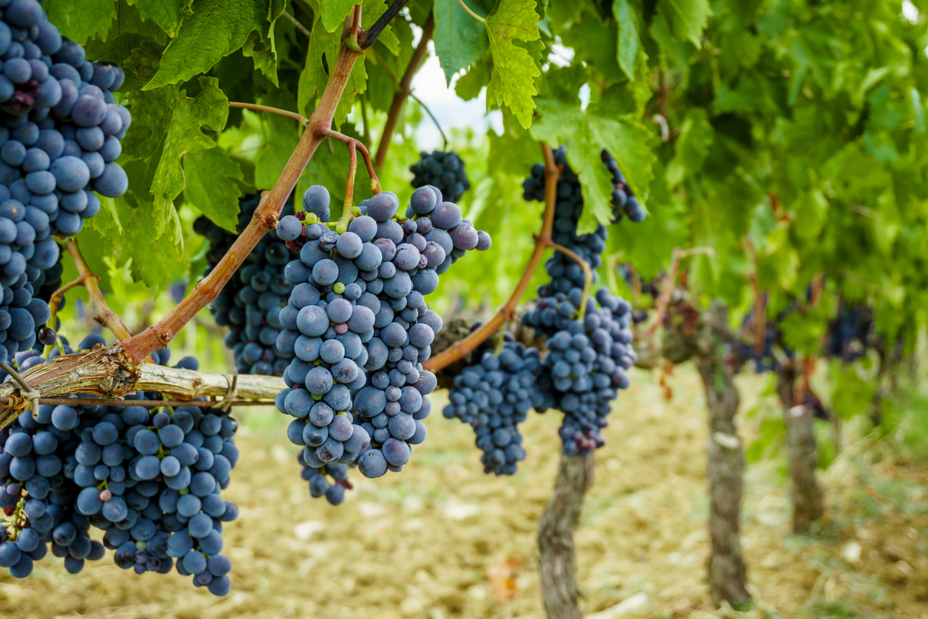
Remaining:
the normal Christian life
Branch
Organic Joining
VINE
We participate in his life – and he in us
That is why, for Christ’s sake, I delight in weaknesses, in insults, in hardships, in persecutions, in difficulties. For when I am weak, then I am strong.
2 Cor. 12:10

Slide 5
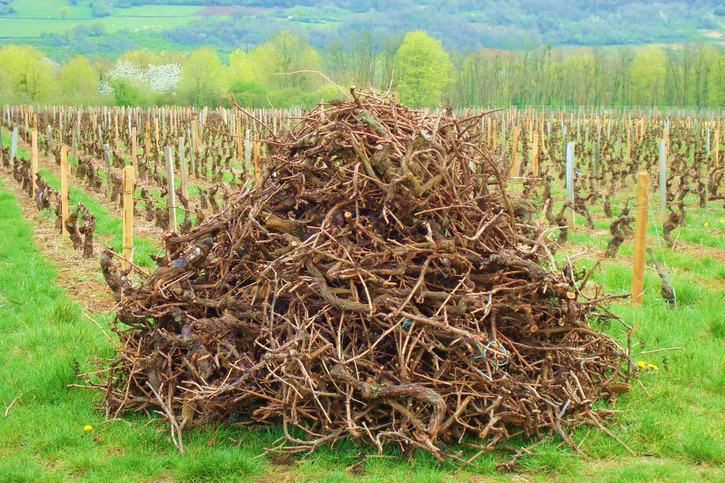
There is no life apart from the vine
Apart from me you can do nothing 15:5
If anyone does not remain in me, he is like a branch that is thrown away and withers; such branches are picked up, thrown into the fire and burned. 15:6

Slide 6
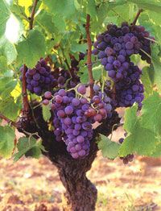
The result of remaining
Fruit
Don’t you believe that I am in the Father, and that the Father is in me? The words I say to you are not just my own. Rather, it is the Father, living in me, who is doing his work
John 14:10
the Father, living (meno) in me

Slide 7
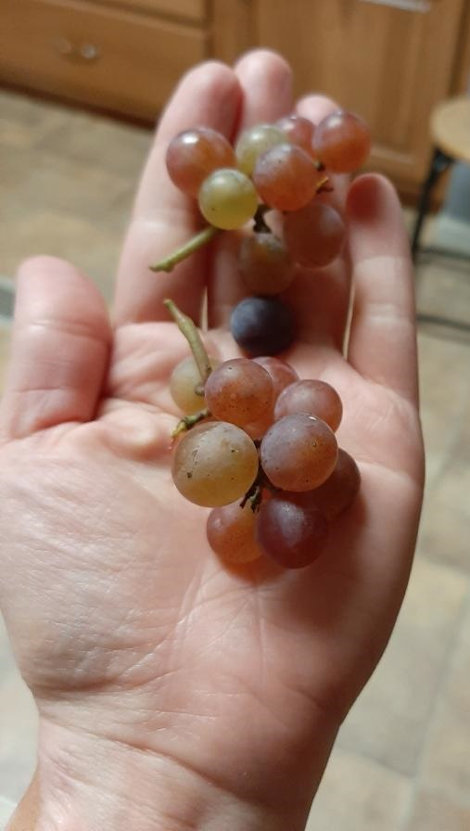
The fruit come from remaining
The fruit is becoming like Jesus
And the life of Jesus
produces “Jesus fruit” in me – love and
all the many expressions of love

Slide 8
How do we remain?
By one spirit you were all baptized into one body
1 Cor. 12:13.

Slide 9
Since then, you have been raised with Christ, set your hearts on things above, where Christ is seated at the right hand of God. Set your minds on things above, not on earthly things..
For you died, and your life is now hidden with Christ in God. When Christ, who is your life, appears, then you also will appear with him in glory - Col. 3:1-4

