Slide 1
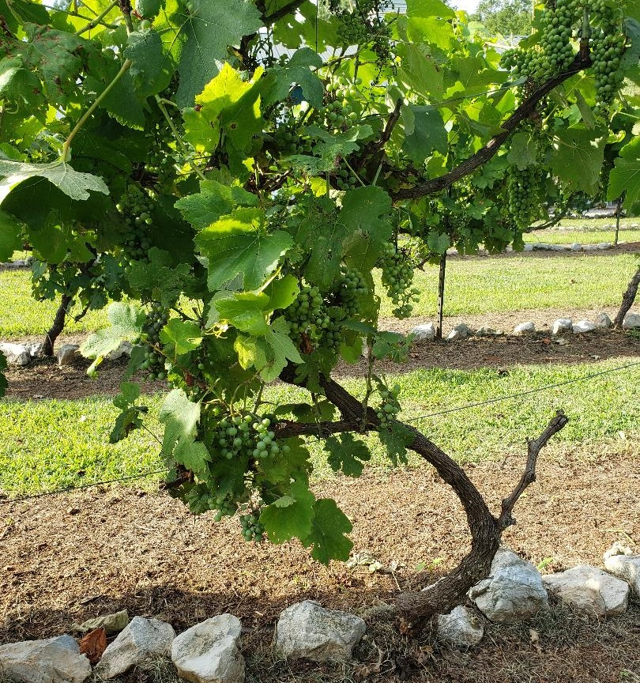
I AM The True Vine
John 15:1-11

Slide 2
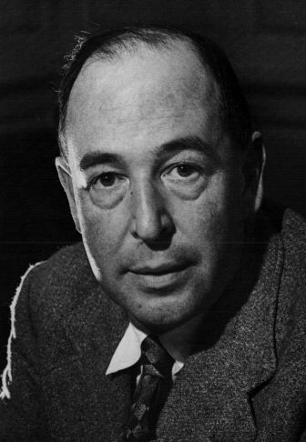
In one way we think a great deal too much of the atomic bomb. “How are we to live in an atomic age?” I am tempted to reply: “Why, as you would have lived in the sixteenth century when the plague visited London almost every year, or as you would have lived in a Viking age when raiders from Scandinavia might land and cut your throat any night; or indeed, as you are already living in an age of cancer, an age of syphilis, an age of paralysis, an age of air raids, an age of railway accidents, an age of motor accidents.”

Slide 3
In other words, do not let us begin by exaggerating the novelty of our situation. Believe me, dear sir or madam, you and all whom you love were already sentenced to death before the atomic bomb was invented: and quite a high percentage of us were going to die in unpleasant ways. We had, indeed, one very great advantage over our ancestors—anesthetics; but we have that still. It is perfectly ridiculous to go about whimpering and drawing long faces because the scientists have added one more chance of painful and premature death to a world which already bristled with such chances and in which death itself was not a chance at all, but a certainty.

Slide 4
This is the first point to be made: and the first action to be taken is to pull ourselves together. If we are all going to be destroyed by an atomic bomb, let that bomb when it comes find us doing sensible and human things—praying, working, teaching, reading, listening to music, bathing the children, playing tennis, chatting to our friends over a pint and a game of darts—not huddled together like frightened sheep and thinking about bombs. They may break our bodies (a microbe can do that) but they need not dominate our minds.
— “On Living in an Atomic Age” (1948) in Present Concerns: Journalistic Essays

Slide 5
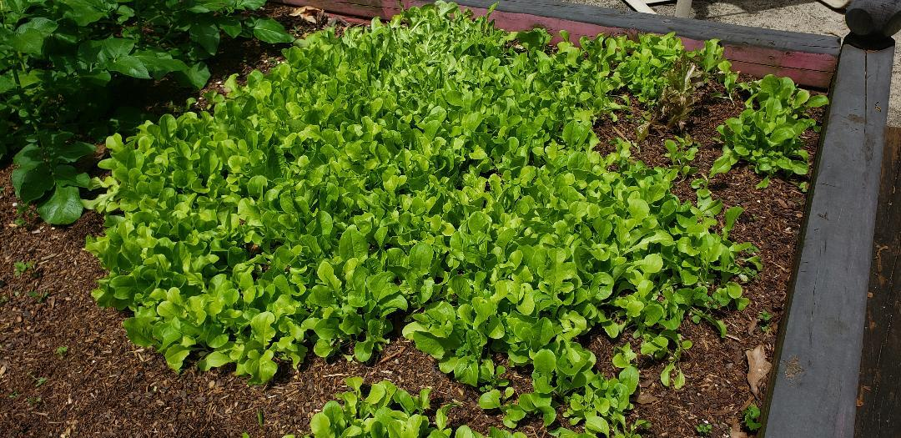
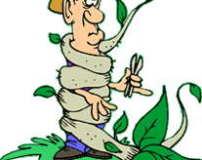
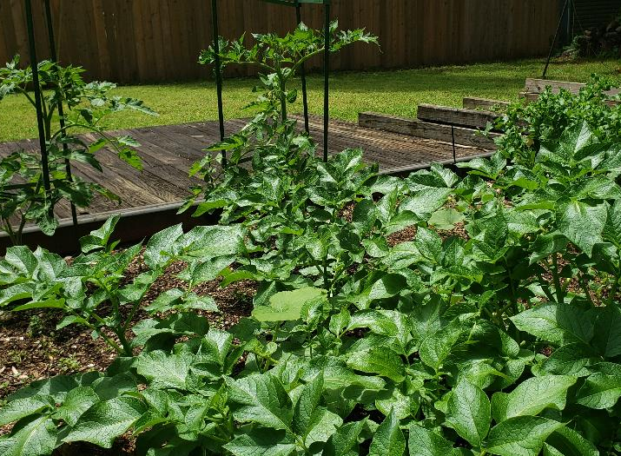
Wanna-be gardener

Slide 6
I AM the true vine
Then Moses said to God, “If I come to the people
of Israel and say to them, ‘The God of your fathers
has sent me to you’ and they ask me, ‘What is his name?’ what shall I say to them? God said to Moses,
‘I AM WHO I AM.’
Exodus 3:13, 14

Slide 7
Physically hungry he said
I AM the bread of life – 6:35
Those in darkness
I AM the light of the world 8:12
In need of entrance into salvation
I AM the gate of the sheep 10:7
In need of direction and protection
I AM the good shepherd 10:11

Slide 8
In the middle of death
I AM the resurrection and the life 11:25
For those in need of relationship
with God and true direction
I AM the way, the truth and the life 14:6
For those who need the nourishment to thrive
I AM the true vine 15:1

Slide 9
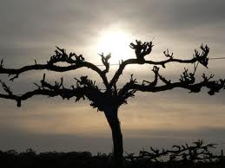
THE VINE
You brought a vine out of Egypt, you drove out the nations and planted it. You clear the ground for it, and it took root and filled the land
Psalm 80:8,9

Slide 10
Now you dwellers of Jerusalem and men of Judah, judge between me and my vineyard. What more
could I have done for my vineyard that I have done
for it? When I looked for good grapes why did it
yield only bad? Now I will tell you what I am going
to do to my vineyard. I will take away its hedge,
and it will be destroyed; I will break down its wall,
and it will be trampled.
Isaiah 5:3-5

Slide 11
THE VINE
I planted you like a choice vine of sound and
reliable stock. How then did you turn against
me into a corrupt, wild vine?
Jeremiah 2:21

Slide 12
The characters of the parable
The Vine
The Gardener
The Branches

Slide 13
REMAIN
To stay, dwell, lodge, rest, settle,
to last, to continue,
to be in a close and settled union.

Slide 14
Jesus – the True Vine will do his part:
And my God will meet all your needs according to his glorious riches in Christ Jesus ~ Phil 4:19
The Father– the Gardener will do his part:
My son, do not make light of the Lord’s discipline…but God disciplines us for our good, that we may share in his holiness…it produces a harvest of righteousness and peace for those who have been trained by it
Hebrews 12:4-11

Slide 15
You: The branches will do your part
Let us fix our eyes on Jesus,
the author and perfecter of our faith….
Consider him…so that you will not
grow weary and lose heart.
Hebrews 12:2,3

