Slide 1
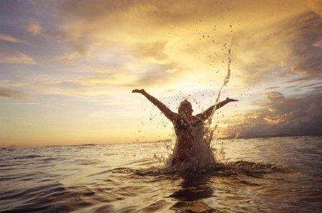
Slaves to Righteousness
Romans 6:19
You have become slaves to righteousness

Slide 2
“The superabundance of grace displayed in the Christian system is not likely to be appreciated, must less exaggerated, in this cold and selfish and sensual age. It would sometimes seem to me as though not one of a thousand in the whole army of the church militant did realize the amount of privilege, of wealth and honor surrendered to
those in covenant with the Lord Messiah.”

Slide 3
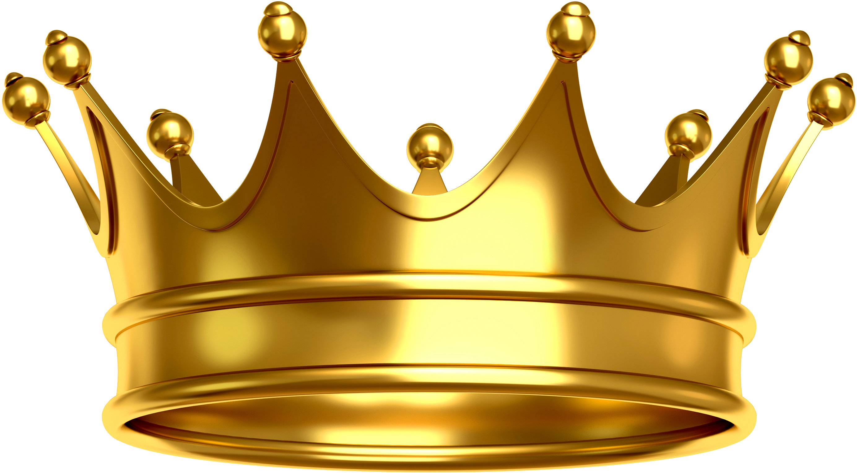
Romans 6:15-18
SIN
LAW
Righteousness

Slide 4
I put this in human terms because you are weak
in your natural selves. Just as you used to
offer the parts of your body in slavery to
impurity and to ever-increasing wickedness,
so now offer them in slavery to righteousness leading to holiness.
Romans 6:19

Slide 5
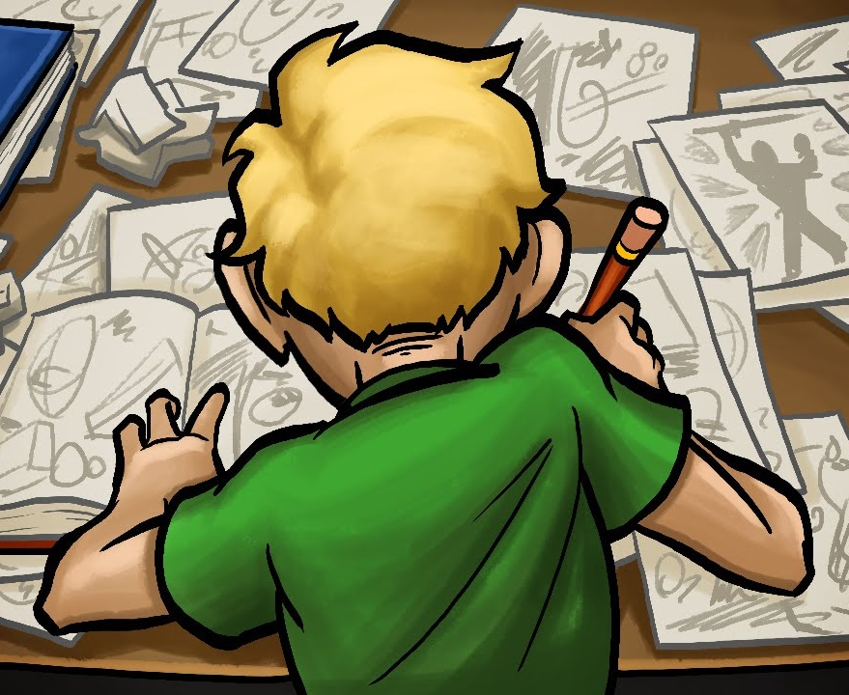
An
illustration
You Know
Don’t Know
Slavery
to impurity
Slavery
to
righteousness
Forced slavery we desire to escape
Bond-slave we desire to serve

Slide 6
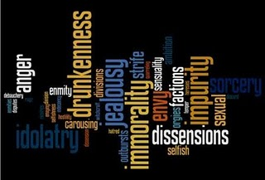
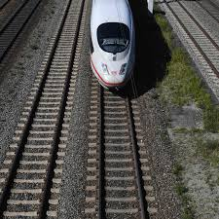
One-track Mind
For Christians this is in the past!
“The” sin, impurity, lawlessness
Powers that ruled us
Slaves to impurity

Slide 7
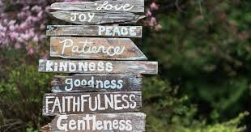
A new track
Christians yield themselves to
right living
Offer your members, yield or turn your life over to God’s way of living
Slaves to righteousness

Slide 8
What then? Since I no longer abide under any kind of rule or regulation but under God’s favor, kindness and blessings, can’t I leave open the possibility of sin and indulge “Me” just a little? What a crazy notion!
It is so obviously clear that if I worshipfully listen and wholly submit to anyone as a slave then I am compelled to obey him. It matters not whether I am a slave to any sort of sin (with the result of death) or whether a slave of obedience (with the result of correct living.)

Slide 9
But thank God! I used to be a slave to the Selfish and Sinful Me but now…!... with every fiber of my being and with full attention and compliance I am molded by the teaching into which God placed me.
I have been emancipated from “The Sin of Me”
and have been placed in bondage to right living.
I’m using a down-to-earth example because it’s
difficult to think in spiritual terms:

Slide 10
I used to be tied up in all sorts of impurity.
My thoughts muddied, feelings mixed, words filthy
and actions addicted; truly a type of slavery following the call of any and all of the world’s pollution.
I was in a downward spiral from chaos to anarchy,
living unruly and rebellious, a mutineer against anything God had to say.

Slide 11
But now, just as I was once wholeheartedly devoted to that kind of life, I have turned that slavery around
and have bonded the whole of myself to God’s
right way of living. Allowing Him to clear
my thinking, keep my feelings focused,
make my words fitting and actions guided under the rule and approval of God’s direction and justice.
This “slavery” leads me down a progressive
path of a continually transformed Life.

