Slide 1
Welcome, Central Church!

Slide 2
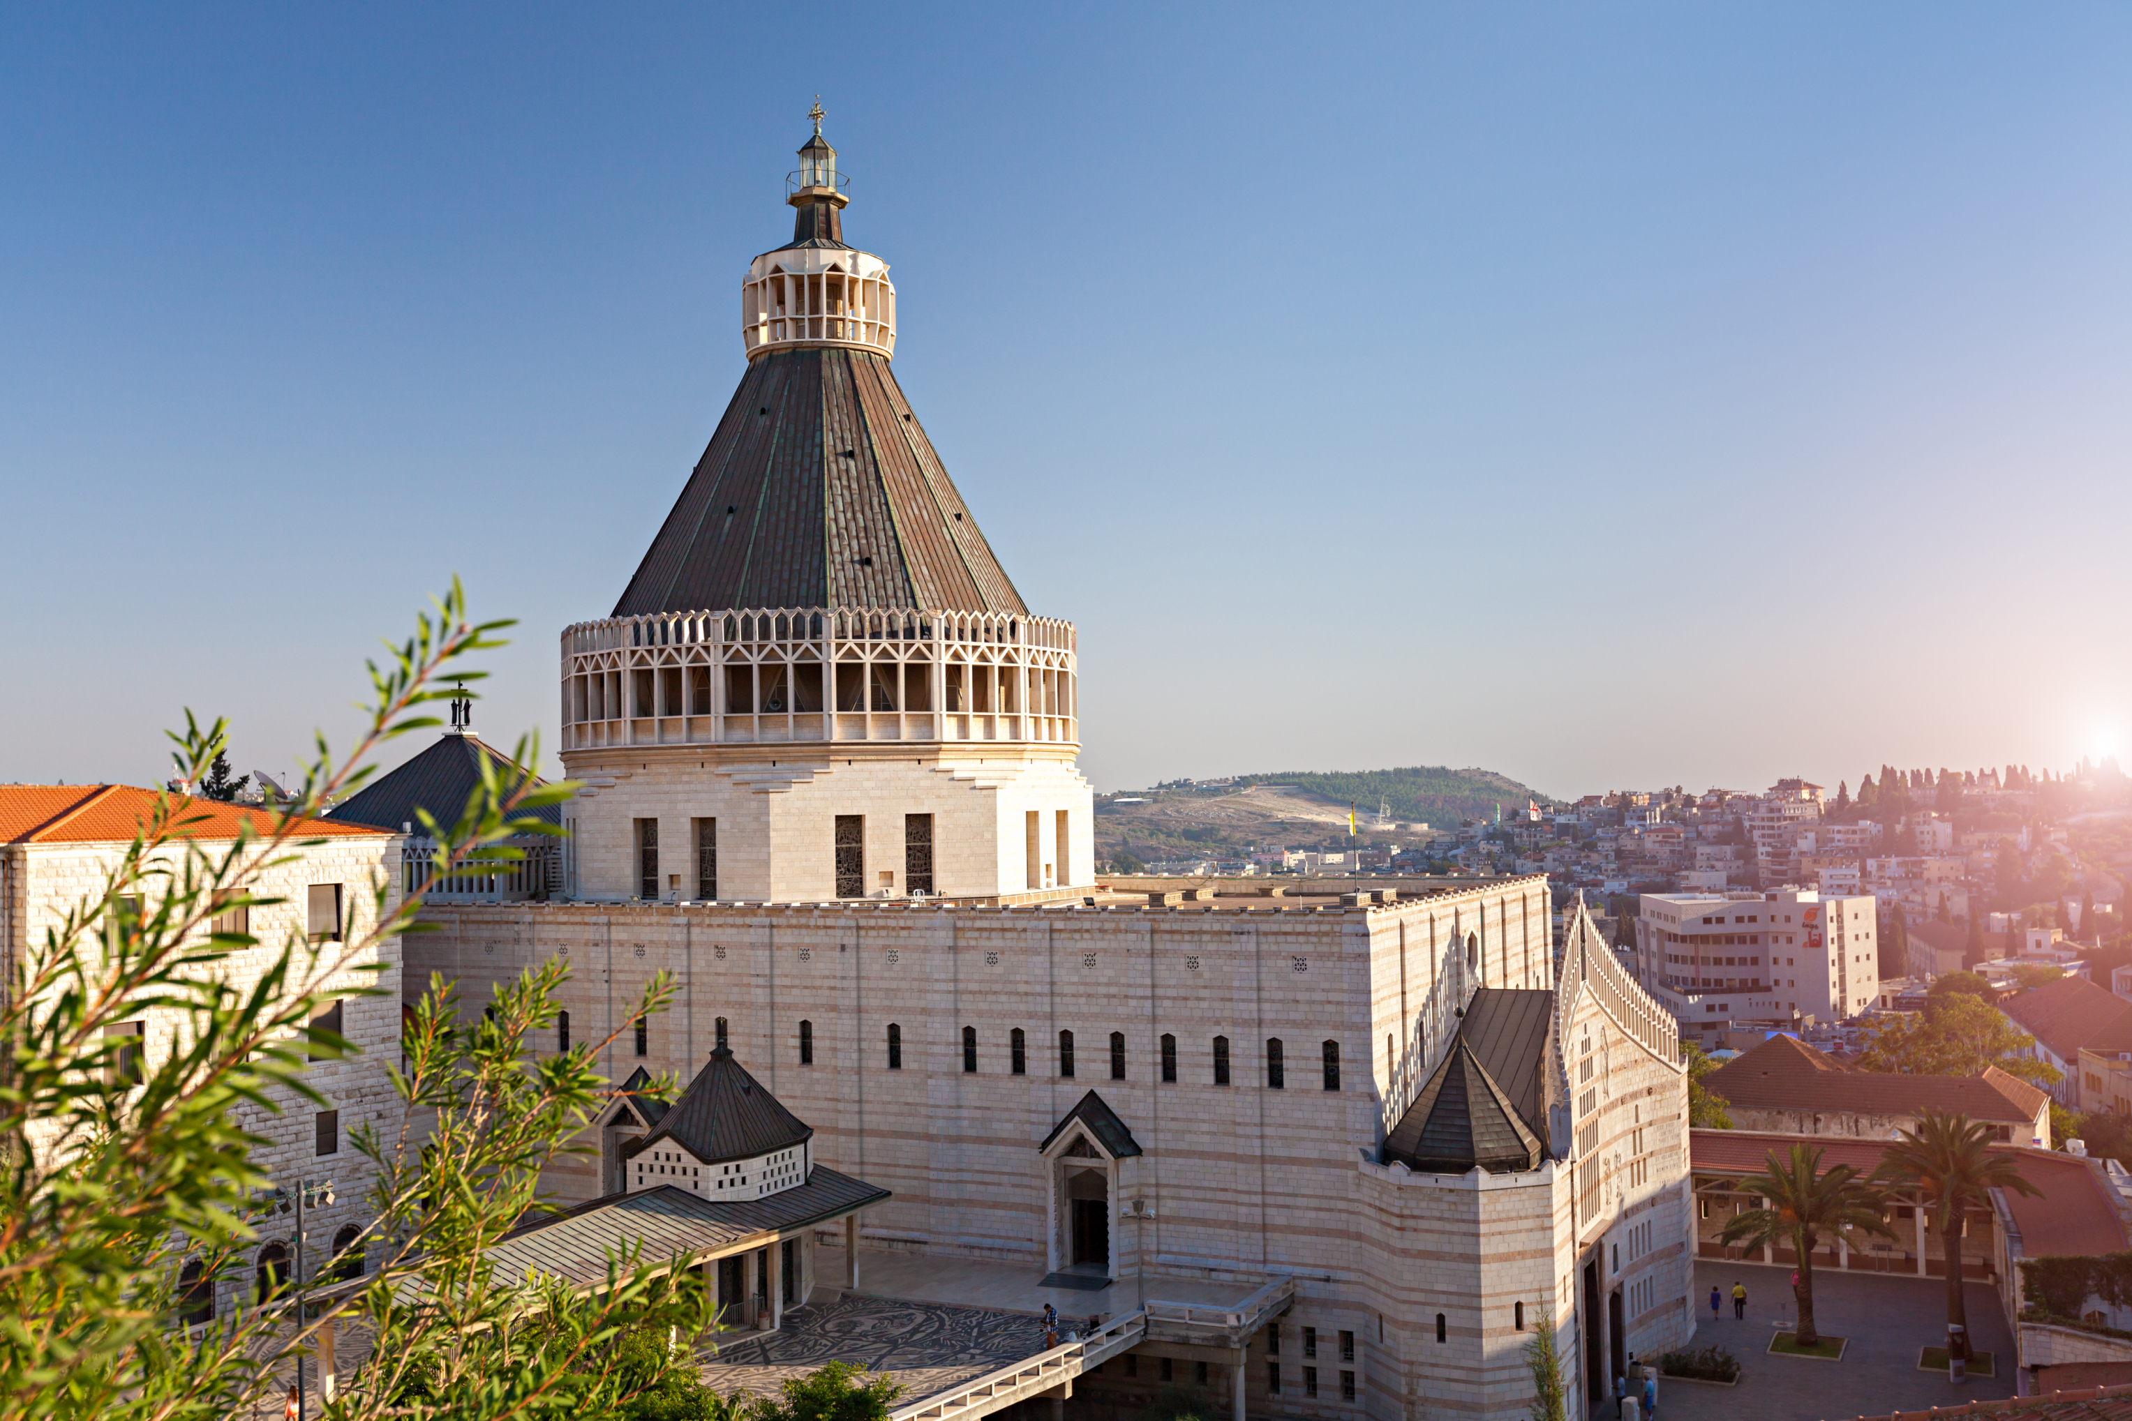

Slide 3
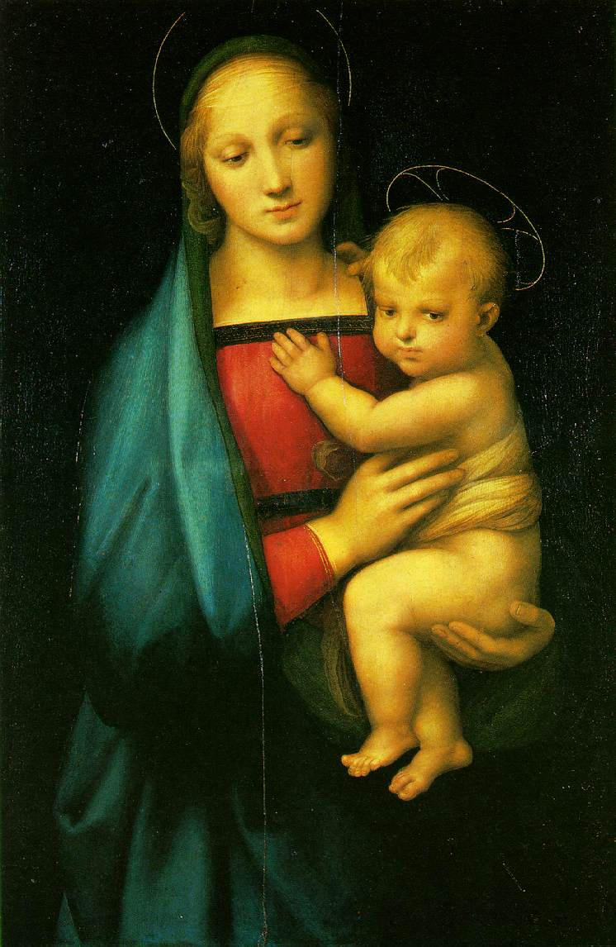

Slide 4
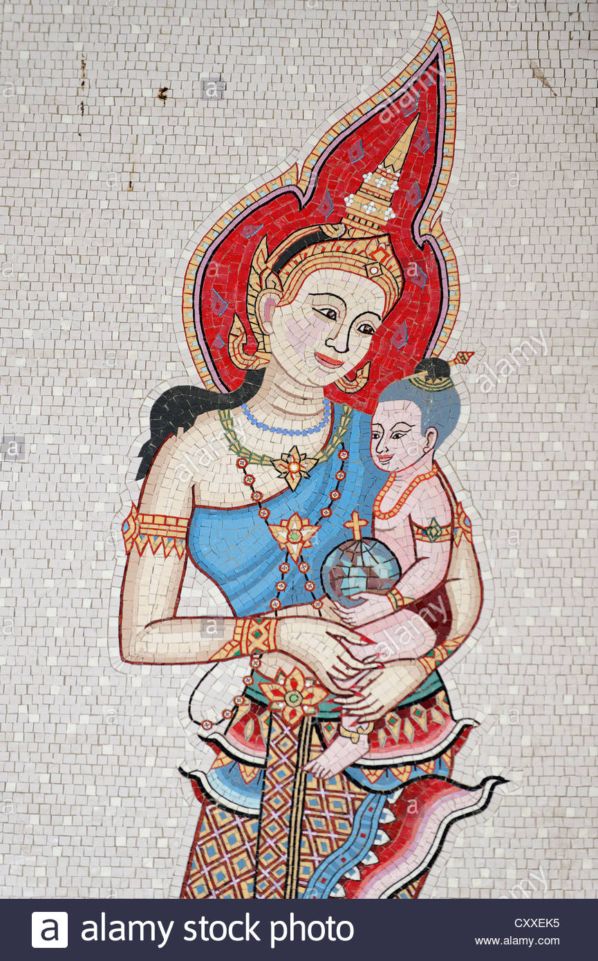

Slide 5
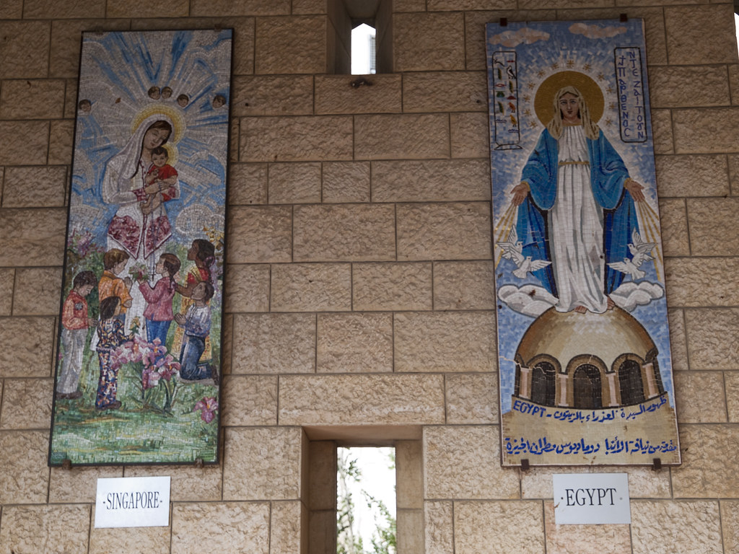

Slide 6
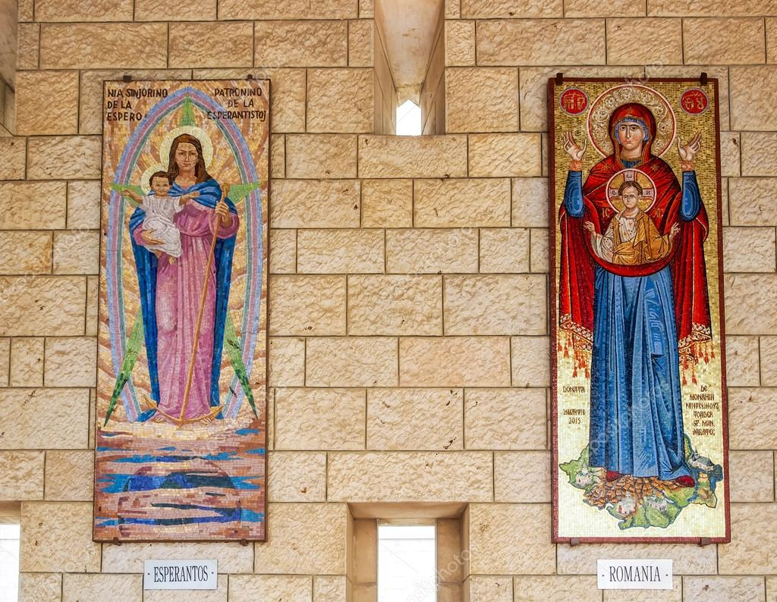

Slide 7
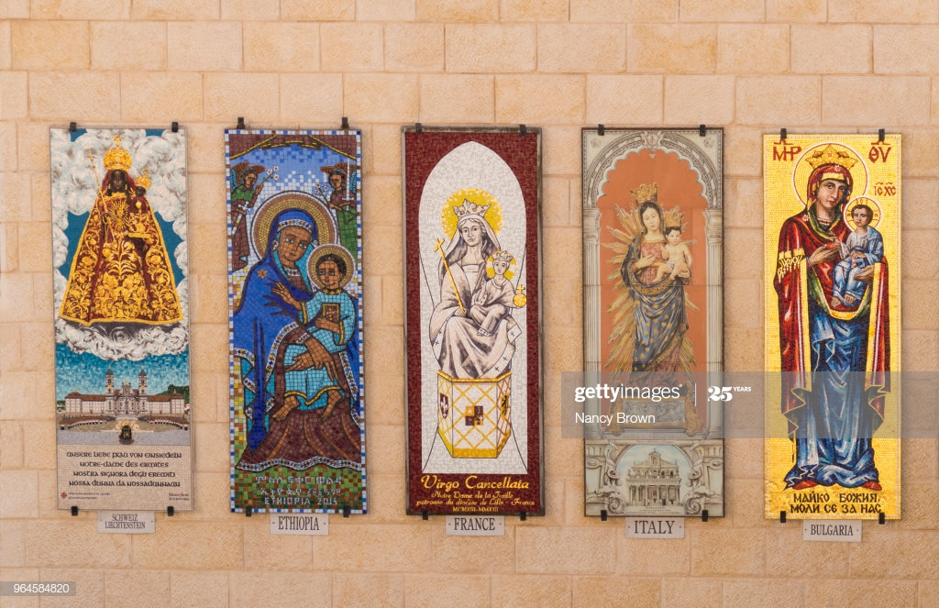

Slide 9
Christianity is the most diverse religious movement in human history.

Slide 10
The Gospel Story Shapes Our Story

Slide 11
The Gospel Story Brings Unity To Our Story

Slide 12
Christianity is the most diverse religious movement in human history.

Slide 13
”… His purpose was to create in himself one new humanity out of the two, thus making peace” (Eph. 2:15)

Slide 14
The Old Humanity
Dishonesty
Anger
Theft
Gossip
Revenge
Promiscuity
The New Humanity
Truth
Peace
Generosity
Encouragement
Forgiveness
Self-Control

Slide 15
¹⁵ Be very careful, then, how you live - not as unwise but as wise, ¹⁶ making the most of every opportunity because the days are evil. ¹⁷ Therefore don’t be foolish, but understand what the Lord’s will is. ¹⁸ Don’t get drunk on wine, which leads to debauchery. Instead, be filled with the Spirit... (Eph. 5)

Slide 16
Paul’s Advice on Navigating your Freedom:
Be wise NOT unwise
Understand God’s Will; DON’T be foolish
Be FILLED with the SPIRIT, NOT wine

Slide 17
¹⁹ speaking to one another with psalms, hymns, and songs from the Spirit. Sing and make music from your heart to the Lord, ²⁰ always giving thanks to God the Father for everything, in the name of our Lord Jesus Christ. ²¹ And, submit to one another out of reverence for Christ. (Eph. 5)

Slide 18
¹⁹ speaking to one another with psalms, hymns, and songs from the Spirit. Sing and make music from your heart to the Lord, ²⁰ always giving thanks to God the Father for everything, in the name of our Lord Jesus Christ. ²¹ And, submit to one another out of reverence for Christ. (Eph. 5)

Slide 19
¹ Children, obey your parents in the Lord, for this is right. ² “Honor your father and mother”—which is the first commandment with a promise—³ “so that it may go well with you and that you may enjoy long life on the earth.” (Eph. 6)

Slide 20
⁴ Fathers, do not provoke your children to anger; instead, bring them up in the training and instruction of the Lord. (Eph. 6)

Slide 21
The Gospel Story Transforms Our Story into Jesus’ Story

