Slide 1
Practical Purposeful Living
Romans 6:12-13
Grace-living with a purpose

Slide 2
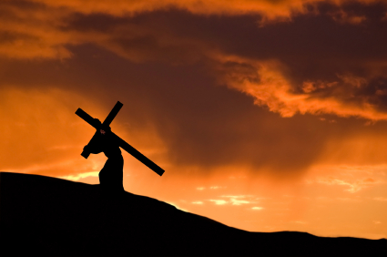
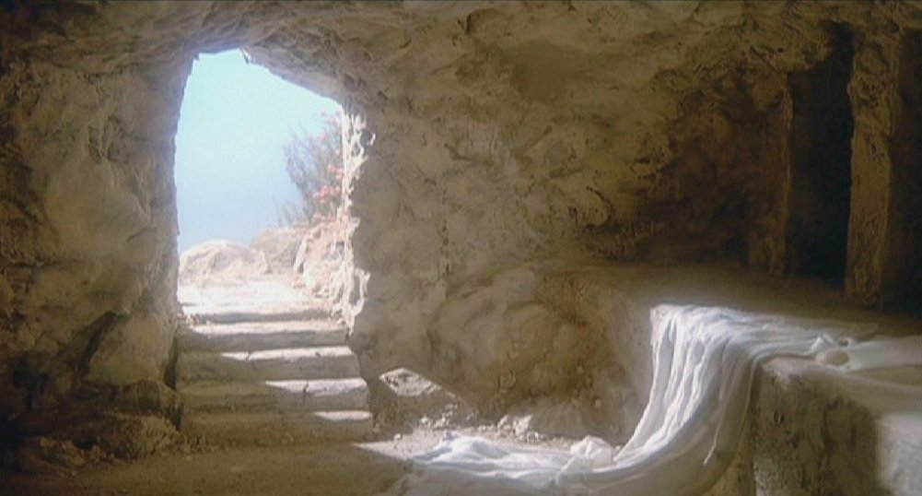
Purposeful living begins by making a life changing decision (6:1-4)
“Take up your cross and follow me”
To his death, burial and resurrection

Slide 3
Purposeful living begins by making a life changing decision (6:1-4)
“Take up your cross and follow me”
To my death, burial and resurrection

Slide 4
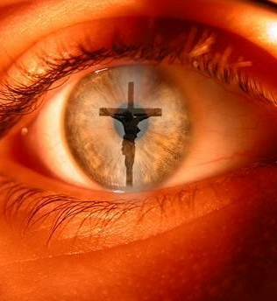
Purposeful living based in being in the reality of “dead to sin” while looking forward to our resurrection
(6:5-11)

Slide 5
for all have sinned and fallen short of the glory of God,
Romans 3:23,24
“and are justified freely by his grace through the redemption that came by Christ Jesus.”

Slide 6
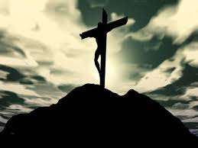
What he achieved on that tree, we received when we joined him there.

Slide 7
What he achieved on that tree, we received when we joined him there.
Since I died to sin how do I stop sinning?

Slide 8
Bob Newhart clip
https://www.youtube.com/watch?v=y8Et28kBi1A&list=RDy8Et28kBi1A&start_radio=1&t=0

Slide 9
Do Don’t
Don’t Do
Romans 6:11
Count yourselves dead to sin but alive to God
Change the way you think

Slide 10
Do Don’t
Don’t Do
Romans 6:11
Count yourselves dead to sin but alive to God
Change the way you think
Romans 6:12
Don’t listen to the call of
“the sin”
“Obey”
“under-hearing”

Slide 11
Do Don’t
Don’t Do
Romans 6:11
Count yourselves dead to sin but alive to God
Change the way you think
Romans 6:12
Don’t listen to the call of
“the sin”
“Obey”
“under-hearing”
Romans 6:13a
Don’t offer yourself to “the sin”
“The sin”
Being my own God

Slide 12
Do Don’t
Don’t Do
Romans 6:11
Count yourselves dead to sin but alive to God
Change the way you think
Romans 6:12
Don’t listen to the call of
“the sin”
“Obey”
“under-hearing”
Romans 6:13a
Don’t offer yourself to “the sin”
“The sin”
Being my own God
Romans 6:13b
Do offer yourself to God’s use
My personality used for God

Slide 13
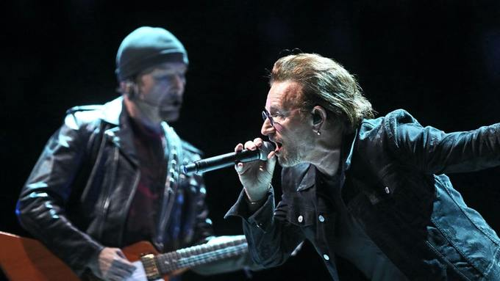
But I still haven't found what I'm looking for But I still haven't found what I'm looking for
I believe in the kingdom come Then all the colors will bleed into one Bleed into one But yes I'm still running
You broke the bonds And you loosed the chains Carried the cross Of my shame Oh my shame You know I believe it But I still haven't found what I'm looking for But I still haven't found what I'm looking for

Slide 14
What shall I say to this? Should I live under
the same roof as Sin just so that there will be
a superabundance of Grace? Ridiculous!
I forever left the dominion of sin; how can I say
it’s still my home? It is quite clear that when I
was immersed into Christ Jesus I was plunged
into his death and bonded to every
benefit of his death.

Slide 15
Let me connect the dots for you:
Through a dipping under water,
I was buried with him into death.
This began a total separation from my old life.
Christ was raised, out from the dead,
by the magnificent majesty of the Father.
In exactly the same way, I am also
raised up like him, so that I might live
my new life in a uniquely new way.

Slide 16
In view of the fact that my baptism intertwined me
with him into a mirror image of his death,
I will certainly experience a similar likeness of his resurrection. Thus experiencing this: the “old me”
was crucified with him. The expressed purpose
of that crucifixion was so that the life of “Selfish Me”
might be completely defective thus I am no
longer slavishly devoted to “Sinful Me.”
For having experienced this death, God’s judgement pronounced me “just-as-if-I-had-never-sinned.”

Slide 17
On top of all of this, if I in fact died with Christ, I am firmly persuaded and am confident that I will also live with him.
For I have come to grasp that Christ, having been raised up from the dead will never face death again. He is outside of death’s jurisdiction and is no longer under its rule. The death Christ died was a one-time-death, but now, the life he currently lives, he lives oriented to God. So in the same way, I consider and think of “Selfish-Me” as truly a lifeless corpse in regard to “Sinful-me.” But indeed, now I live oriented with eyes toward God while implanted in Christ Jesus.

Slide 18
This is how it all comes together: I must not allow for any possibility for “Sinful-Me” to be King and pay attention
and comply to the urges, feelings and passionate
longings of my physical body. Neither will I keep on pampering any part of my personality using it as a
weapon or excuse toward hurtful living centered in
“Sinful Me”. Rather I will yield myself to God just as
if I was snatched out of death to Living! My whole
personality as a tool of right conduct oriented toward God

