Slide 1
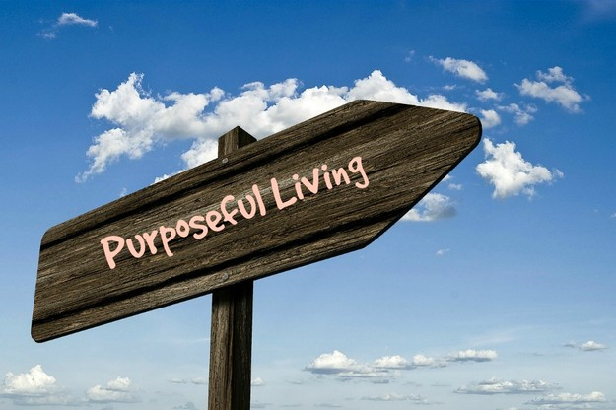
You Live What You Believe Romans 6:8-11
Part Two

Slide 2
At that crossroads of life – baptized into Christ,
into his death
& into every benefit of his death.
Lesson One
Life Changing Decision
Romans 6:1-4

Slide 3
At that crossroads of life – baptized into Christ,
into his death
& into every benefit of his death.
Lesson One
Baptism: an entry point
Baptism: our death initiated by God and performed by him
Baptism: An act of Grace
on God’s side
Baptism: An act of Faith
on our side
Life Changing Decision
Romans 6:1-4

Slide 4
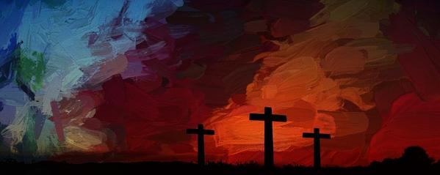
Two essential facts to know in order to live with purpose
First fact: to recognize and know, that we were crucified with him.

Slide 5
Two essential facts to know in order to live with purpose
First fact: to recognize and know, that we were crucified with him.
Means a past event that was successfully, completely, effectively, and actually took place.

Slide 6
Two essential facts to know in order to live with purpose
It was done to you – you didn’t do it. God did it to and for you.
First fact: to recognize and know, that we were crucified with him.
Means a past event that was successfully, completely, effectively, and actually took place.

Slide 7
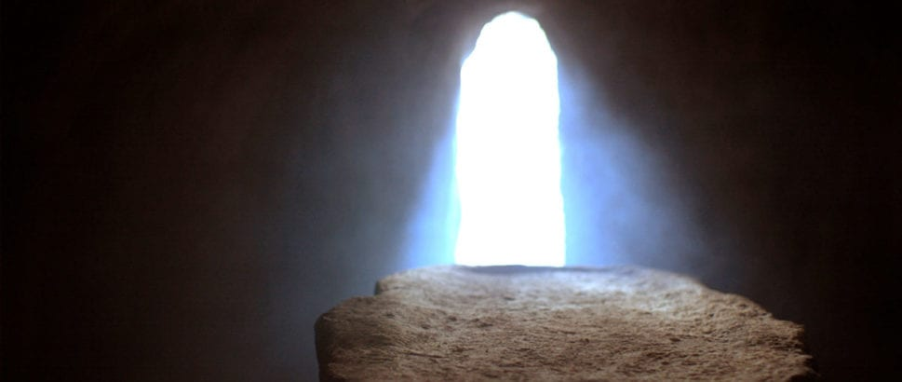
My future resurrection keeps my eyes in the correct direction
“…we will certainly also be untied with him in his resurrection.6:5 b

Slide 8
My future resurrection keeps my eyes in the correct direction
More to come in
my resurrection
“now” and “not yet”
“…we will certainly also be untied with him in his resurrection.6:5 b
Living in the reality of “dead to sin”

Slide 9
My future resurrection keeps my eyes in the correct direction
More to come in
my resurrection
“now” and “not yet”
“…we will certainly also be untied with him in his resurrection.6:5 b
Living in the reality of “dead to sin”
We are living in the reality of “dead to sin” and yet
a “more to come” in the final death of sin.

Slide 10
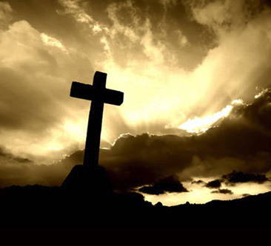
My ‘death’ unites me with a future life with Christ
Now if we died with Christ,
we believe that we will also live with him
Romans 6:8

Slide 11
My ‘death’ unites me with a future life with Christ
Two things Satan wants to get your attention off
The reality of your death,
and the reality of a future
resurrected life with Christ.
Now if we died with Christ,
we believe that we will also live with him
Romans 6:8

Slide 12
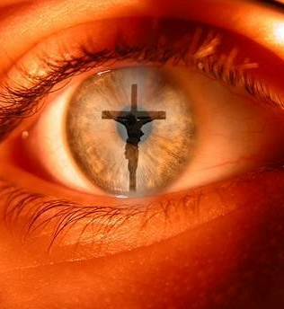
Christ-focused; Christ-centered
For we know that since Christ was raised from the dead, he cannot die again; death no longer has mastery over him. The death he died, he died to sin once for all; but the life he lives, he lives to God.
Romans 6:9,10

Slide 13
In the same way, count yourselves
dead to sin but alive to God in Christ Jesus
Romans 6:11

Slide 14
What shall I say to this? Should I live under
the same roof as Sin just so that there will be
a superabundance of Grace? Ridiculous!
I forever left the dominion of sin; how can I say
it’s still my home? It is quite clear that when I
was immersed into Christ Jesus I was plunged
into his death and bonded to every
benefit of his death.

Slide 15
Let me connect the dots for you:
Through a dipping under water,
I was buried with him into death.
This began a total separation from my old life.
Christ was raised, out from the dead,
by the magnificent majesty of the Father.
In exactly the same way, I am also
raised up like him, so that I might live
my new life in a uniquely new way.

Slide 16
In view of the fact that my baptism intertwined me
with him into a mirror image of his death,
I will certainly experience a similar likeness of his resurrection. Thus experiencing this: the “old me”
was crucified with him. The expressed purpose
of that crucifixion was so that the life of “Selfish Me”
might be completely defective thus I am no
longer slavishly devoted to “Sinful Me.”
For having experienced this death, God’s judgement pronounced me “just-as-if-I-had-never-sinned.”

Slide 17
On top of all of this, if I in fact died with Christ, I am firmly persuaded and am confident that I will also live with him.
For I have come to grasp that Christ, having been raised up from the dead will never face death again. He is outside of death’s jurisdiction and is no longer under its rule. The death Christ died was a one-time-death, but now, the life he currently lives, he lives oriented to God. So in the same way, I consider and think of “Selfish-Me” as truly a lifeless corpse in regard to “Sinful-me.” But indeed, now I live oriented with eyes toward God while implanted in Christ Jesus.

