Slide 1
Godly Leadership
Mark 10:35-45

Slide 2
Christian leadership:
More to do with one’s character
than by their position
Godly Leadership

Slide 3
Worldly Principles
Godly Principles

Slide 4
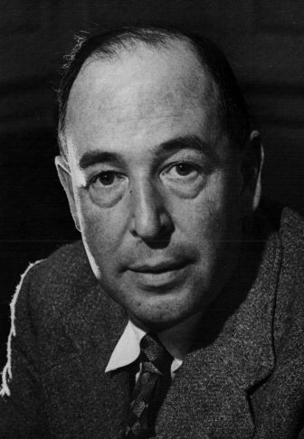
“Hell is a state where everyone is perpetually concerned about his own dignity and advancement, where everyone has a grievance, and where everyone lives the deadly serious passions of envy, self-importance and resentment.”

Slide 5
Be a servant
Mark 10:35-45
Me First!
Time to Grow Up

Slide 6
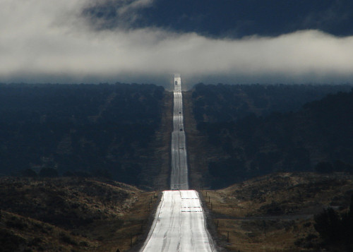
Great
First
Not So With You
Servant
Slave
The Road to Greatness

Slide 7
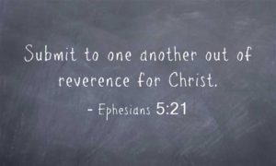
Christians have the greatest right of all – the right to give up their rights
Yield Your Rights

Slide 8
The first principle in having godly leaders.
A Christian leader
must be a Servant
and Submissive.
I am a servant, I will submit.

