Slide 1
Blending in new members
Forward
Romans 15:7
UPWARD
Outward
WARD
IN

Slide 2
God is a hospitable God
Genesis 1 – it was good
Our fellowship is with the Father… 1 John 1:3,4
UPWARD
Everything we need 2 Pet. 1:3
Life to the full– John 10:10
Who richly provides everything for our enjoyment. 1 Tim 6:17

Slide 3
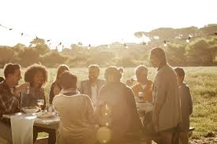
On this mountain the Lord Almighty will prepare a feast of rich food for all peoples, a banquet of aged wine – the best of meats and the finest of wines. Isaiah 25:6,7

Slide 4
Offer hospitality to one another
without grumbling - 1 Peter 4:9
Characteristics of an elder/shepherd. 1 Tim 3:2;
Titus 1:8 – “must be hospitable.”
WARD
Hospitality is a sign of spiritual maturity.
IN

Slide 5
Remember that at that time you were separate from Christ, excluded from citizenship in Israel…and without God in the world. But now in Christ Jesus you who were once far away have been brought near through the blood of Christ…. His purpose was the create in himself one new man out of the two, thus making peace,... He came and preached peace to you who were far away… For through him we both have access to the Father by one Spirit. Consequently, you are no longer foreigners and aliens,… members of God’s household. Ephesians 2:12-18
Outward

Slide 6
Accept one another, then, just as Christ accepted you, in order to bring praise to God – Romans 15:7
Forward
The strong bearing with the failings of the weak 15:1
Doing things to please others in order to
encourage them 15:2
Focus on the sharing Scriptures to promote endurance, encouragement and hope. 15:4
Recognize that God is working through his word and is the cause of unity 15:5
Results in a God-centered and Christ-centered life 15:6

Slide 7
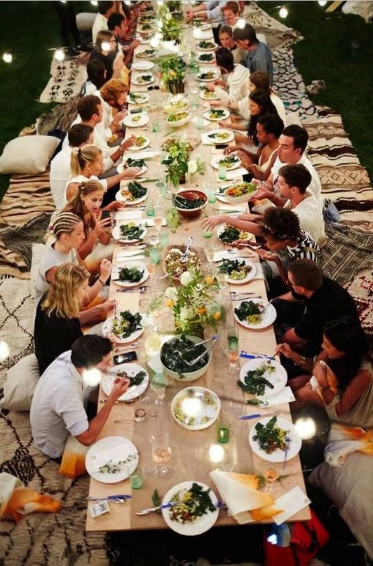
I delight greatly in the Lord; my soul rejoices in my God. For he has clothed me with garments of salvation and arrayed me in a robe of righteousness Isaiah 61:10
For all of you who were baptized into Christ have clothed yourselves with Christ Galatians 3:27
Matthew 22:1-14

