Slide 1
Kingdom Life Requires Daily Workouts!
Central Family: Our Journey Together
November 3, Study 2
1 Corinthians 9:19-27

Slide 2
Consider…
Christian master narrative: take your given blessings, choose to use them for other than your own advantage, serve others for their well-being.
Purpose of the church – to show the world the holiness of God as we live in God’s narrative of generous gift…
God leads us to die so that we might live.
We are not who we think we are to the world – for them we are who they think we are – we need to “re-brand.”
We (all humanity) were made in the image of God. Jesus is the image of God in the flesh. Kenosis is the frequency of authentic living.
Not so much to “imitate” Jesus as to participate with him in new creation. We are called to be the proleptic, eschatological people of God – a contrast community – the visible reign of God

Slide 3
What might this look like?
A community:
of justice in a world of economic and ecological injustice
of generosity and simplicity (of “enough”) in a consumer world
of selfless giving in a world of selfishness and entitlement
of humble and bold witness to the truth in a world of uncertainty
of hope in a world of disillusionment and brokenness
of joy and thanksgiving in a hedonistic world that frantically pursues pleasure

Slide 4
If we don’t change the narrative, we can’t change the church…transformation is the Spirit’s work.
Most present solutions are not helpful. Tweak worship, change preachers, remodel the building, take a survey…
Must confront the elephant in the room – too many of us are not living in God’s redemptive narrative.
Helpful change comes from within (renewing, transformative work) via the Holy Spirit.
Jesus said our actions come from within, caused by how we “see” the world. If our eyes are full of darkness (sinful distortions), there is no light.
Romans 8:1-15 – live according to the flesh? Death. Mind governed by the Spirit? Life and peace! “Through the Spirit put to death the misdeeds of the body and live!” (8:13)

Slide 5
Paul’s Challenge to the Colossians…
New (ancient) narrative: Colossians 1:15-22
Colossians 2:2, 3 – all treasures of wisdom and knowledge hidden here
Colossians 2:8 – WARNING – all other narratives are false…
How do we become a part of this story? Colossians 2:9-15 By God’s grace!
Colossians 3 is the challenge – live into the story! You have been raised, set your hearts and minds on God’s purposes, not this secular world!
Take off, put to death what does not belong…
Replace it with godly attire – intentionally dress yourselves with compassion, kindness, humility, gentleness and patience…
Live a life of singing this song! All that you do!

Slide 6
OK, I understand, but how?
We all need a “Rule of Life.”
We have been called to be athletes of God’s kingdom and training is required!
I Corinthians 9:19-27 – diligent training is indispensable in Christian walk.
Training vs. Trying
We cannot try to be like Jesus without accepting his training regimen.
IT IS NOT ABOUT DOING MORE OF WHAT YOU ARE PRESENTLY DOING POORLY. “A bucket of balls does not cure a bad swing.”
We need to relearn the Christian practices so that they become the workplace of the Holy Spirit.

Slide 7
Essential Practice Elements…
Love God with all your heart, mind, strength, soul – all disciplines should deepen our love for God!
Feed your soul! A high spiritual metabolism requires nourishment Psalms 19:7-8; 119:20, 27 Developing a longing for study…
Quiet your mind and learn from God – the desperate need for reflective disciplines…
Note the results. Not all practices produce fruit.
All spiritual disciplines lead not only to love of God but love of fellow human beings.
Spiritual formation or disciplines that does not lead to missional living is not authentically Christian…

Slide 8
Daily, Weekly, Monthly, Yearly
Homework? Develop a “rule of life” and keep it. INTENTIONALITY is the first discipline.
Begin the day with the Lord, intentionally
Give the best part of your day to knowing God better
Open your eyes and your ears to the language and events of the kingdom
Examen – awake to the work of God around you. Join God in his work – he is already there.
Find helpful “replacement” disciplines. Consider buying a copy of Adele Calhoun’s Spiritual Disciplines Handbook (2 edition is better).
Develop a routine. Assess the value – experiment, discover, flourish!

Slide 9
Surprise the World: M. Frost
Colossians 4:2-6
The 5 weekly habits of highly missional people:
Bless – bless three people this week, one nonbeliever
Eat – eat with three people, at least one nonbeliever
Listen – develop the habit of listening to the Spirit’s voice
Learn – intentionally learn something new about Christ
Sent – journal about the ways you alert others to the universal reign of God through Christ
Generous, hospitable, Spirit-led, Christ-like, Missional

Slide 10
Living God’s Love
“Embodied Evangelism”
God is already at work in every heart and every place
God works most powerfully through the servant who, with the help of God’s Spirit, increasingly embodies Jesus Christ…
We cannot share what we do not have. The key to evangelism is an authentic relationship with God through Christ Jesus (1 John 1:1-4)
We must manifest a deep and sincere hope that is so apparent to others they will ask about it…
Communities of sincere love stand as a beacon for those longing for meaningful relationships and purposeful lives…
Notes:
May require more than one slide

Slide 11
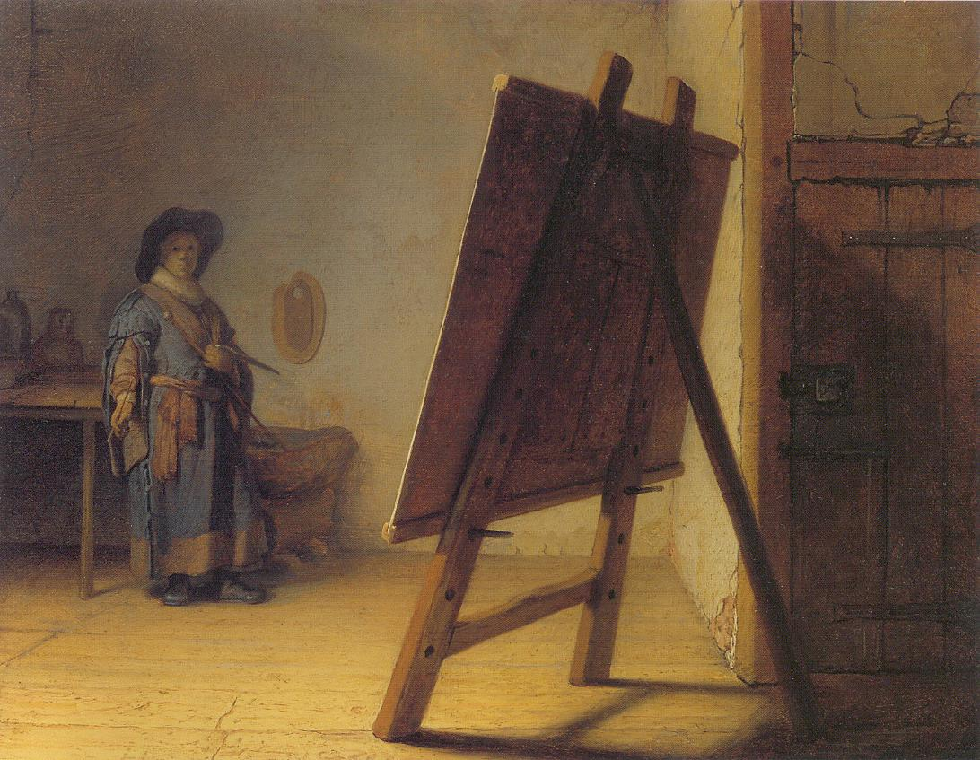
The canvas of your life stands before you…

