Slide 1
Lifting Up The Persecuted At Home
Matthew 5:10,11
UPWARD
Outward
WARD
IN

Slide 2
Blessed are those who are persecuted
because of righteousness,
for theirs is the kingdom of heaven.
Blessed are you when people insult you,
persecute you and falsely say all kinds of evil
against you because of me
Matthew 5:10,11

Slide 3
The point
of persecution
Righteousness sake
In fact, everyone wants to live
a godly life in Christ Jesus
will be persecuted…
2 Timothy 3:12
…you do not belong to the world, but
I have chose you out of the world.
That is why the world hates you
John 15:19

Slide 4
The point
of persecution
…they think it strange…they
heap abuse on you
1 Peter 4:3,4
You will be betrayed even by parents, brothers, relatives and friends, and they will put some of you to death. All men will hate you because of me.
Luke 21:16,17

Slide 5
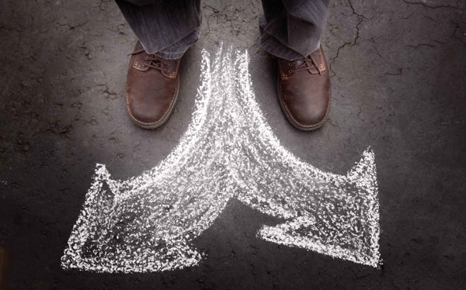
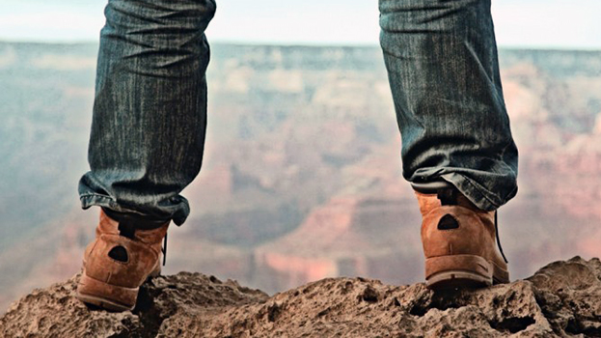
Two Alternatives
Revert to old way of life
Stand your ground
At the point of persecution
either faith becomes trust
or we will lose our faith.
By standing firm you
will gain life.
Luke 21:19

Slide 6
Consider him who endured such opposition
from sinful men, so that you will not
grow weary and lose heart
Hebrews 12:3

Slide 7
Blessed are the poor in Spirit
for theirs is the kingdom of heaven
Blessed are those who are persecuted for righteousness
for theirs is the kingdom of heaven
Mourn,
Meek,
Hunger and thirst for righteousness,
Merciful,
Pure in Heart,
Peacemakers

Slide 8
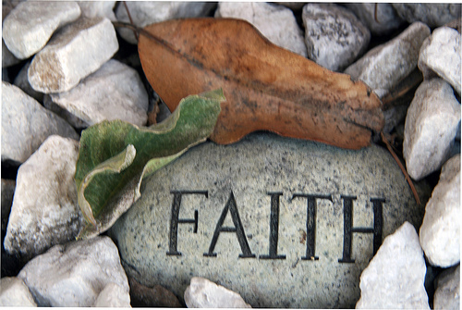
Suffering solidifies
I am not ashamed, because I know whom I have believed and am convinced that he is able to guard what I have
entrusted to him for that day.
2 Tim 1:12b
“And of this gospel I was appointed a herald, and an apostle and a teacher” (this was his work of telling people of the good new of Jesus). The results? “That is why I am suffering as I am….”
1 Timothy 1:11.12a

Slide 9
So do not be ashamed to testify about our Lord, or ashamed of me his prisoner. But join with me in suffering for the gospel, by the power of God…”
2 Tim. 1:8

