Slide 1
Helping the Weary and Burdened Find Rest
Matthew 11:28-30
UPWARD
Outward
WARD
IN

Slide 2
Rest
Come to me, all you who are weary and burdened, and I will give you rest. Take my yoke upon you and learn from me, for I am gentle and humble
in heart, and you will find rest for your souls. For my yoke is easy
and my burden is light
Matthew 11:28-30

Slide 3
A Call to Come
“Come here!”
“Come Now!”

Slide 4
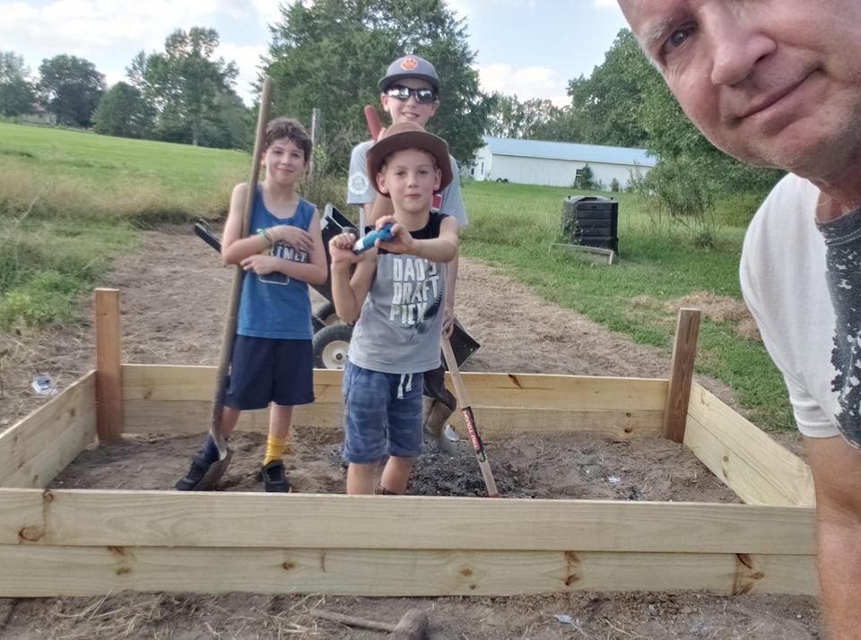
A Call to All
All who are weary and burdened
Weary – the exhaustion that occurs after hard and sweaty work.

Slide 5
Weary
“Come to me”
“I will give you rest”
Burdened

Slide 6
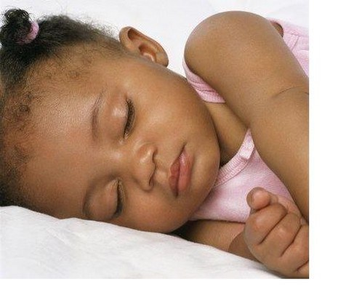
A Call to Rest
Rest comes in a relationship
“Come learn
of me.”
“I will give you rest”
A Promise
"I will give you rest," i.e., I will stay (sustain you with strength) you. Not - I will put you to bed and hold your hand and sing you to sleep; but - I will get you out of bed, out of the languor and exhaustion, out of the state of being half dead
while you are alive; I will imbue you with the
spirit of life, and you will be stayed by the perfection of vital activity.
Oswald Chambers

Slide 7
Lord, thou madest us for Thyself,
and we can find no rest till we find rest in Thee!
Augustine
How rested are you?
“Come learn of me”

