Slide 1
Seeing the Lost & Caring Deeply
Acts 8:4
UPWARD
Outward
WARD
IN

Slide 2
Matthew 28:19
“having gone” (Berean Literal Bible),
“as you go” (International Standard Version)
“wherever you go” (God’s Word Translation),
“having gone” Young’s Literal.
“as you go throughout your day”
“wherever you go.”

Slide 3
God’s word spread by persecution
Those who had been scattered preached the word where ever they went.
Acts 8:4
Because they didn’t obey
1:8
God allowed 8:1
“Therefore”
“Saul
consented”
Christians were scattered into
Judea and Samaria.

Slide 4
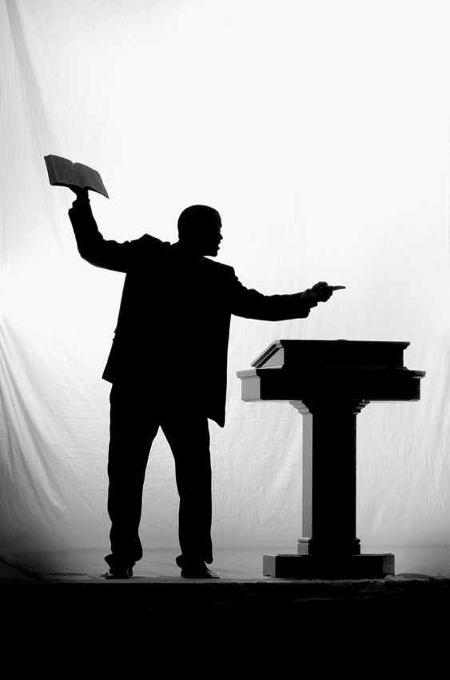
Positive reaction to persecution
They escaped persecution!
Gossiping the Gospel
They “preached”
Euangelizo:
Good tidings
“gospeling”
“speaking good news”,
“sharing good tidings”.
Kerygma:
preach
Didasko:
teach

Slide 5
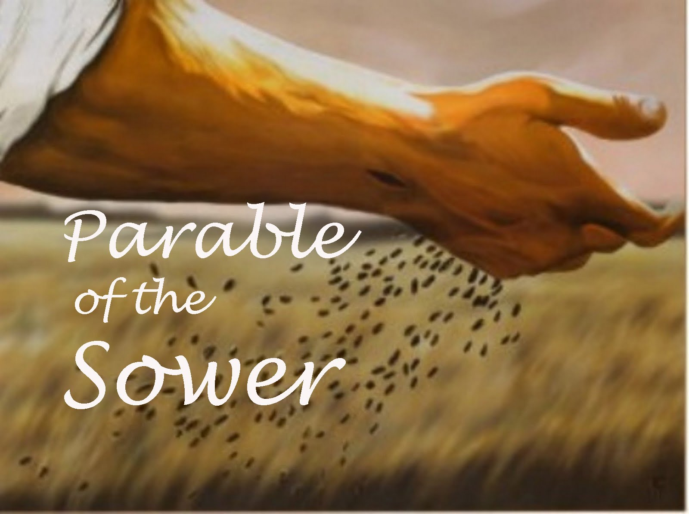
Scattered people scattering the Word
Dia-speria: disperse
Acts 8:4: God is sowing people
in Judea and Samaria
When the people are scattered the word is scattered – gossiped
The seed was the word of God –
fell on four soils

Slide 6
Christ living in you
Christ-centered living
Your life is your worship

