Slide 1
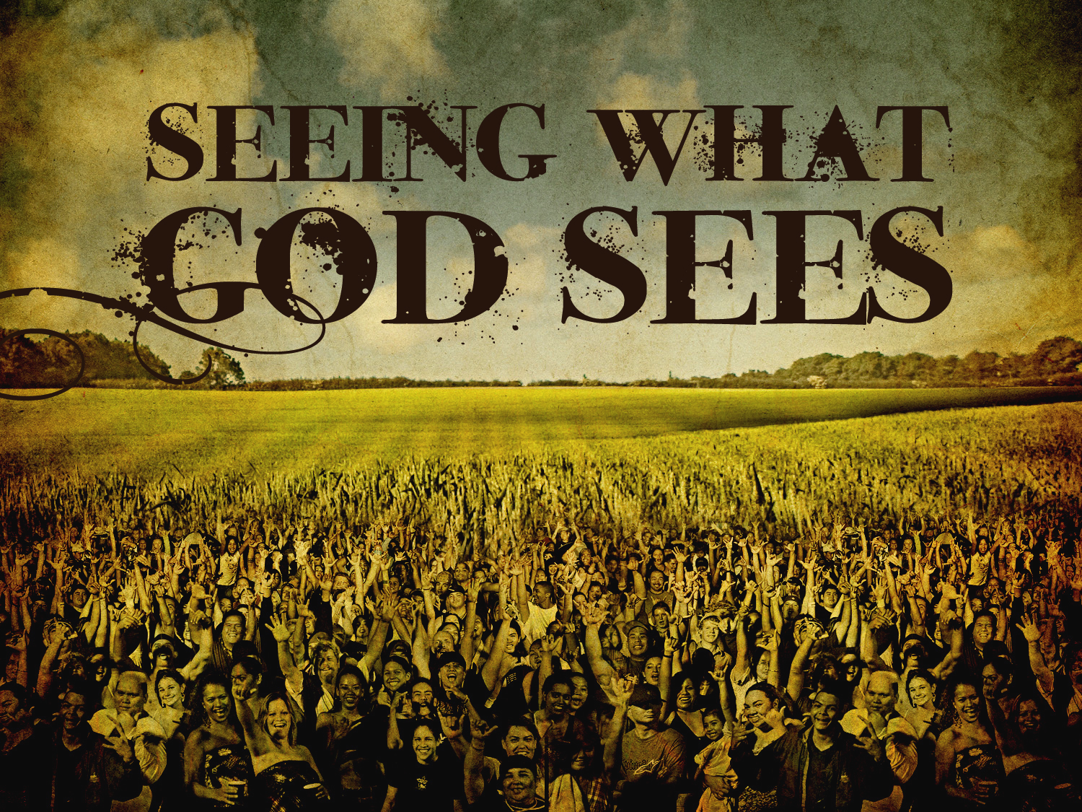
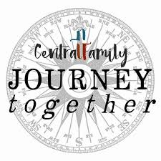
July 28, 2019

Slide 2
Memory verse: Matthew 9:36
“When he saws the crowds, he had compassion on them, because they were harassed and helpless, like sheep without a shepherd.”
Following verse is where we come into the story: “Then he said to his disciples, ‘The harvest is plentiful but the workers are few. Ask the Lord of the harvest, therefore, to send out workers into his harvest field.”
This is not a one-time event. Luke loves this attribute. Consider Luke 9 – disciples sent out, then return. Withdrew, only to be followed by crowds!
Time to withdraw, rest? No, Jesus welcomed them…
What we see as distractions and disturbances, Jesus saw as kingdom opportunities.

Slide 3
The Gift of Sight…
A compelling story in the gospels – the blind are given sight…
John 9 “I am the light of the world” – put mud on blind man’s eyes…
Who was blind? Not the blind man, but the blinded Jewish leaders.
Matthew 20:29-34. Two blind men. “What do you want me to do for you?”
What would we say?
Matthew 6:19-24. We see what we value…
How do we look at “the other?”
Summer course “Story of Israel.”

Slide 4
The Incredibly Offensive Ministry of Jesus
Jesus saw what no one else saw…
Over and over, he saw seeking hearts and responded with grace.
Jesus “died” every day…
Luke 7:36-50. How did the sinful woman know she would be safe?
At Levi’s party. “I have come to seek and save the lost…”
Not politically correct today – can’t say someone is “lost.”
Who is lost?
Anyone who is without peace, purpose, and a deep centering story…
Don’t have to tell someone bad news to hear good news!

Slide 5
The Integrated Soul at Peace…
SOCIAL INTERACTIONS
The soul is the capacity to integrate all the parts into a single, whole life.
A well-ordered soul also harmonizes one’s totality with other humans and creation itself
This is the true meaning of integrity – we are integral when aligned and flourishing
An unhealthy soul experiences disintegration – a lost soul is not speaking of its “destination” but its current condition…
“Kingdom of God” is an alignment of the human condition providing shalom for the soul…
SOUL
BODY
MIND
WILL

Slide 6
This is the invitation of Jesus…
Are you tired? Worn out? Burned out on religion?
Come to me.
Get away with me and you’ll recover your life.
I’ll show you how to take a real rest.
Walk with me and work with me – watch how I do it.
Learn the unforced rhythms of grace.
I won’t lay anything heavy or ill-fitting on you.
Keep company with me and you’ll learn how to live freely and lightly.”
Matthew 11:28-30 The Message

Slide 7
Simply Christian
NT Wright
Gradually we are glimpsing a truth which cannot be overemphasized: the tasks which await us as Christians, the paths we must walk and the lessons we must learn, are part of the great vocation which reaches us in God’s word – the word of the gospel, the word of Jesus and the Spirit. We are called to be part of God’s new creation, called to be agents of that new creation here and now.

Slide 8
We are called to model and display that new creation in symphonies and family life, in restorative justice and poetry, in holiness and service to the poor, in politics and in painting.
When you see the dawn breaking [of new creation], you think back to the darkness in a new way. “Sin” is not simply the breaking of a law. It is missing of an opportunity [to live].

Slide 9
We are called to become people who can speak and live and paint and sing that word so that those who have heard its echoes can come and lend a hand in the larger project.
That is the opportunity that stands before us, as gift and possibility. Christian holiness is not a matter of denying something good. It is about growing up and grasping something even better…

Slide 10
Made for spirituality, we wallow in introspection.
Made for [lasting] joy, we settle for [temporary] pleasure.
Made for justice, we clamor for vengeance.
Made for relationship, we insist on our own way [even if it costs the relationships closest and dearest to us]
Made for beauty, we are satisfied with sentiment.
But new creation has already begun. The sun has begun to rise.

Slide 11
Christians are called to leave behind, in the tomb of Jesus Christ, all that belongs to the brokenness and incompleteness of the present world.
It is time, in the power of the Spirit, to take up our proper role, our fully human role, as agents, heralds, and stewards of the new day that is dawning.
That, quite simply, is what it means to be Christian:
to follow Jesus Christ into the new world - God’s new world
which he has thrown open to us…

