Slide 1
Standing firm on Biblical truths
Hebrews 3:14
UPWARD
WARD
IN

Slide 2
Hebrews 3:14
“We have come to share in Christ,
if indeed we hold our
original conviction firmly to the very end.

Slide 3
Two choices
Right
Light
Spirit
Narrow
Scriptures
Wrong
Darkness
Flesh
Wide
Many Ways
We all live by faith

Slide 4
1 - Be ready to give an answer
But in your hearts set apart Christ as Lord.
Always be prepared to give an answer to everyone who asks
you to give the reason for the hope that you have ~ 1 Peter 3:15
Context: persecution and suffering
“Do not be afraid of their attempts to make you afraid
and don’t get uptight and worried thinking about all
the things that might happen to you” 3:14
Three Responses to Reality

Slide 5
Set
apart Christ
as
Lord
Be ready to give an answer
“BUT”
“simply concentrate on being completely devoted to Christ
in your hearts”
The answer is based in a growing relationship with Christ.
Means give a defense.
The
hope
Three Responses to Reality

Slide 6
2 - Not ashamed of the full gospel
I am not ashamed of the gospel, because it is the power of God for the
salvation of everyone who believes; first for the Jew, then for the Gentile.
For in the gospel a righteousness from God is revealed, a righteousness that is by faith from first to last, just as it is written: “The righteous will live by faith.” Romans 1:16,17
Gospel: “good news”
Multilayered
God’s character 4His initiative 4Remove sin/guilt 4Power 4 Transformed lives 4Future home and glory
Three Responses to Reality

Slide 7
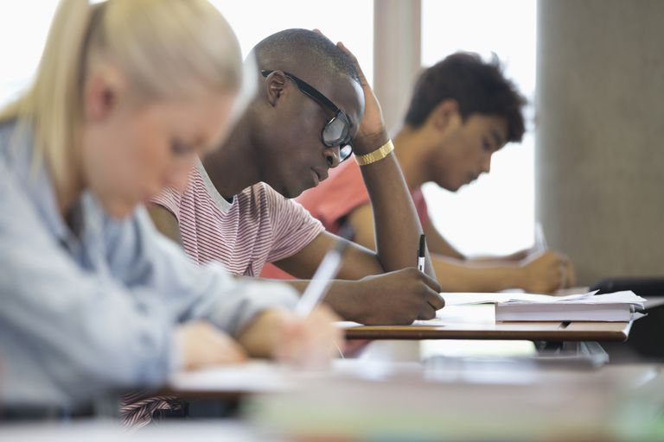
3 – Testing to see if I am remaining
true to the faith
“Beloved”
Based in who you are – in your
relationship with God
Test
not based in how
well I perform
or make a grade
Don’t be naïve
Just as God’s spirit is expressed
in our lives by the fruit of the Spirit
so the world’s spirits are expressed
in the life of the world.
1 John 4:1-3
Three Responses to Reality

Slide 8
How Do You Test the Spirits?
You do it by the word of God.
Rom 12:1,2; 2 Tim 3:16; Heb 4:12
If you don’t know the word of God, if you
haven’t been trained in righteousness by it,
then you’ll be duped by the spirits of this
world over and over.

Slide 9
Practical Applications
Two choices
WORK
RELATIONSHIPS
ATTITUDES
MARRIAGE
ETC.
The World
Scripture

Slide 10
A Choice:
Savior plus
my works:
Savior but holds
to the world:
What think you of Christ? is the test
To try both your state and your scheme;
You cannot be right in the rest,
Unless you think rightly of him;
Some call him a Savior in word,
But mix their own works with their plan;
And hope he his help will afford,
When they have done all that they can;
Some style him the pearl of great price
And say he’s the fountain of joys,
Yet feed upon folly and vice,
And cleave to the world and its toys;

Slide 11
If ask’d what of Jesus I think,
Although my best thoughts are but poor;
I say he’s my meat and my drink,
My life, and my strength, and my store,
My Shepherd, my husband, my friend,
My Savior from sin, and from thrall,
My hope from beginning to end,
My portion, my Lord, and my all

