Slide 1
Living an open and righteous life
1 Peter 2:12
UPWARD
WARD
IN

Slide 2
Live such good lives among the pagans
that though they accuse you of doing wrong
they may see your good deeds and glorify God
on the day he visits us.
1 Peter 2:12

Slide 3
Live - “have” or “hold”. Hold the line as a soldier
Good - beautiful, handsome, excellent, surpassing, precious, commendable, admirable.
Lives – “from down to up – turn!” or Upturn. Outward change of behavior based on inward change
Among the pagans – those not Christians
Accuse – put down, speak down in an hostile and malicious way.

Slide 4
Doing wrong – someone evil who deserves to be punished.
See – eyewitness, observe, watch attentively.
Good deeds – deeds, works, actions
Glorify – give proper opinion of God
Day of visitation – anytime God enters a person life for blessing or judgement.

Slide 5
Hold the line when it comes to your conduct out
in the day-to-day battlefield of the world. You should be of such excellent character that though
people place you in the category of evil their eyes
will witness admirable and surpassing goodness in your beautiful conduct. Then when push comes to shove,
and their lives fall apart or when their eyes are
opened to God’s blessings they will have no choice
but to glorify Him by what you say and do.

Slide 6
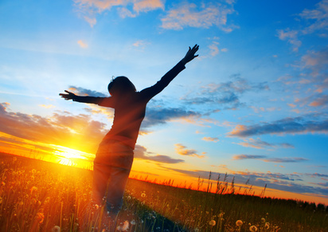
Four ways
to live “beautifully”
Holy, righteous living and accountability.
Therefore, since we have these promises, dear friends, let us purify ourselves from everything that contaminated body
and spirit, perfecting holiness out of reverence for God. - 2 Cor 7:1
Therefore – since we have these promises
2 Cor. 6:16-18
I will live with them. I will walk among them.
I will be their God. They shall be my people. I will receive you.
I will be a Father to you. You shall by my sons and daughters.

Slide 7
Four ways
to live “beautifully”
Speak the truth in love
Instead, speaking the truth in love, we will grow to become in every respect the mature body of who is the head, that is, Christ
Eph. 4:15
Beautiful living is express
with beautiful words
Scripture is Christ-focused in how we live,
not Me-focused in how I speak.
“Truthing in love”
It means not only what I say but how I live.

Slide 8
Four ways
to live “beautifully”
Dealing with Hypocrisy
You are like white-washed tombs…one the outside you appear to people as righteous but on the inside you are full of hypocrisy and wickedness – Matthew 23:27,28
Hypocrisy - different on the outside than the inside
Who are you on the inside?
Colossians 3:4 – when Christ, who is your life…

Slide 9
Four ways
to live “beautifully”
Humble confession and restoration
Requires an honest evaluation
of self and Christ
A Christian’s continual confession is that we are less than what we should be – that we are greater than what we once were – that we are on a journey toward maturity.

Slide 10
Four ways
to live “beautifully”
1:6 – we cannot claim fellowship and live hiding our sin –
1:8 we cannot even claim we don’t struggle with sin.
1:10 we cannot claim that we don’t commit acts of sin.
Our lives of continued humble confession produce a continued life of living in a right relationship with God.

Slide 11
You are beautiful beyond description Too marvelous for words Too wonderful for comprehension Like nothing ever seen or heard Who can grasp Your infinite wisdom Who can fathom the depths of Your love You are beautiful beyond description Majesty, enthroned above
And I stand, I stand in awe of You I stand, I stand in awe of You Holy God to whom all praise is due I stand in awe of You

