Slide 1
Superiority of Christ
Ephesians 1:19-23
Dealing with the overwhelming powers of life
UPWARD
WARD
IN

Slide 2
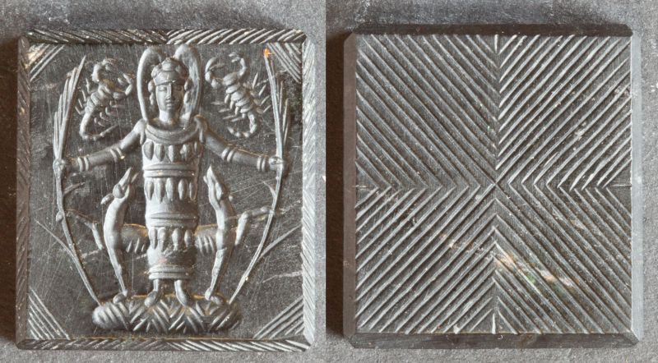
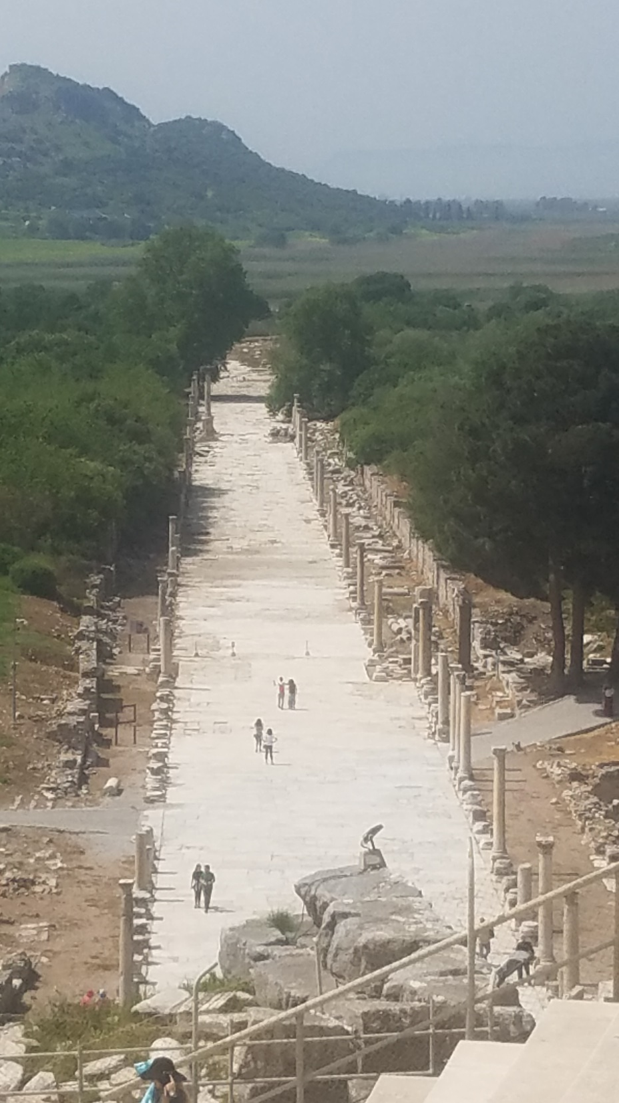
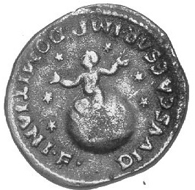
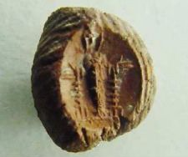
Journey Point Supremacy
Characteristic Being
Christ-like

Slide 3
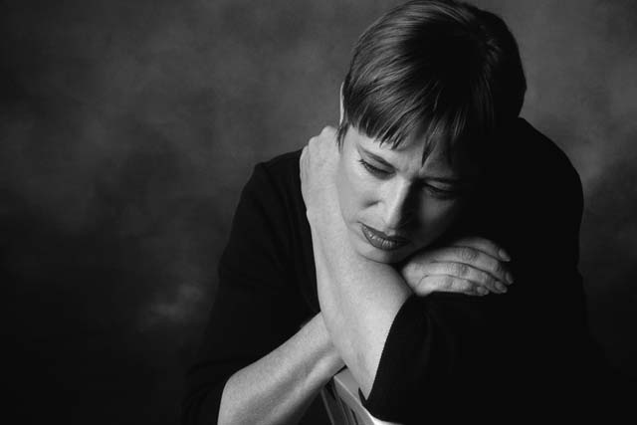
The answer to overwhelming powers
The answer is knowledge:
“Know him better” v. 17
“That you may know” v.18
The answer to the overwhelming powers of life is based in the superiority of Christ.

Slide 4
Three things to know
Know the hope
(v.18)
You will live toward your hope
Your hope is either in something uncertain (a wish)
or certain (Biblical hope based in a firm
conviction of truth).
The hope of our calling means that the life
I am called to is life with meaning

Slide 5
Three things to know
Know the riches of God’s inheritance (v.18)
To know that you are special in God’s sight – his child, his beloved, his chosen, the one he has redeemed and justified is to know your place in God’s sight.
Know his incomparable great power (v19)

Slide 6
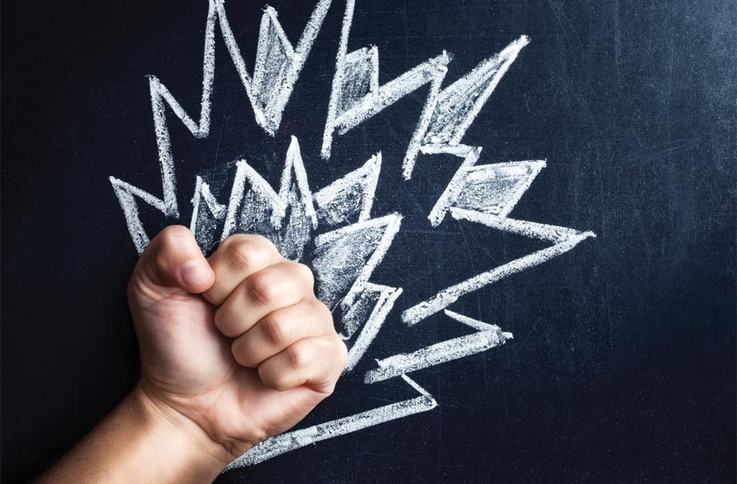
Power words
MEGA-thos
“Surpassing greatness”
”To throw beyond”
To go far beyond greatness – Greater than greater
Power - used of natural, inherent power.
Working - the realization of the power
Might - force and strength that is dominant
Strength - absolute strength, force and able to
overcome immediate resistance.

Slide 7
Power words
What this power does:
It raised Jesus from the dead
It seated him at the right hand of God.
It make him superior or more powerful than any other power or thing or event or circumstance or situation.
It places him at the head or guiding force of the church
It makes the church full of this same power.

Slide 8
And what is this but a greater greatness beyond greatness of the inherent power of God. This power is directed toward those who “faith-walk” – this power comes by the way of his energetic accomplishments
in the absolute might of his able strength to overcome any immediate threat or circumstance. This he demonstrated (to prove he can mightily work in your life) when he raised Jesus from the dead.

Slide 9
God’s mighty strength placed Christ in a mighty place – seated at his right hand in the reality of the
heavenly realms. Christ’s position is greatly higher
than anything! Over all kings or principle positions,
over anything or anyone that bears authoritative
rule or any natural power or anything that would dominate and force allegiance; over every name that declares itself a high status.

Slide 10
And not only now as we live on this earth,
but this is forever – right into the future reality
that is coming. And God placed everything so
far below him that we could say they could only
be seen if he lifts his feet. He is the guiding force,
the principle mind over everything for those
called out of the world and into what we can call,
“his body” He is the “Super Abundance”
filling us all to our fullest capacity.

