Slide 1
Sealed with the Spirit
Ephesians 1:13b-14
UPWARD

Slide 2
Who is a deposit guaranteeing our inheritance until the redemption of those who are God’s possession – to the praise of his glory.
,14

Slide 3
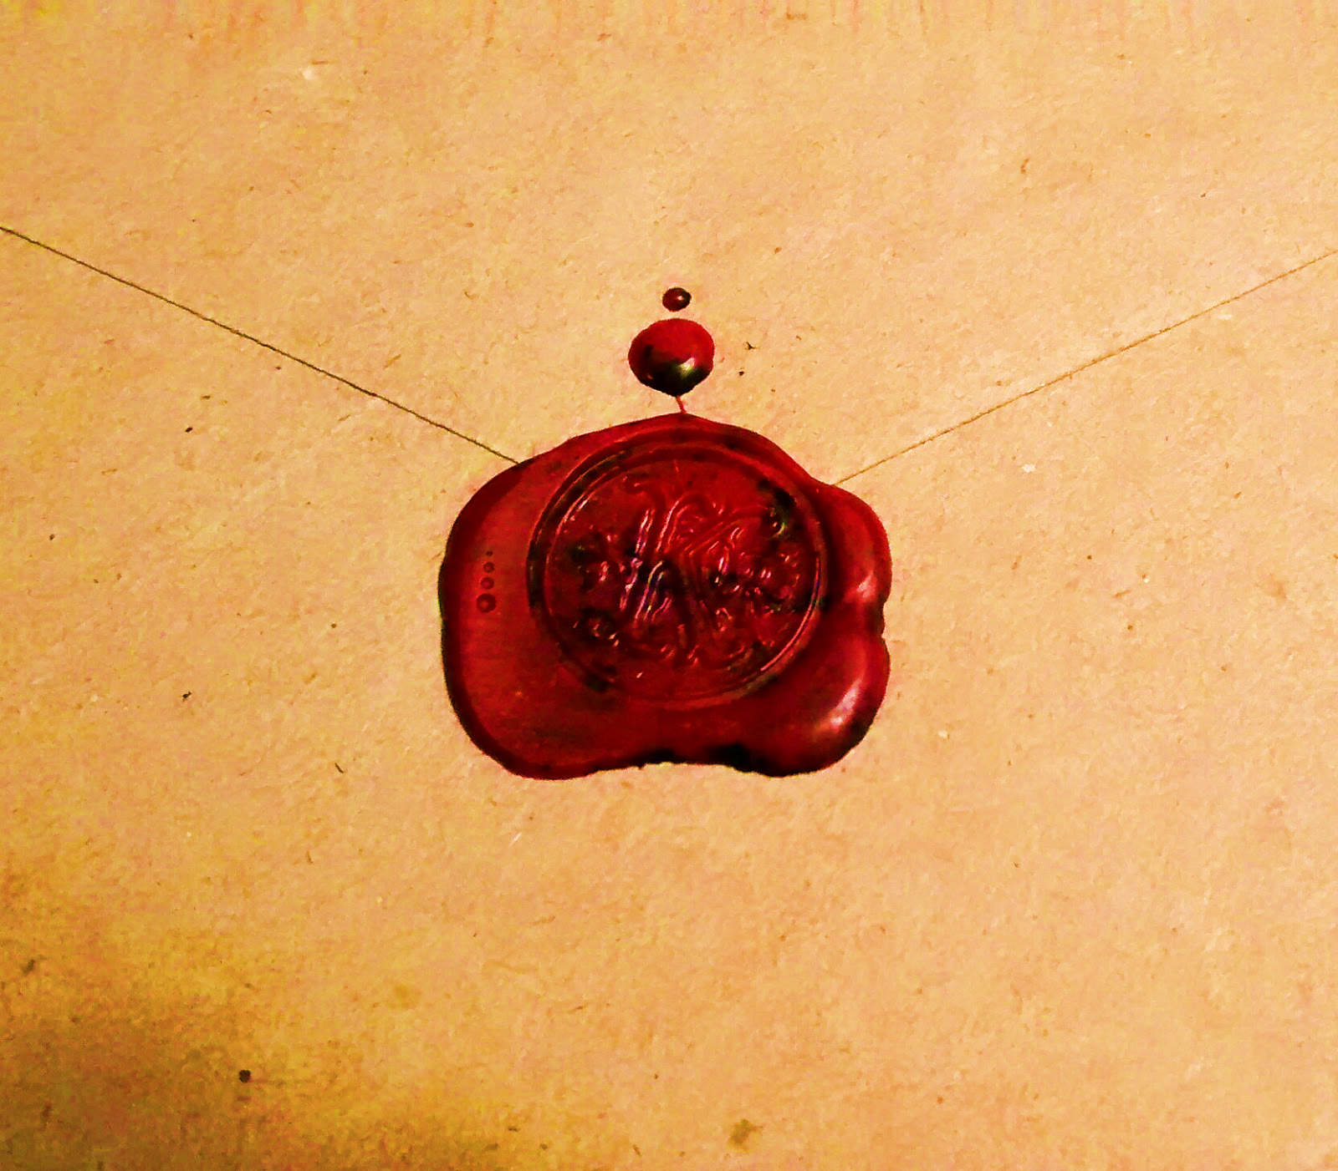
Marked with a seal
We are witnesses of these things, and so is the Holy Spirit, whom God has given to those who obey him
Acts 5:32
Purpose of a seal
True or genuine
Ownership
The seal is the
Holy Spirit
Security
Repent and be baptized, every one of you, in the name of Jesus Christ for the forgiveness of your sins.
And you will receive the gift of the Holy Spirit.
The promise is for you…Acts 2:38,39

Slide 4
We are Marked with a seal
Our seal marks us as genuine and true children of God.
Our seal states that we are God’s possession
Holy Spirit
Our seal provide security – He is a deposit guaranteeing our inheritance

Slide 5
But when he, the Spirit of truth comes, he will guide you into all truth
John 16:13
Seal of the world is instability
Security in an insecure world

Slide 6
Calls attention to Christ
He (the Holy Spirit) will glorify me (Jesus) …
John 16:14
Exalts Christ through
his people
Ephesians 1:22,23
Changes your character
2 Corinthians 3:18
What does the Holy Spirit look like in our lives?

Slide 7
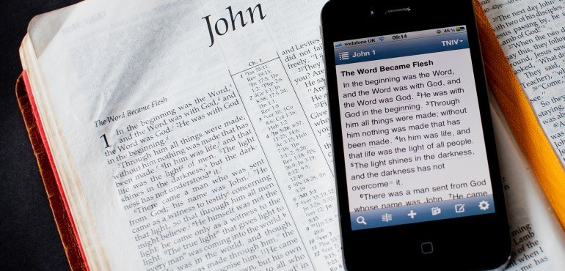
The Holy Spirit and the Scriptures
The Scripture is the means by which the Holy Spirit changes us.
Sanctify them by the truth; your word is truth
John 17:17

Slide 8
You study the Scriptures diligently because you think in them you have eternal life.
These are the very Scriptures that testify about me
John 5:39

Slide 9
Holy Spirit
The Mark of the Spirit is a life that is God praising, maturing in Christ, empowered by the Holy Spirit working through the Scriptures and his church

