Slide 1
Price-tag of Salvation
Ephesians 1:7
UPWARD

Slide 2
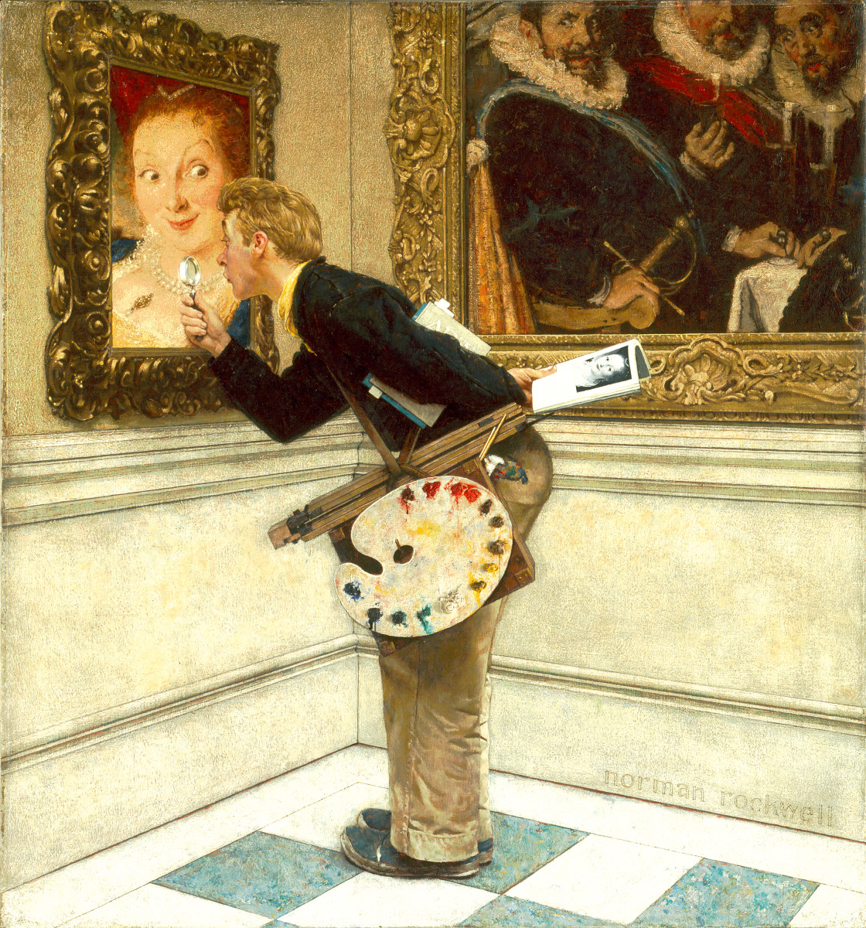
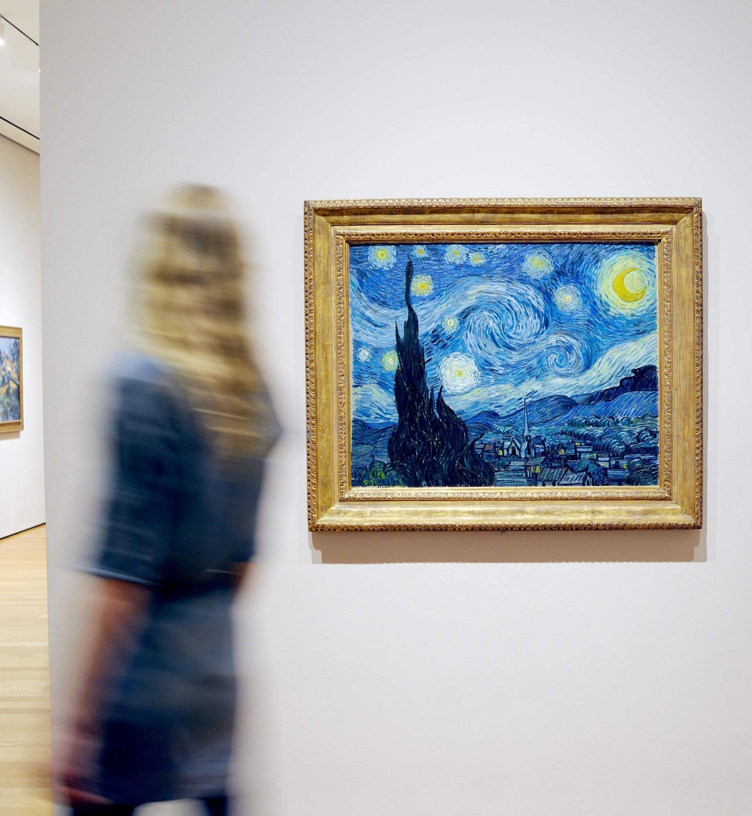
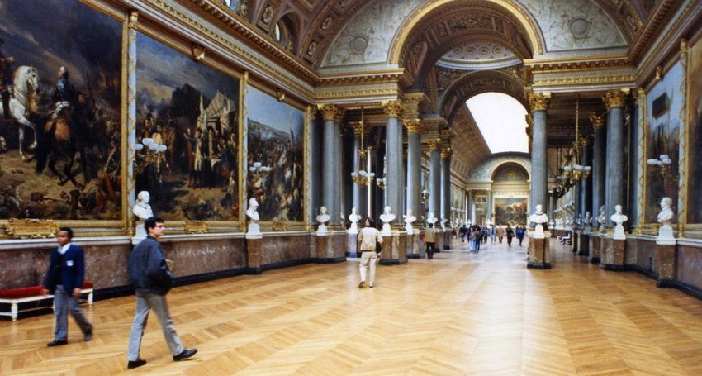
Bible Study can be like going to the Louvre

Slide 3
1:6
The
Downward Upward
GRACE
Whatever causes delight or enjoyment
God’s grace expressed in Spiritual blessings
All blessings…chosen….holy, blameless…adopted
Pleases God and is His desire

Slide 4
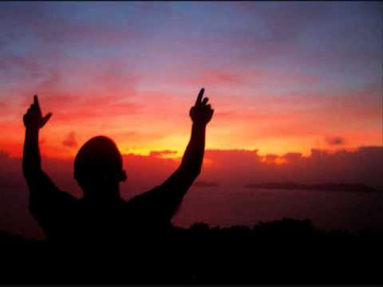
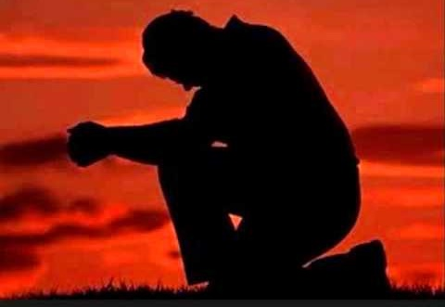
1:6
The
Downward Upward
Praise!
Stand in Awe;
Bow in Wonder
“To the praise of the glory of the grace of which he graced us.”

Slide 5
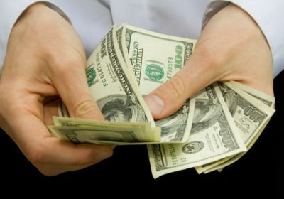
1:7
Our
Beginning Point
Redeemed
Deliverance by payment
The Son of Man came…to give his life as a ransom for many Matthew 20:28
Do you not know that your body is a temple of the Holy Spirit, who is in you…..you are not your own,
you were bought at a price 1 Cor. 6:19,20

Slide 6
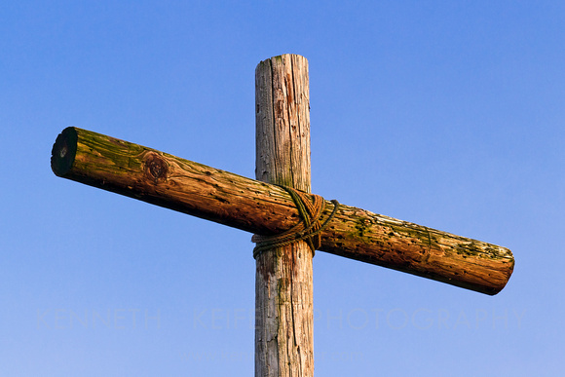
1:7
Our
Beginning Point
Value
What you pay for something shows
its worth
…you were redeemed …with the precious blood of Christ 1 Peter 1:18,19
Redeemed
Through His Blood

Slide 7
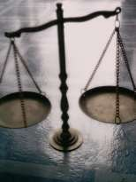
1:7
Our
Beginning Point
Justice
…for all have sinned…and are justified freely by his grace through the redemption that came through Christ Jesus…he did this to demonstrate his justice…
Romans 3:23-25b
Redeemed
Through His Blood

Slide 8
1:7
Our
Beginning Point
Ownership
The shedding of blood shows that Jesus cannot just
be a great teacher
Redemption puts me in a right relationship with God – that relationship is Lord to Servant
Redeemed
Through His Blood

Slide 9
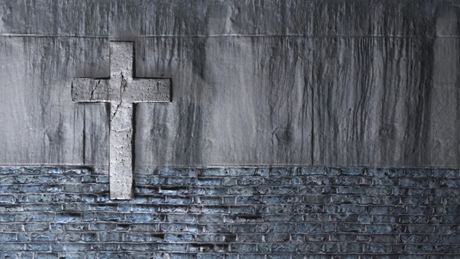
Redeemed, how I love to proclaim it! Redeemed by the blood of the Lamb; Redeemed through His infinite mercy, His child and forever I am.
Redeemed, redeemed, Redeemed by the blood of the Lamb; Redeemed, redeemed, His child and forever I am.

