Slide 1
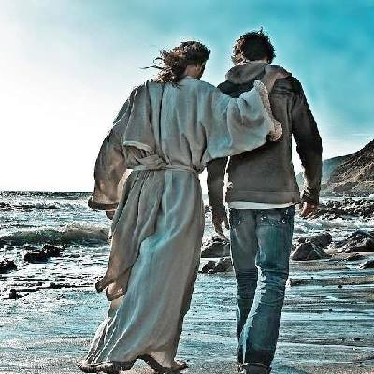
UPWARD! My Partnership with the Holy Spirit: Walking Daily with Jesus through the Spirit
Central Family
February 17, 2019
Bible Study: John 14-16

Slide 2
Take Aways?
Encouraged by a renewed awareness of God’s activity in today’s world.
A profound understanding of the work of the Holy Spirit in the world.
A deeper awareness of the purpose and function of the personal indwelling of the Holy Spirit. The “guarantee” of 2 Corinthians 1:21, 22.
A reminder of the importance of your (everyone’s) contribution to God’s purposes in creation and specifically your realm of influence.
A renewed conviction that we are all participating in God’s continuing story of redemption, while awaiting new heavens and new earth.
Though we may disagree on specific manifestations of the Holy Spirit, we will come to a common understanding of the overarching purpose of the Spirit in our lives – to bear the fruit of the Spirit – glorifying Jesus Christ, honoring God the Father and feeding a “hungry” world.

Slide 3
A Word About the Triune God
Perhaps the great mystery of the Christian faith – one God or three?
One of great debates in Christian history – what is relationship between God the Father, God the Son, and God the Holy Spirit?
Imperative to embrace what Bible teaches – One God, three persons.
Perfect unity – each works in concert, each has a role, all participate together in ideal collaboration.
“God is love” necessitates relationship. Because God, by nature, is relational – all of creation is likewise relational.
We are invited into “the cosmic dance of joyous, eternal relationship.”
God did not create out of loneliness, but out of joyful companionship in order to share that relationship. But humanity walked away…

Slide 4
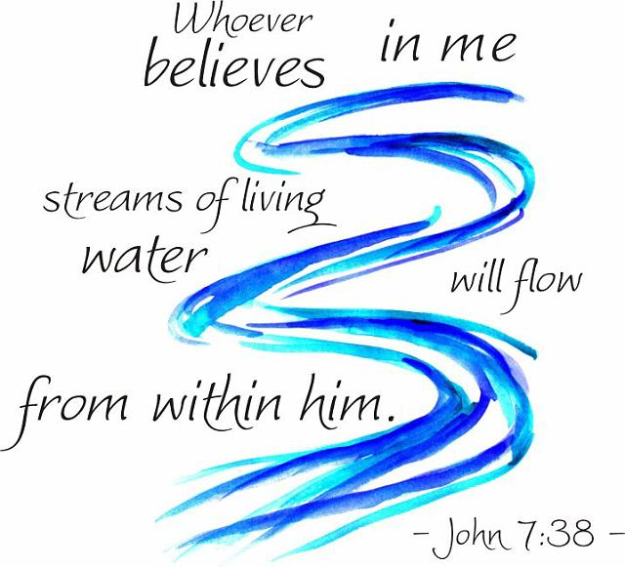

Slide 5
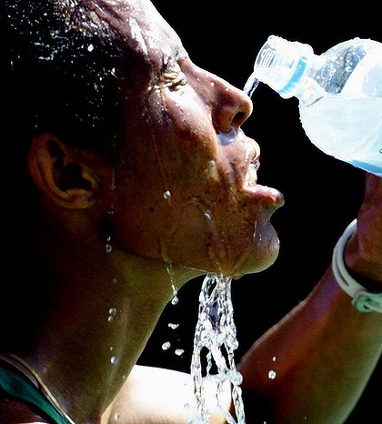
Everyone who drinks this water will be thirsty again, but whoever drinks the water I give will never thirst again. The water I give will become a fresh water source from within –gushing fountains of never ending life in its fullest possible expression
(John 4:13, my translation)

Slide 6
“Water” theme permeates Bible from creation
Most valuable natural resource, civilizations established
Isaiah 44:3 “I will pour water on the thirsty land and
streams on the dry ground; I will pour my Spirit on
your offspring…”
Ezekiel 47 – River flowing from new temple, creating life
Jesus’ promise “living water from within”
“If anyone is thirsty, let him come to me and drink. Whoever believes in me … streams of living water will flow from within him.” (John 7:38 NIV)

Slide 7
What is this life giving water?
“By this he meant the Spirit, whom those who believed in him were later to receive” (John 7:39).

Slide 8
Jesus’ Introduction of the Holy Spirit: John 14-16
Jesus comforting his disciples, preparing for imminent departure…
“I am going to prepare a place for you, and I will come back.”
Philip, “Show us the Father.” “If you’ve seen me, you’ve seen the Father. I am in him and he is in me. It is the Father doing his work through me.”
“If you believe in me, you will do even greater things…” HOW??!
“God will be in you as in me through another paracletos – I will not leave you as orphans.”
Triune God – through the Holy Spirit you will know that I am in you, and you know that I am in my Father.

Slide 9
How Does the Spirit Indwell? (John 15)
“I am the vine, you are the branches.” [remember, you are in me and I am in you – this is a metaphor for that reality]
“If you meno (dwell) in me you will bear much fruit. You can do nothing apart from me.”
Consistent, even persistent teaching throughout John’s gospel – obedience is central to abundance and faithfulness (as Jesus displayed).
“As the Father has loved me, I love you – remain in my love by keeping my commands.” Key word, again – meno – the discipline of intentionality
The world will not be in favor of this – you will pay a price!
The paracletos will testify about Jesus. And you MUST testify? How?

Slide 10
“It is better for you that I leave”…WHAT?
Can you imagine this? Disciples have come to know and love and depend.
“Unless I go, the paracletos cannot come.” (God’s greatest gift – Luke 11:13)
The Spirit inside us is better than Jesus beside us! Could this be?
Jesus, incarnated, could be only in one place.
Now – Jesus is in a million places! Wherever the Spirit is, Jesus is!
“When the Spirit comes, he will prove the world wrong about sin and righteousness.”
“I have so much more to say! But you couldn’t digest it now. But, oh, you will hear it! The Spirit will reveal it – he will not speak on his own, but through me – and all I say comes from the Father.”
John’s theme – Jesus chooses to do and say only what the Father would…

Slide 11
John, the last living apostle, gives us hope of continued guidance and counsel…
Jesus did not leave us – he blessed us with a greater presence.
Through the sanctifying work of the cross – Jesus paid the price to allow God’s Holy Spirit to indwell the temple of his choice – you and me – and together – the church. The glory of God dwells here!
What does the Spirit do? Jesus, “He [the Holy Spirit] will glorify me” (John 16:14)
How? The answer is found in Ezekiel 36! V.27 “I will put my Spirit in you and move you to follow my decrees and be careful to keep my laws.”
Why? (to what end?) “I will show the holiness of my great name…the nations will know I am the Sovereign Lord, when I am proved holy through you before their eyes.” (23)

